Slide 1
Recent Developments in Tangra 3 and the ADV File Format
Hristo Pavlov
IOTA Meeting 2014, College Park, MD, 13 July 2014
Notes:
[9:00] Presentation start

Slide 2
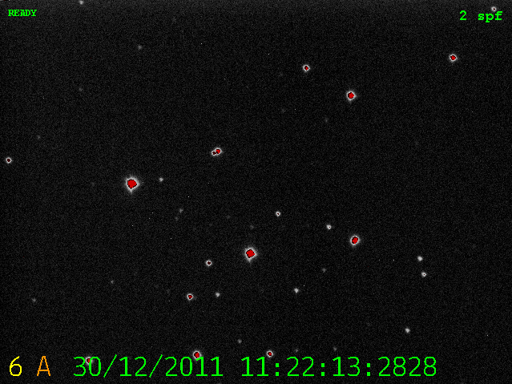
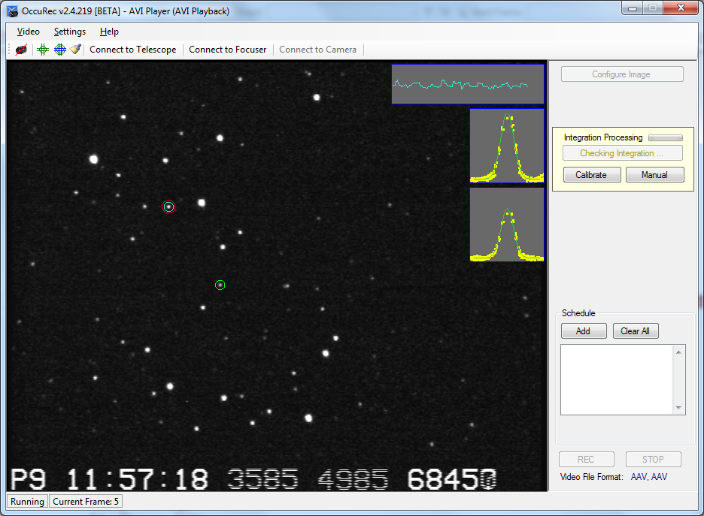
New Video File Formats
Astronomical Digital Video
with ADVS
ADV
AAV
Astronomical Analogue Video
with OccuRec
Notes:
[9:01 – 9:02]
ADV – Efforts to make the file format more widely used with involvement from SER file format consortium
AAV – Significant improvement for analogue integrating video cameras via a desktop recording software - OccuRec

Slide 3
ADV – The Open File Format of ADVS
FITS
ADV
STREAM1 (IMAGES/BAND1)
STREAM2 (STATUS DATA/BAND2)
IMAGE (BAND1)
IMAGE (BAND1)
IMAGE (BAND1)
IMAGE (BAND3)
FRAME1
FRAME1
IMAGE (BAND1)
IMAGE (BAND3)
IMAGE (BAND2)
FRAME2
FRAME2
IMAGE (BAND2)
IMAGE (BAND1)
IMAGE (BAND3)
FRAME3
FRAME3
IMAGE (BAND1)
IMAGE (BAND3)
IMAGE (BAND3)
FRAME4
FRAME4
IMAGE (BAND3)
IMAGE (BAND1)
IMAGE (BAND3)
FRAME N
FRAME N
METADATA
METADATA
METADATA
METADATA
METADATA
INDEX (FAST ACCESS)
Astro Digital Video (ADV) File Structure
HEADER
DATA SECTIONS DEFINITION
DATA BLOCKS
INDEX TABLE
USER METADATA TABLE
SYSTEM METADATA TABLE
Notes:
[9:02 – 9:04] - ADV format was developed as part of the ADVS project for storing 12 and 14 bit video produced by the PointGrey Flea3 and Grasshopper Express cameras
Is it a failure tolerant format that will not corrupt the file if the recording is stopped suddenly (e.g. as a result of a power failure)
The format of the container is called (Flexible Stream Transport) and has been heavily influenced by the Flexible Image Transport (FIT) image format
ADV allows user data storage and is extensible

Slide 4
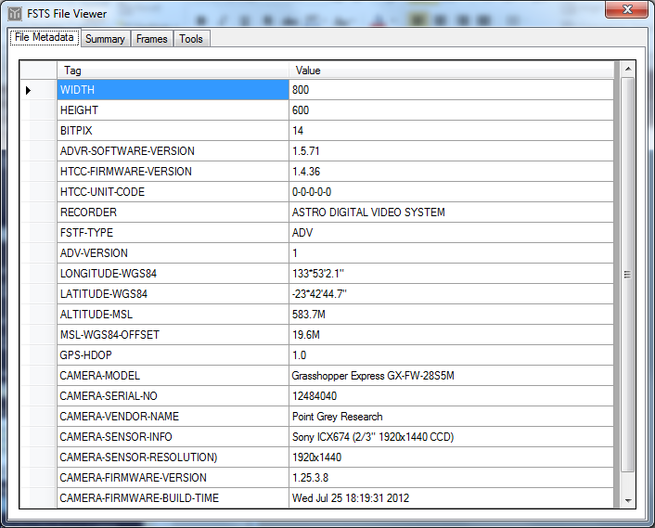
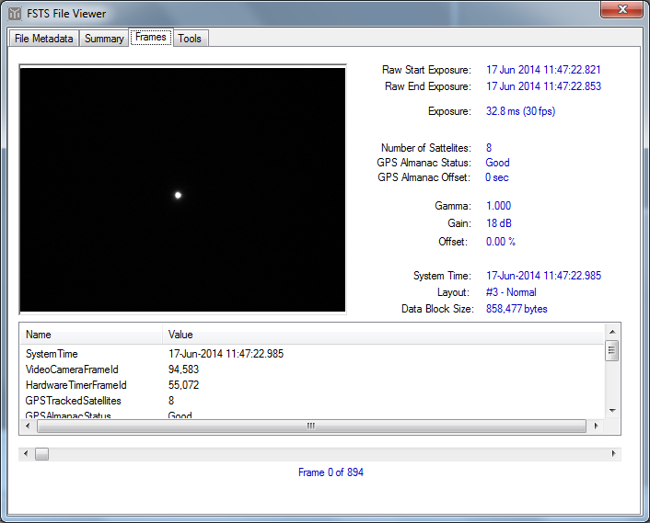
Typical Non-Image Data Stored in ADV
Notes:
[9:04 – 9:05] Saved metadata include: Geographical longitude and latitude, camera model, software information. Each frame may contain gamma, gain, GPS status and of course the timestamp.

Slide 5
ADV version 2 and AdvLib
New ADV version 2 being developed
- Lagarith16 lossless compression
- More powerful and extensible
- Larger development group
Open source C++ and C# libraries available to record in ADV format
https://github.com/AstroDigitalVideo/ADVLib
ADV (ver1) Already used by other software
- Genika Trigger
- Holenstein’s High Speed Video Recorder
Notes:
[9:05 – 9:07] – The author of the Lagarith video codec (Ben Greenwood) has built and contributed a 16 bit version of his Lagarith compression for the ADV project
The new format allows to save calibration images, such as darks and flats, into the same file but in a separate area of the file
A few people from the SER file consortium have joined the ADV format development group
AdvLib is open source and available publically on GitHub
The ADV file format has been used by other recorders including the Genika Trigger used in the Paris Observatory and the high speed video recorder developed by Bruce Holenstein, Dylan Holenstein and Steve Conard

Slide 6
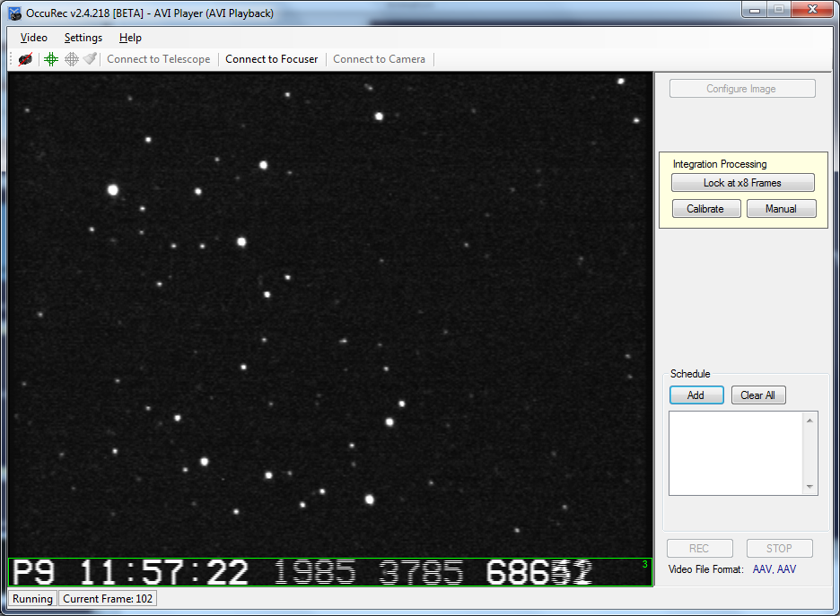
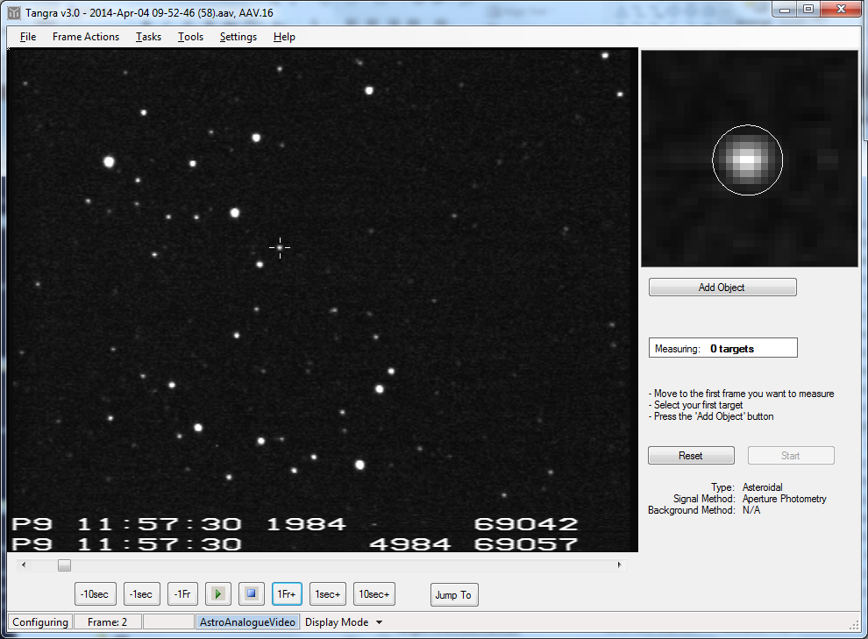
AAV Files and OccuRec
Notes:
[9:07 – 9:08] – OccuRec is my choice for an occultation video recorder for the WAT-910BD camera
Used by other, including Brian Loader with his WAT-120N and KIWI
It recognizes the OSD area and the used integration and then saves a single frame for the integration period with the correct start and end timestamps from the first and last video field. This leads to SNR improvement and reduced file size. For long integrations the file size reduction is quite big.
Tangra later slipts the timestamp area

Slide 7
New Tangra 3 Features
IOTA-VTI Timestamp OCR-ing
New Tracking Engine
Display Mode Enhancements
Integration with Occult’s AOTA and OccultWatcher
Mutual Events Reduction
‘Overlapping’ Objects PSF Fitting
3D Polynomial Background Support
Display of Instrumental Stellar Magnitudes on the Light Curves
Notes:
[9:08 – 9:09] Quick overview of new features to be covered next

Slide 8
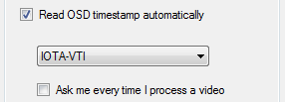
Reading IOTA-VTI Timestamp
Background must not be too bright
All fields and frames must be present
Notes:
[9:10– 9:12] OCR-ing is difficult stuff. Well done to LiMovie for supporting 3 different timestamp readers
Tangra3 at the moment only supports IOTA-VTI
The reading will happen with any frame resolution and aspect but all video fields must be present in the video and the entire timestamp, including the frame number must be fully inside the video frame.

Slide 9
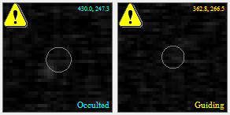
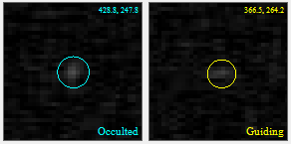
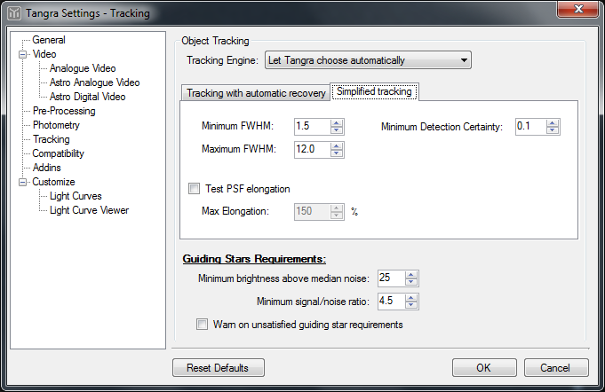
New Tracking Algorithm
Notes:
[9:12 – 9:13] New tracking engine – faster and more accurate for ‘standard’ videos. Old tracking engine was built to handle issues like severe wind, shaking and flickering but wasn’t great for the majority of the ‘normal’ videos.

Slide 10
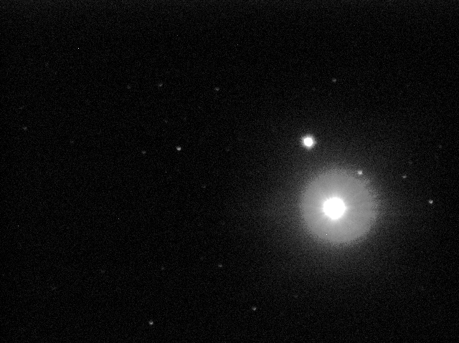
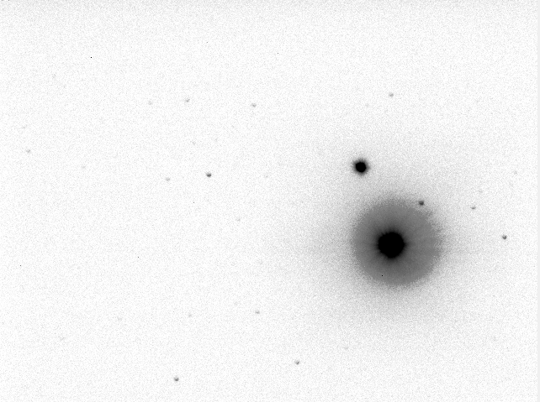
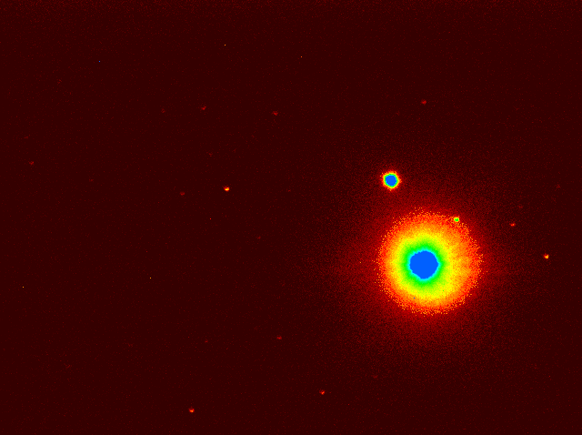
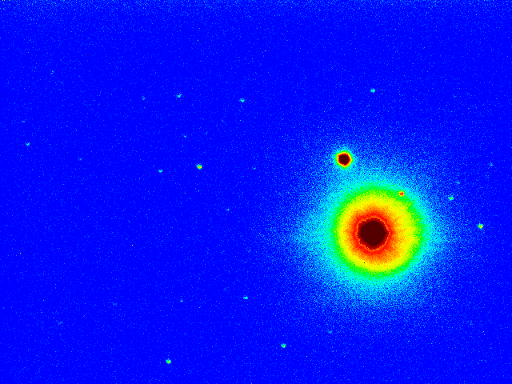
Display ‘Modes’
Notes:
[9:13 – 9:14] New ‘Hue Intensity’ and ‘Inverted’ display modes.

Slide 11
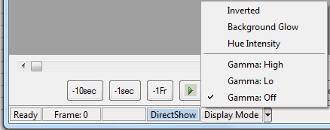
Display Gamma
Notes:
[9:14 – 9:15] New display gamma mode – very useful for 12 and 14 bit videos.

Slide 12
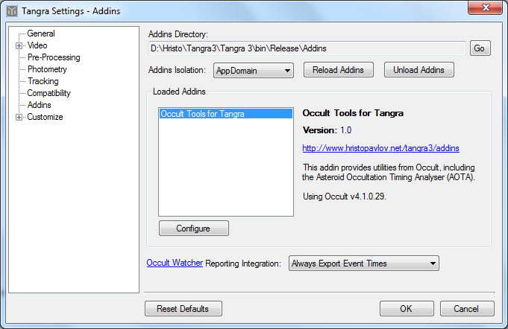
AOTA Integration
Notes:
[9:15 – 9:17] - The AOTA Add-in is part of the standard distribution of Tangra 3
Occult4 is required for the Add-in to work
Tangra also can provide data for OccultWatcher to auto populate occultation report forms
AOTA add-in is started from the Add-ins menu in the Light Curve form

Slide 13
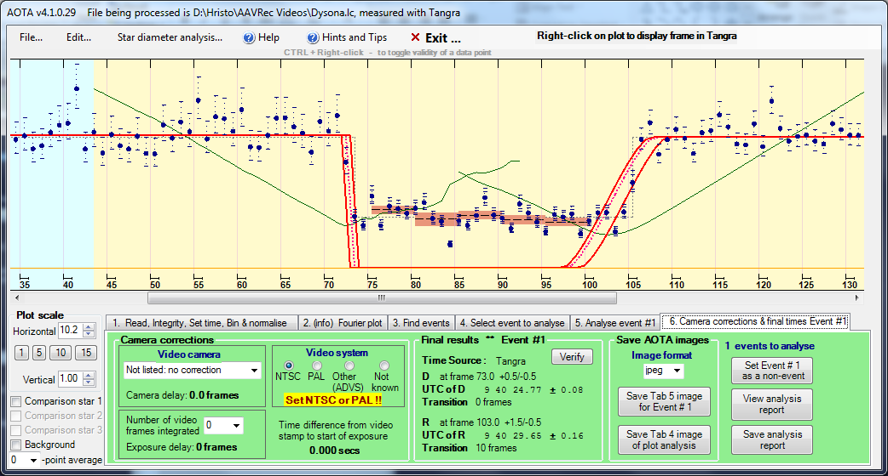
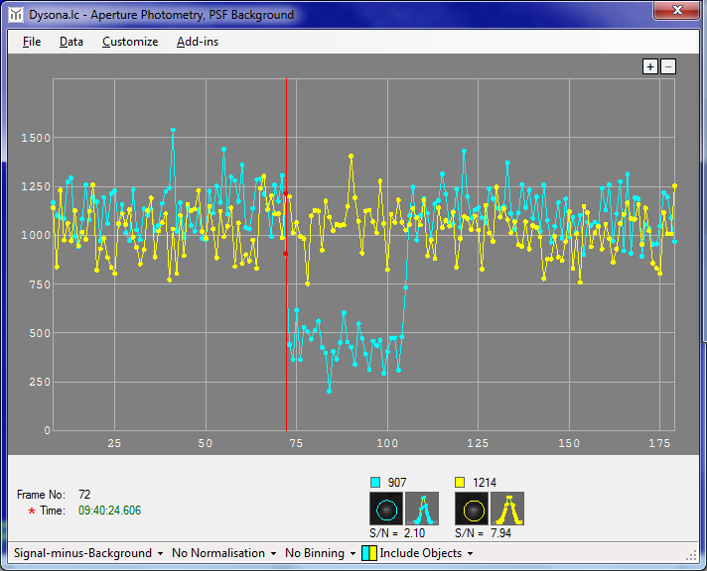
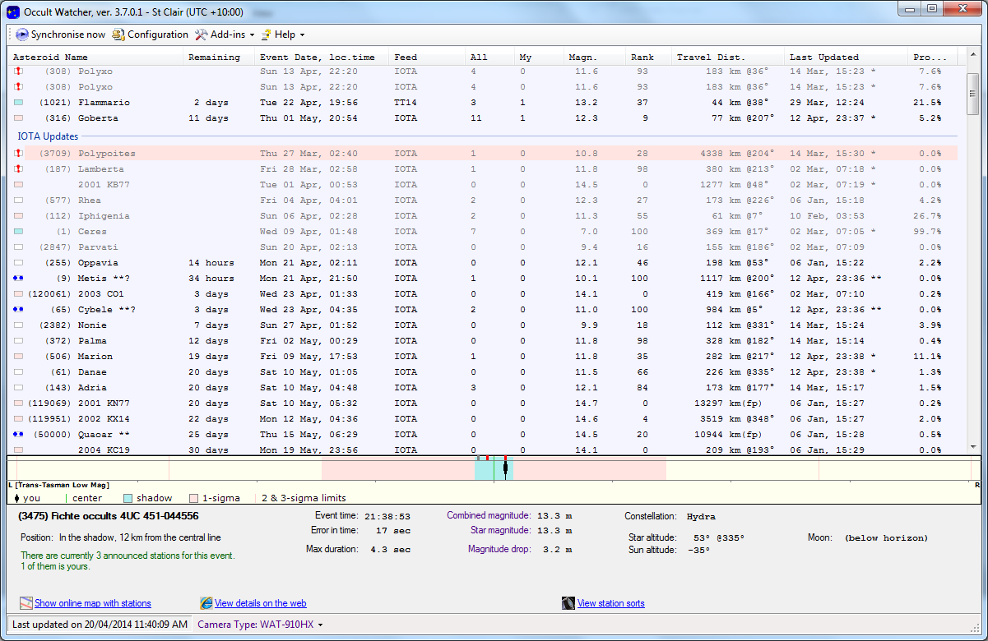
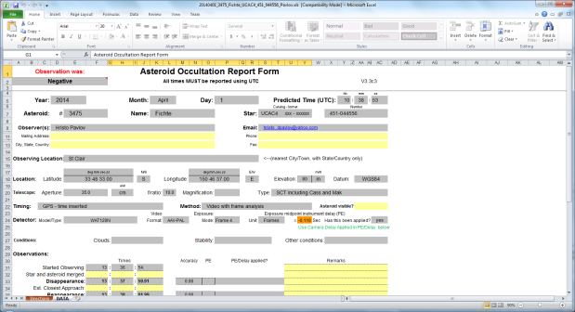
OccultWatcher Integration
C:\Videos\OccVideo_AOTA_Event#1.jpg
C:\Videos\OccVideo_AOTA_Xcorr.jpg
C:\Videos\OccVideo_AOTA_Xcorr.jpg
C:\Videos\OccVideo.trep.xml
C:\Videos\OccVideo.avi
Notes:
[9:17 – 9:19]: The full process of measurement, even time extraction and population of the report form in OW works like this:
- (1) The video is processed with Tangra and a light curve is displayed. (2) The user runs the AOTA Add-in from Tangra. (3) The user can optionally save screens from AOTA using the buttons in the AOTA form. (4) The user selects event, verifies it and closes AOTA. (5) Tangra receives the report from AOTA and saves it as a file. (6) Tangra writes to a shared place with OW information about the new report. (7) From OW the user initiates a new report form generation. OW finds the available reports from Tangra and prefills the report form.

Slide 14
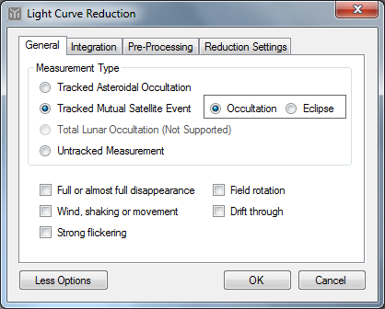
Mutual Events Reduction
New “Measurement Type”
Need to specify Occultation or Eclipse
Notes:
[9:19 – 9:20] - A new measurement type of “Tacked Mutual Satellite Event” has been added with special tracking algorithm being used.
The user needs to select if this is an occultation or an eclipse
The other standard flags still apply (such as wind, full disappearance and flickering)

Slide 15
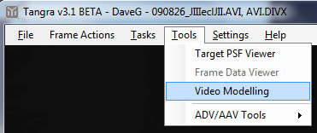
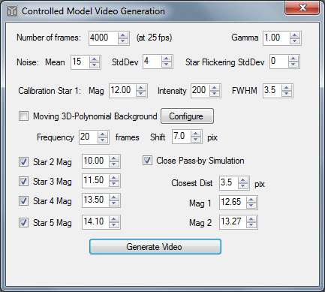
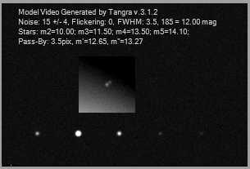
Video Modelling
Notes:
[9:20 – 9:21] – Originally built to test Tangra’s mutual events tracking and measurement algorithms including the new close objects and 3D Polynomial Background
Could be used by anyone for ‘calibration’ of their measurement processes
Could be used in software other than Tangra

Slide 16
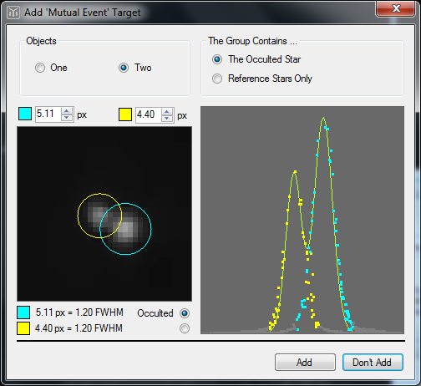
Close Targets Overlapping PSF Fitting
Notes:
[9:21 – 9:22] – Objects can be tracked and measured in a group of 2
Tangra will fit a combined PSF model of the two close objects
As the Jovian satellites are only 4, finding an object for normalisation may be difficult. The close target measurement will help in all cases where the available targets for normalisation are too close to another satellite

Slide 17
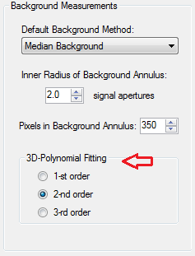
3D Polynomial Background
1-st Order
2-nd Order
3-rd Order
Notes:
[9:22 – 9:23] - When satellites are too close to Jupiter, calculating the background will be challenging. The 3D Polynomial background has been built to help
- Tangra supports 1-st, 2-nd and 3-rd order polynomials. Which order will be used is configured from the settings
- For close targets and single target PSF photometry the fitted polynomial background model is included in the model of the target to be fitted

Slide 18
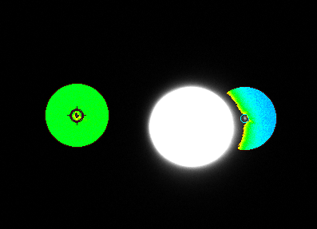
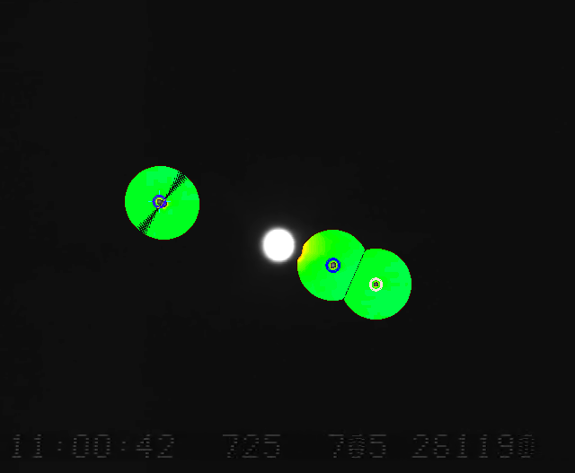
‘Background Glow’ Display Mode
Notes:
[9:23 – 9:24] There is also a special display mode called “Background Glow’ which shows with a hue intensity the background distribution around the selected targets for measurements in Tangra. This can be used to determine is there a need to use a 3D Polynomial background.

Slide 19
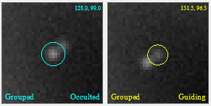
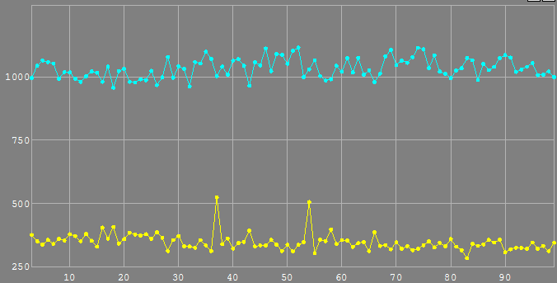
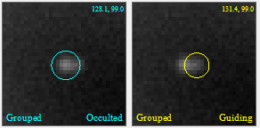
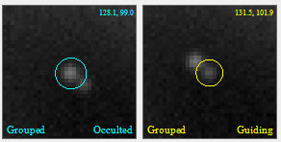
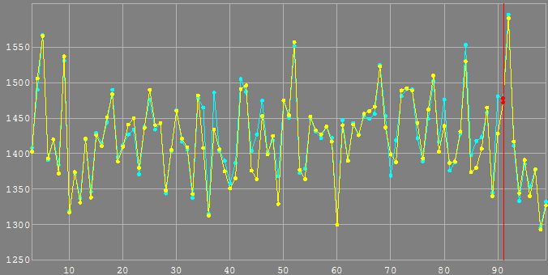
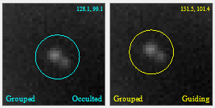
Separated and Combined Measurements
Notes:
[9:24 – 9:25] Close targets will produce separate measurements when PSF photometry is used. When aperture photometry is used the aperture will be placed around the two objects and the two measurements are roughly the same.

Slide 20
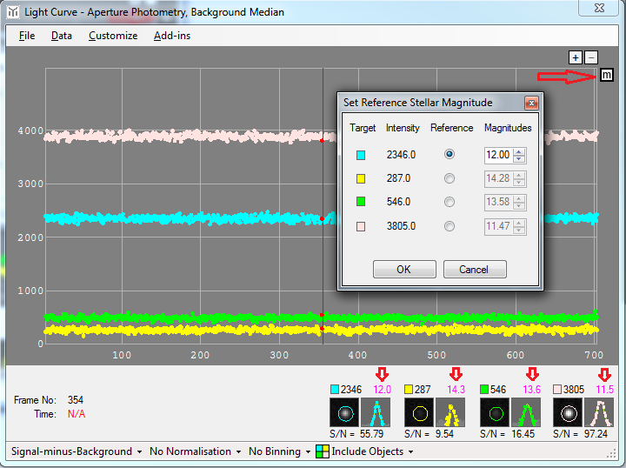
Instrumental Stellar Magnitude Scale
Notes:
[9:25 – 9:26] - The user can now set a magnitude for one of the stars and Tangra will compute the display the magnitudes of the other targets
This will only work in terms of instrumental magnitudes for the stars. Usually the instrumental magnitude of any real star is not known
This functionality was built to test Tangra’s measurements using the simulated video generation, where instrumental magnitudes can be configured
This functionality needs to be enabled first from the Light Curve customisation settings

Slide 21
Tangra is Open Source & Cross Platform
Project Managed on GitHub
Open Source for Contributors and Researchers
Sciencewere License (Similar to OrbFit)
Cross-Platform on Windows, Linux and Mac OSX (Using C++ and the Mono Framework)
Notes:
[9:26 – 9:27] Tangra 3 is an open source project using a special Scienceware License. You can also become a contributor in the project of you want – please consider joining the project! Tangra 3 is cross-platform and runs on Linux and Mac.

Slide 22
Questions?
http://www.hristopavlov.net/Tangra3
https://github.com/AstroDigitalVideo
Notes:
[9:27 – 9:30] Time for questions

