Slide 1
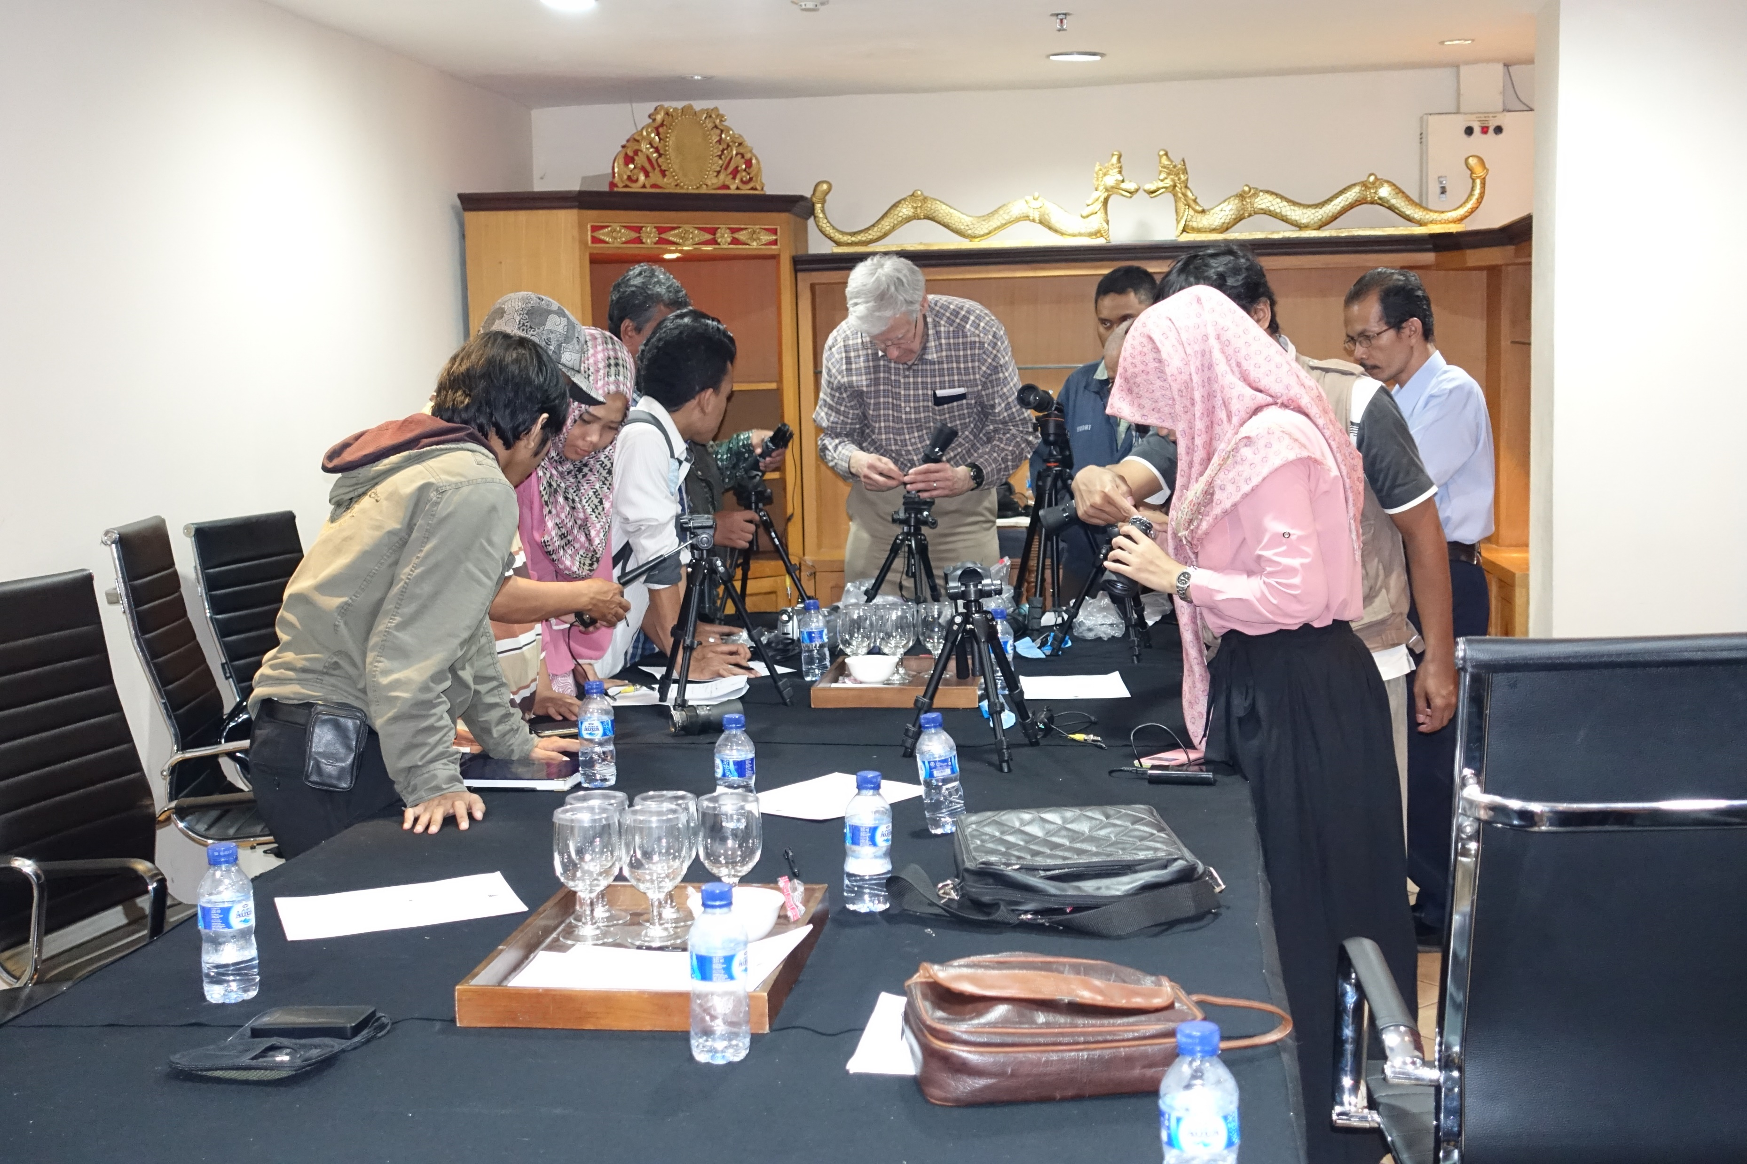
Boot Camp for Occultation Observers – A Proposal
Joan Dunham
IOTA Meeting July 17-18, 2021

Slide 2
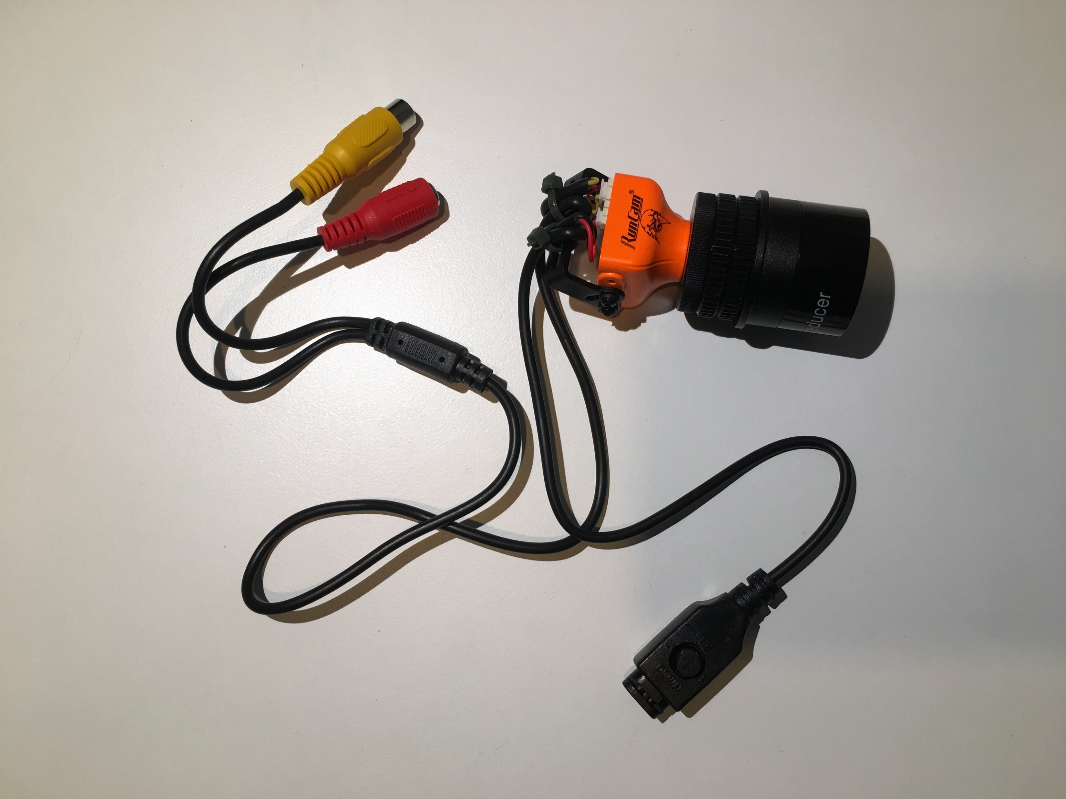
What is this and why do it
A daytime session or two learning how to use supporting software
An evening session learning how to observe with one’s own equipment, preferably in a group session so observers can help each other
An opportunity to improve observing skills
A way to encourage the use of available prediction and reduction software
A session to prepare for specific high-profile events
This is not expected to provide instant expertise, but it is to have observers gain some experience with observing occultations and the software that supports our observing.

Slide 3
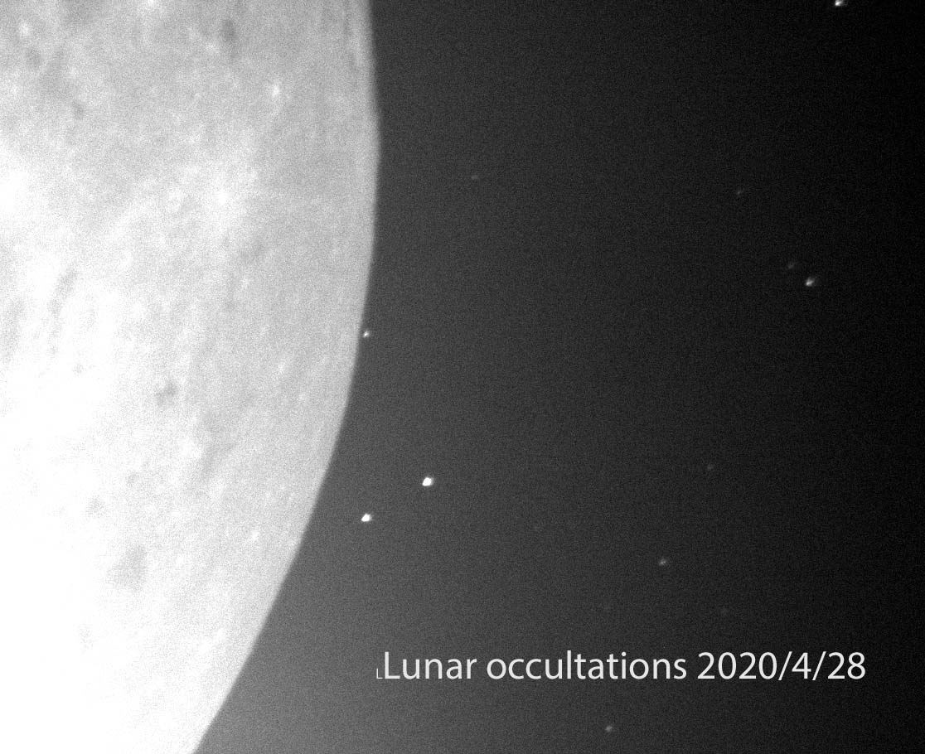
Observing Session Schedule Suggestions
During lunar passage through denser star fields, which give multiple opportunities for observing and recording events.
Does not need to be associated with IOTA annual meetings
Evening observing session in-between daytime sessions on prediction software and data analysis
Times of lunar passages through the Milky Way
Northern Milky Way
Evening – April
Morning – August
Southern Milky Way
Evening – November
Morning – March

Slide 4
Where and Who
Anywhere, anyone
Observing sessions need a darker sky with near-by parking and access to power and maybe WiFi.
Discussions of software use and software training requires individual access to personal computing equipment, WiFi or prior downloads of the necessary software.
Software discussions could be done via online discussions, but that would be more challenging.
A mixture of observing experience from none to quite experienced would be nice but not required

Slide 5
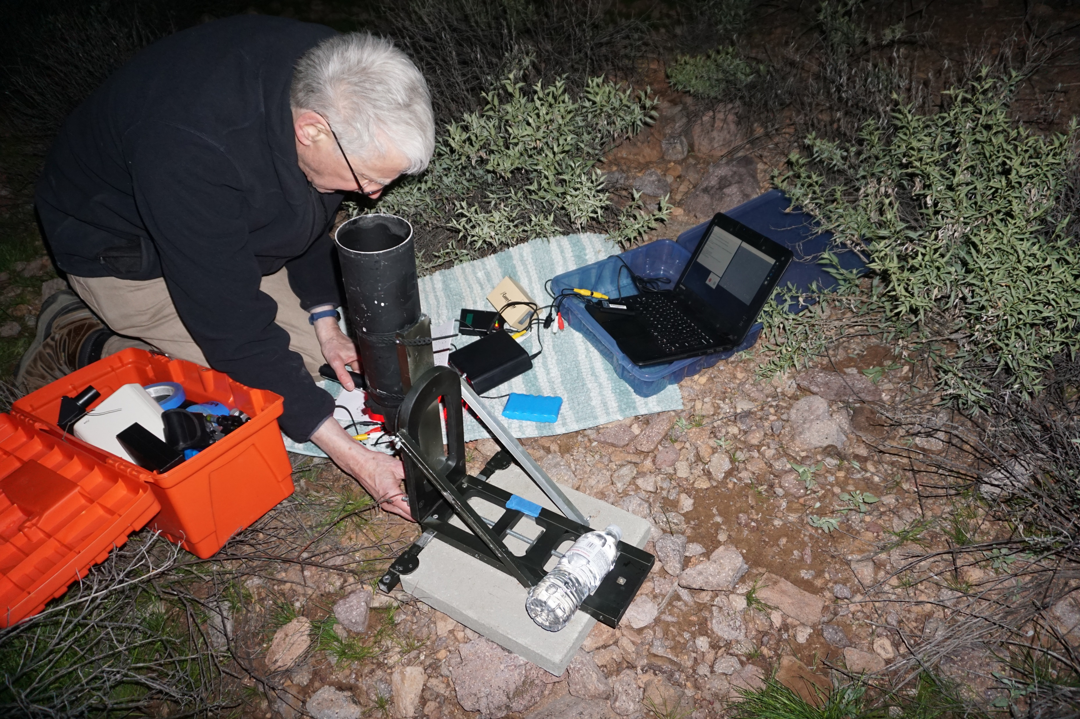
Equipment for Each Participant
Windows computer to operate the current software
Telescope and equipment to record the data.
Best would be a field telescope, a camera, a way to annotate recorded data with GPS time stamps, and a small windows computer or tablet to record the data
A means of operating observing equipment without dependence on A/C power, WiFI, or cell phones.
Visual timing methods should be discouraged.

Slide 6
Suggested Agendas
First session – before observing
Preparation session(s) on installing and using Occult, Occultwatcher, Guide9 or C2A.
Discuss how to join iotaoccultations or planoccult groups.
Installing and using IOTA Video Capture or SharpCap or VirtualDub or limovie (observer’s choice)
Hold in a group session or via Zoom or Skype
Second session – practice observing
Set up scopes and equipment
Capture some occultation data
Learn prepointing or finding a target with Guide9/C2A.
Evening observing session probably preferred, together is better than online if possible.
Data reduction session
Pymovie, Pyote, Occult, reducing data from observing session or use some from previously reported events
Requesting a report spreadsheet from OccultWatcher
How/where to report lunar occultations, grazes, asteroid occultations

Slide 7
Other Suggestions
Start with small sessions of a few people and see how this goes
Leader/teacher nice but not necessary for a successful session
Organize as a club activity
Do before an occultation campaign
Please report to IOTA (via Secretary/Treasurer) on session experiences
Was it helpful?
What recommendations for future camps?
What would you like future organizers to know?

Slide 8
Resources
All of the software can be found on line. Most of it is free or very low cost.
Many of the programs have user guides, how to documents, YouTube tutorials.
Software packages are available via the occultations.org website.
Outreach Support Page, in development, will have links to software pakages, user guides, tutorials
Please note that this presentation is also my personal suggestions, not official pronouncements from IOTA. And hurrah to anyone who arranges, supports, and participates in an Occultation Boot Camp!

