Slide 1
Future North America Best Events Steve Preston IOTA Annual Meeting Sep 2017

Slide 2
Priority Events
Priority | Date | UT |  | Asteroid | Mag | Dur | Dia (km) | Rank
A | October 9, 2017 | 4:01 |  | (44) Nysa | 9.4 | 11.4 | 71 | 100
A | November 6, 2017 | 5:32 |  | (505) Cava | 9 | 21.7 | 105 | 100
B | November 23, 2017 | 6:54 |  | (494) Virtus | 8.7 | 6.9 | 86 | 100
+ | December 21, 2017 | 12:27 |  | (980) Anacostia | 9.9 | 7.1 | 96 | 100
A | February 17, 2018 | 1:50 |  | (20) Massalia | 9.2 | 18.7 | 146 | 100
A | March 18, 2018 | 3:58 |  | (444) Gyptis | 9.4 | 23.9 | 163 | 99
B | March 19, 2018 | 7:19 |  | (814) Tauris | 9.2 | 8.1 | 110 | 99
A | June 14, 2018 | 9:46 |  | (168) Sibylla | 8.9 | 22 | 144 | 99
B | July 14, 2018 | 6:49 |  | (1015) Christa | 9.3 | 7 | 97 | 99
A | September 16, 2018 | 8:54 |  | (80) Sappho | 7.2 | 5 | 79 | 100
A | October 2, 2018 | 1:46 |  | (213) Lilaea | 9.8 | 3.8 | 83 | 99

Slide 3
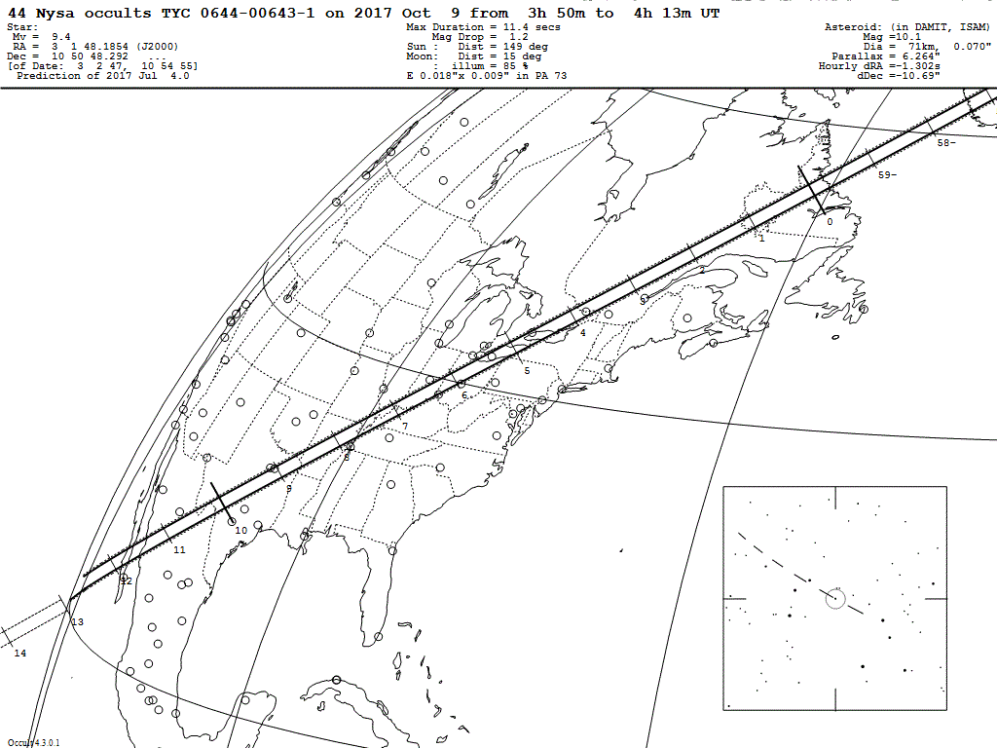
2017 Oct 9 (44) Nysa / TYC 0644-00643-1 (m 9.4)

Slide 4
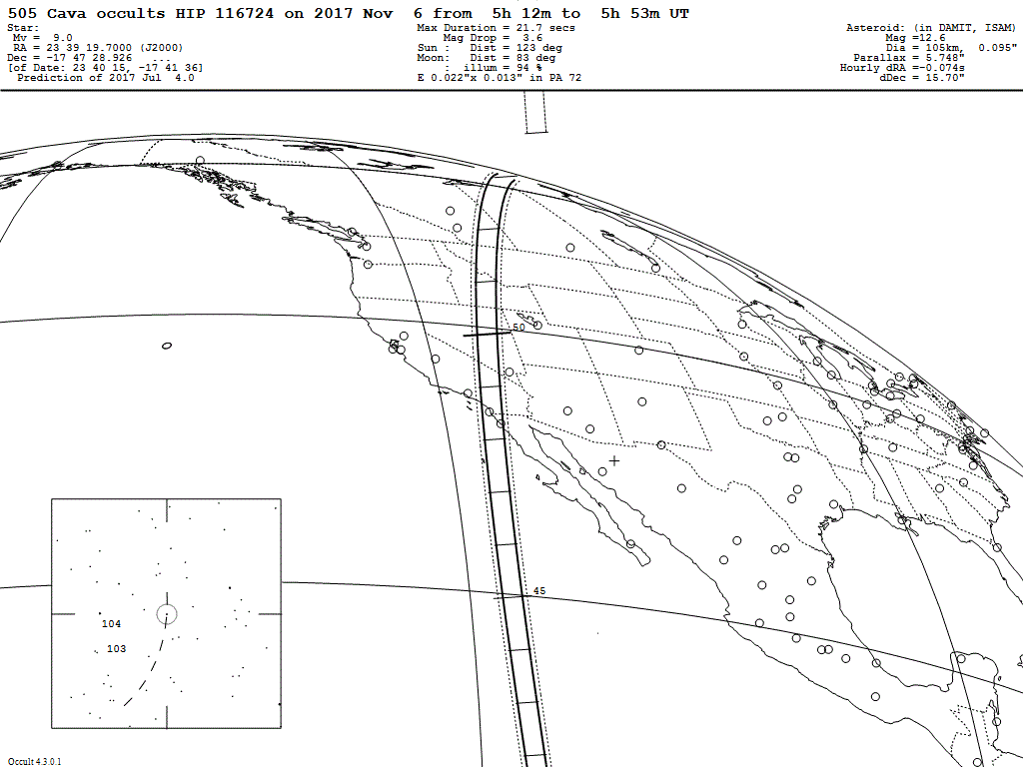
2017 Nov 6 (505) Cava / HIP 116724 (m 9.0)

Slide 5
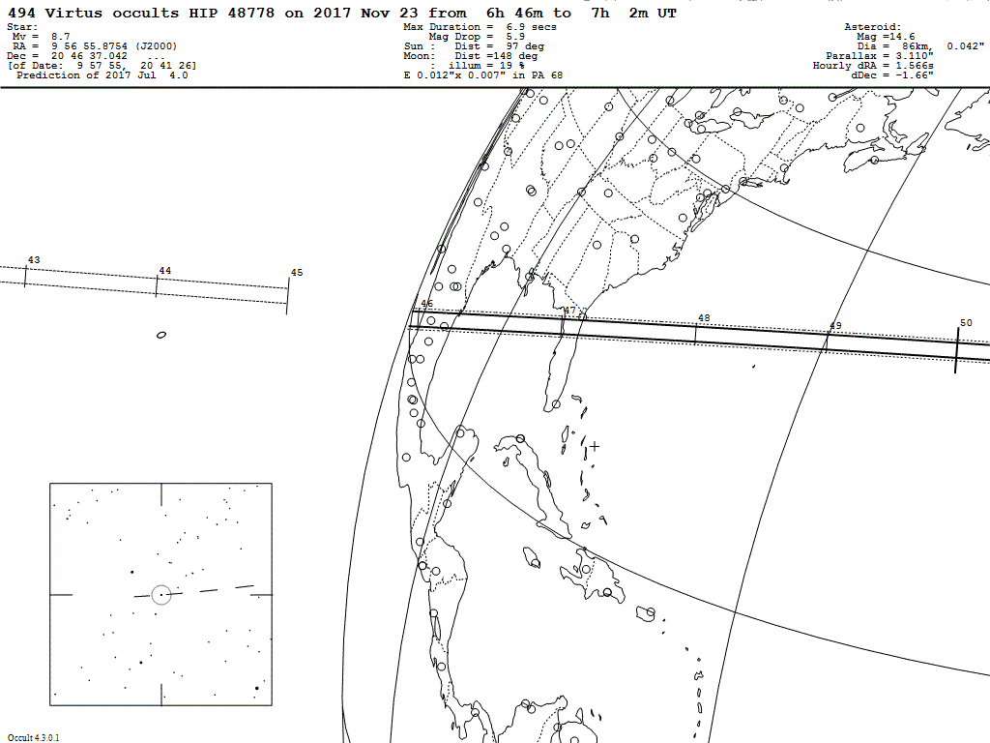
2017 Nov 23 (494) Virtus / HIP 48778 (m 8.7)

Slide 6
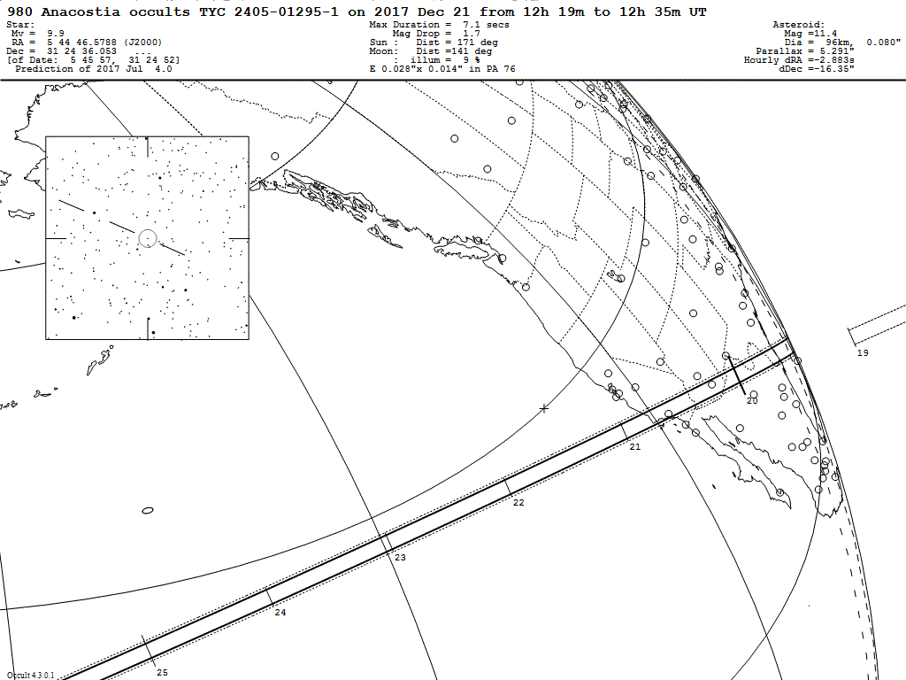
2017 Dec 21 (980) Anacostia / TYC 2405-01295-1 (m 9.9)

Slide 7
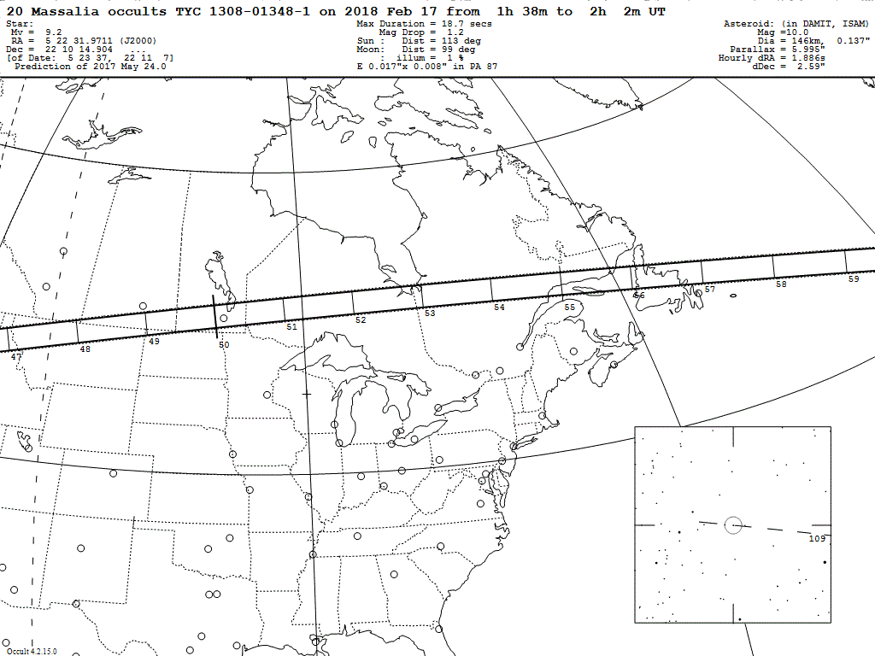
2018 Feb 17 (20) Massalia / TYC 1308-01348-1 (m 9.2)

Slide 8
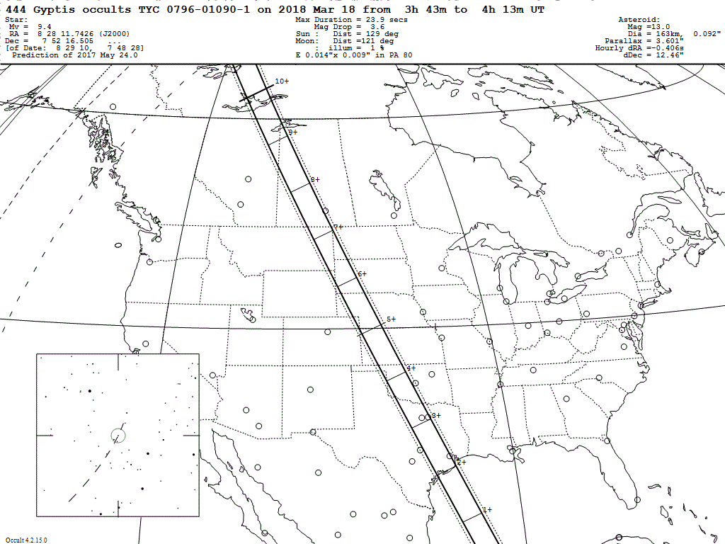
2018 Mar 18 (444) Gyptis / TYC 0796-01090-1 (m 9.4)

Slide 9
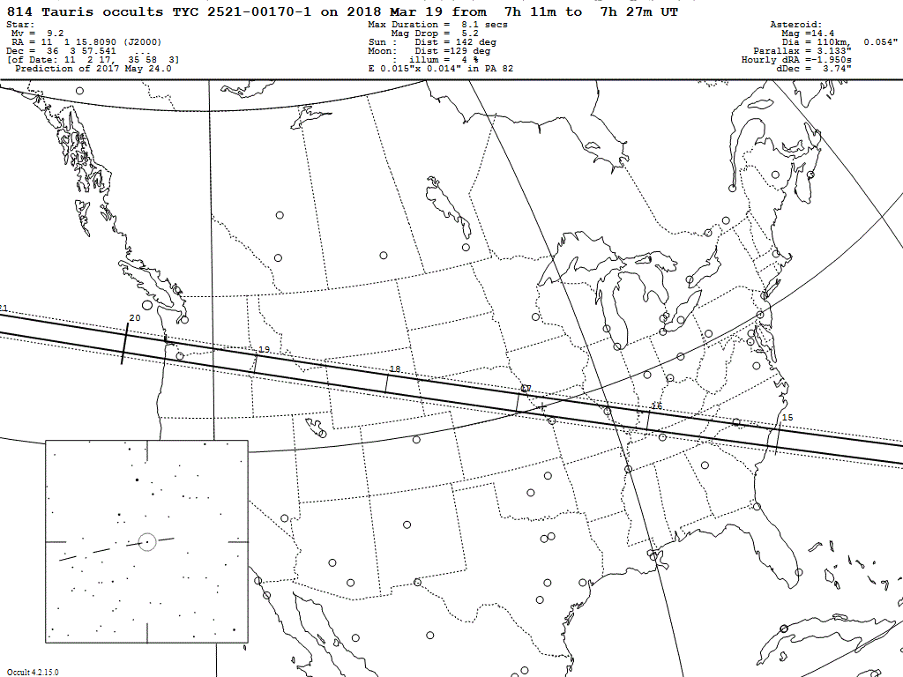
2018 Mar 19 (814) Tauris / TYC 2521-00170-1 (m 9.2)

Slide 10
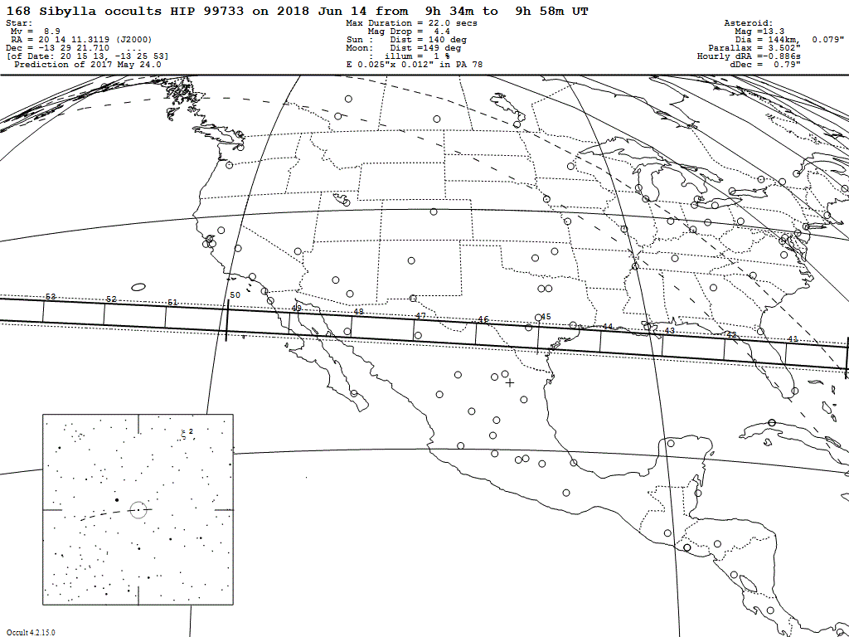
2018 Jun 14 (168) Sibylla / HIP 99733 (m 8.9)

Slide 11
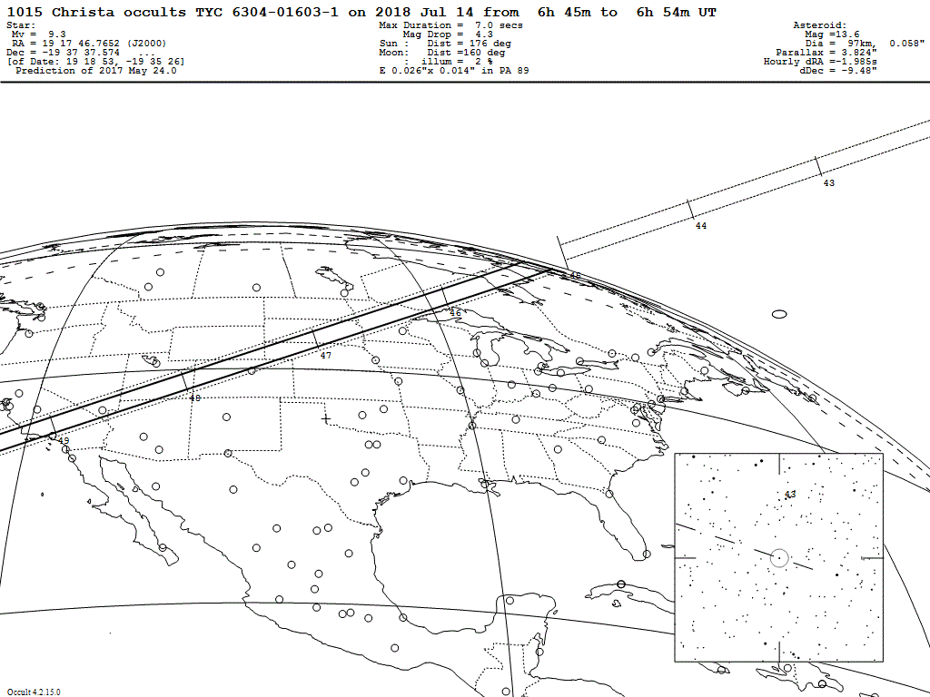
2018 Jul 14 (1015) Christa / TYC 6304-01603-1 (m9.3)

Slide 12
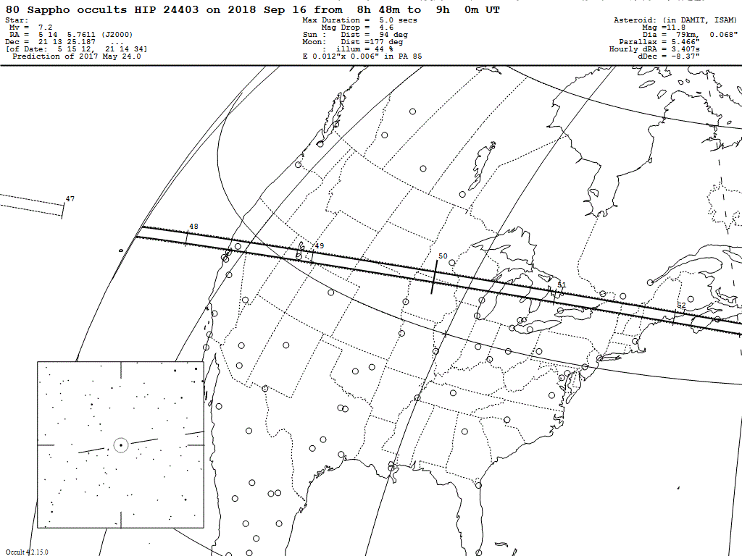
2018 Sep 16 (80) Sappho / HIP 24403 (m 7.2)

Slide 13
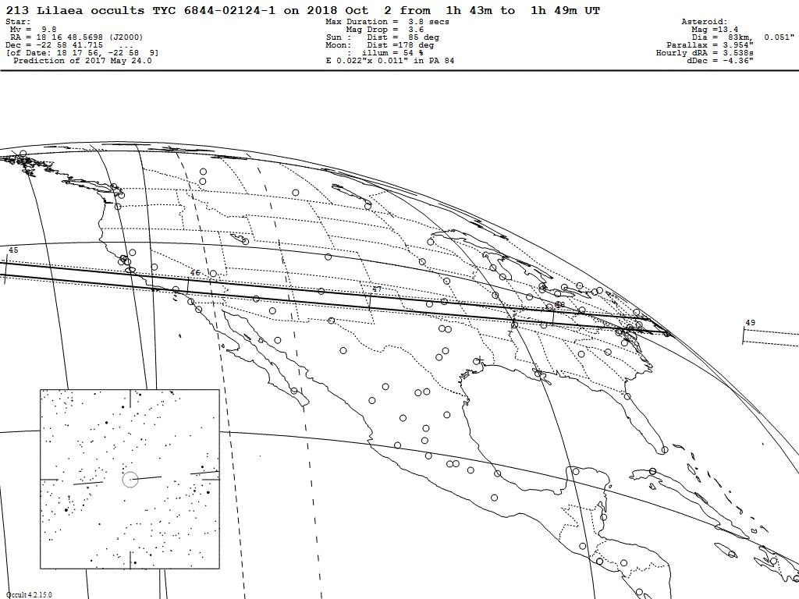
2018 Oct 2 (213) Lilaea / TYC 6844-02124-1 (m 9.8)

