Slide 1
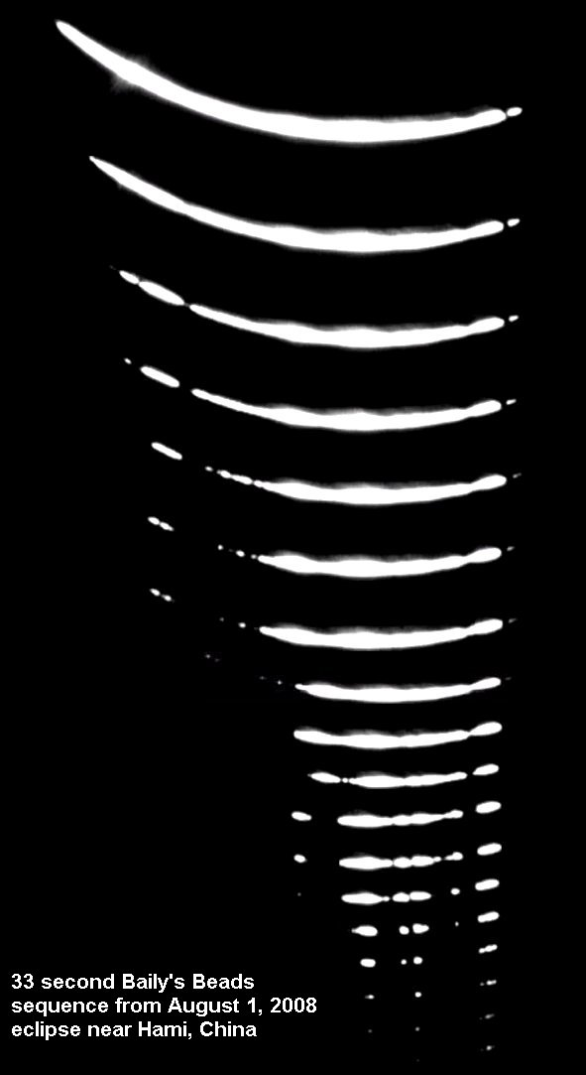
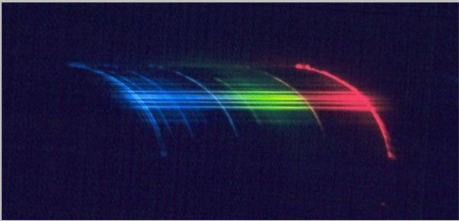
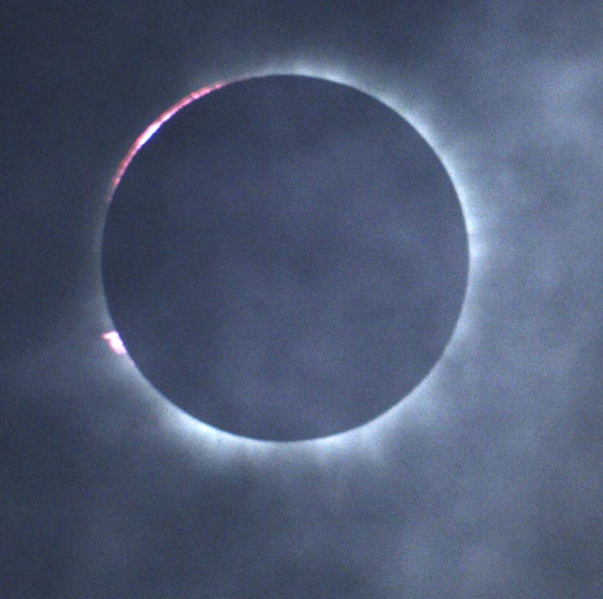
IOTA Plans for 21 August 2017 Eclipse
Plans are to observe the 2017 eclipse with a variety of observing techniques, modern and ones used in the past. We want to determine their differences and the effects of those differences accurately.
Measure umbra on ground
Known diameter of Moon
Known distances to Moon, Sun
Compute diameter of Sun
The diameter is determined by timing the 2nd and 3rd contacts and specific Bailey’s Beads before 2nd and after 3rd contact. Except for direct visual observation, the observer needs to time the beads and locate them on the solar limb.
Methods to use are one or more of the following: Direct visual observation (with eye protection), visual observation of telescopically projected images, direct timed video telescopic observations in B&W and in color, recording the flash spectrum.
Paul Maley has organized a citizen science experiment to position a chain of observers in Minden, Nebraska at the South limit of totality. They will be using two observation techniques: Direct visual observation and recording the eclipse with cell phones. See http://www.eclipsetours.com/eclipse-edge-2017/
Flash spectrum taken by Paris Observatory expedition of the 11/7/2010 eclipse
The Eclipse Megamovie will provide videos it receives to IOTA to be included in the diameter measurements, many of which will also be recordings done with cell phones
https://eclipsemega.movie
Eclipse of
9/3/2016 Halmahera, Indonesia
Eclipse circumstances and a road atlas of the eclipse are available through EclipseWise.com
David Dunham will collect the observation data davidwdunham@Verizon.net

Slide 2
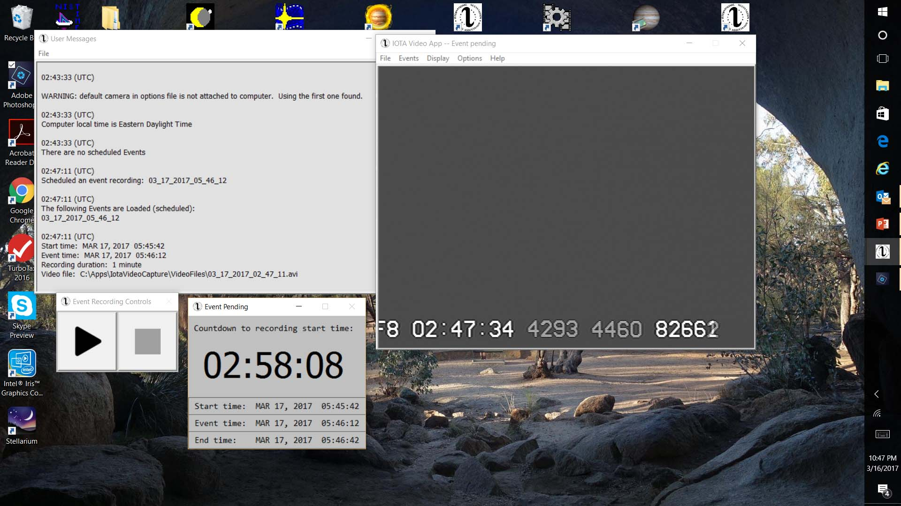
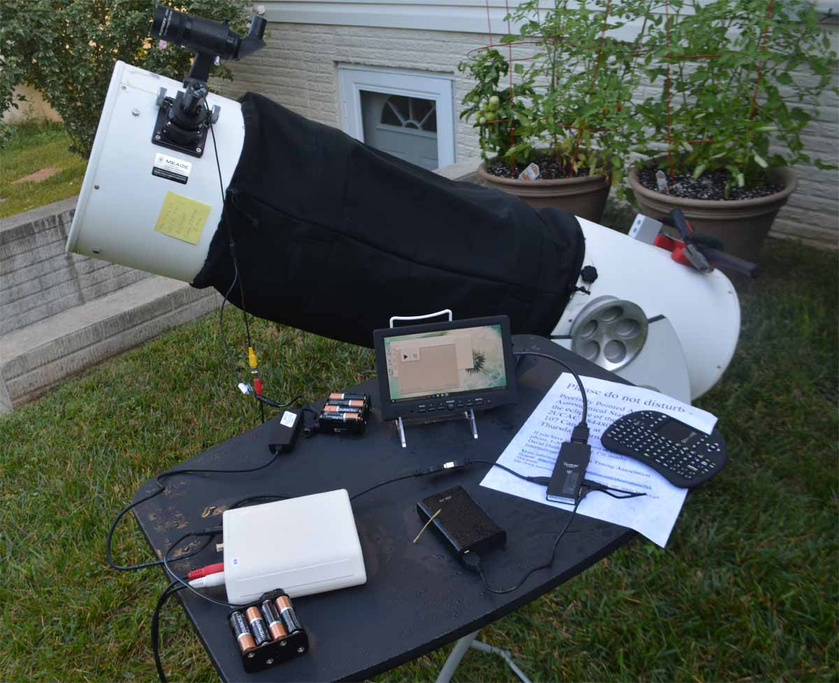
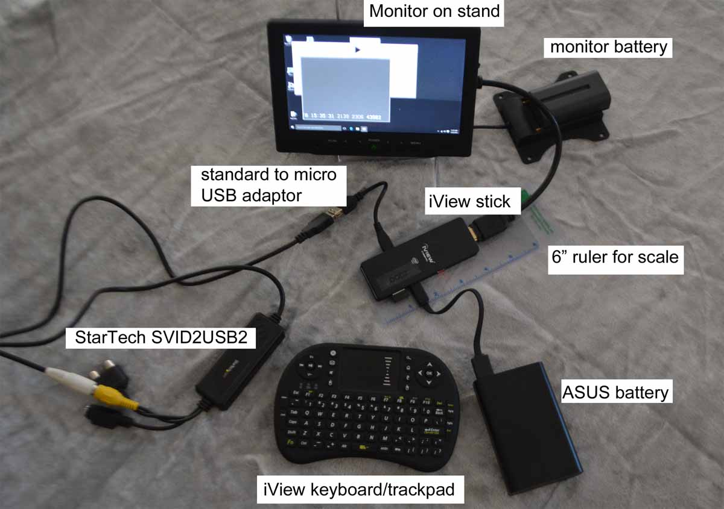
Observing with the IOTA Video Recording Application
A Windows App designed for the occultation observer, for automated, unattended capture of digitized analog video of occultations.
An observing station typically consists of a telescope with a video camera feeding an analog video stream to the IOTA VTI which inserts the GPS time and in turn feeds the analog video digitizer which is connected to a Windows computer via a USB port where the data are captured by the IOTA Video Recording App.
Example video capture system, for attended observing. The iView is a Win 10 stick computer. During unattended observing, the monitor and keyboard are removed. One monitor and one keyboard are all that are needed for multiple remote stations.
The app runs on Win 7, 8, and 10 computers and tablets. Future versions with additional capabilities and, eventually, digital camera support are in work.
Available at http://occultations.org/observing/software/

Slide 3
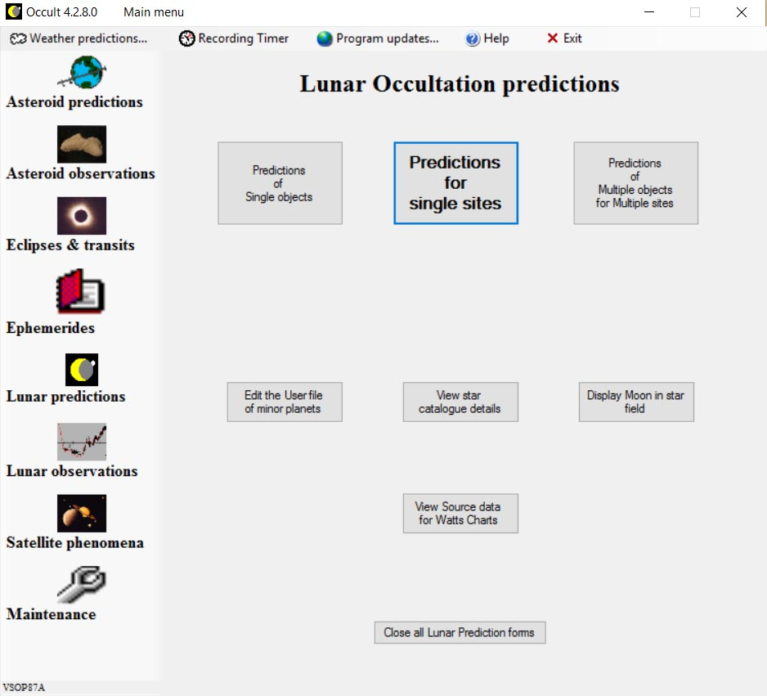
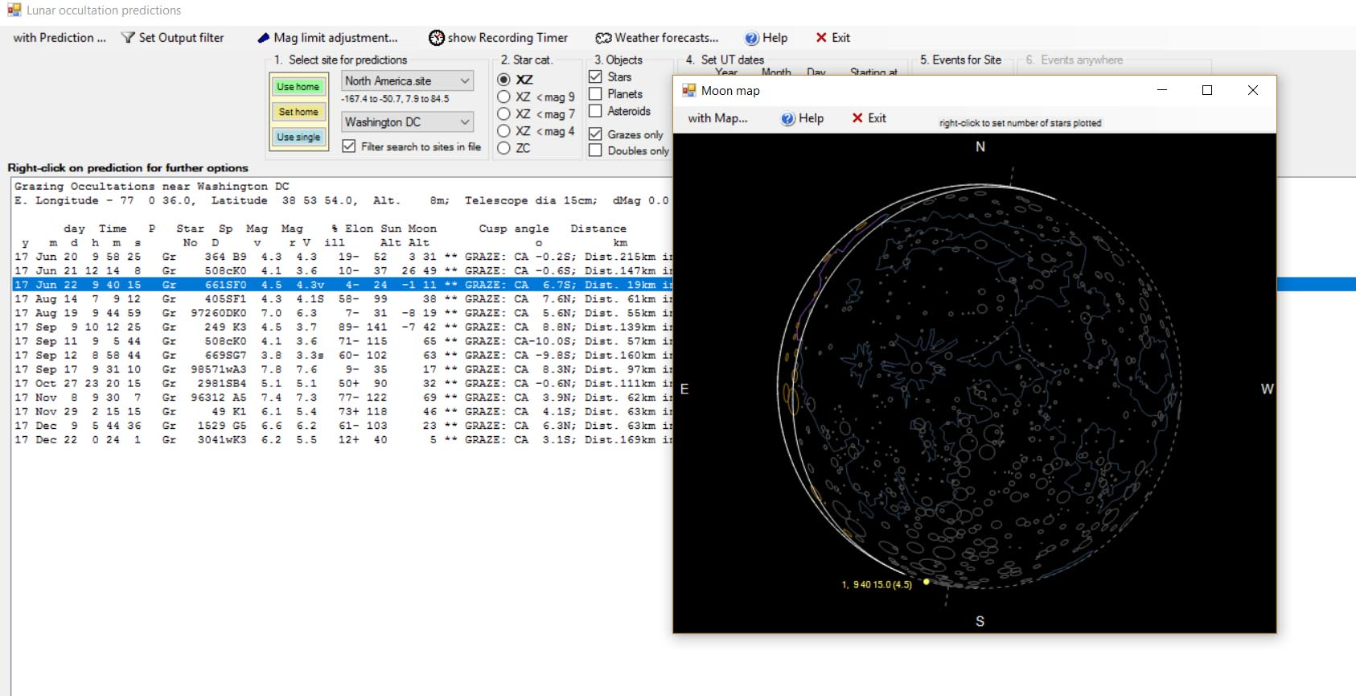
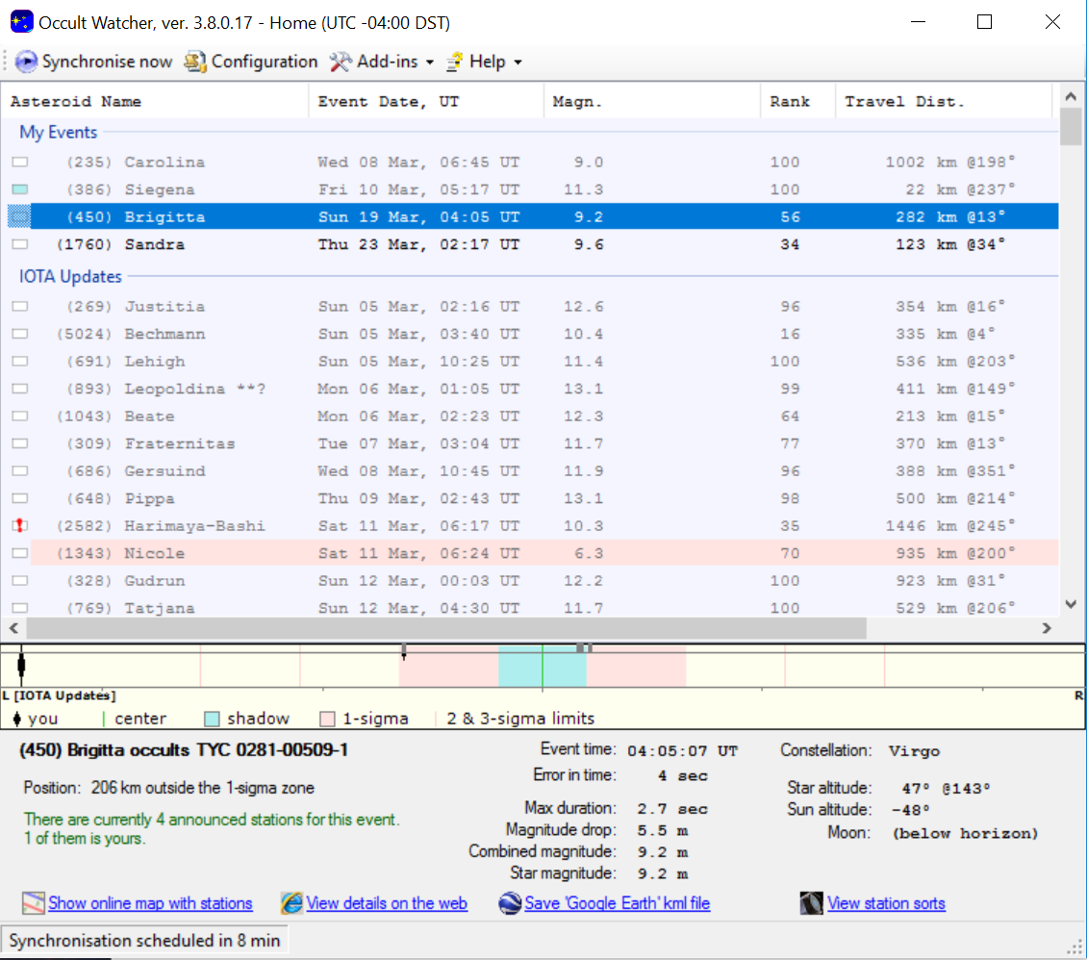
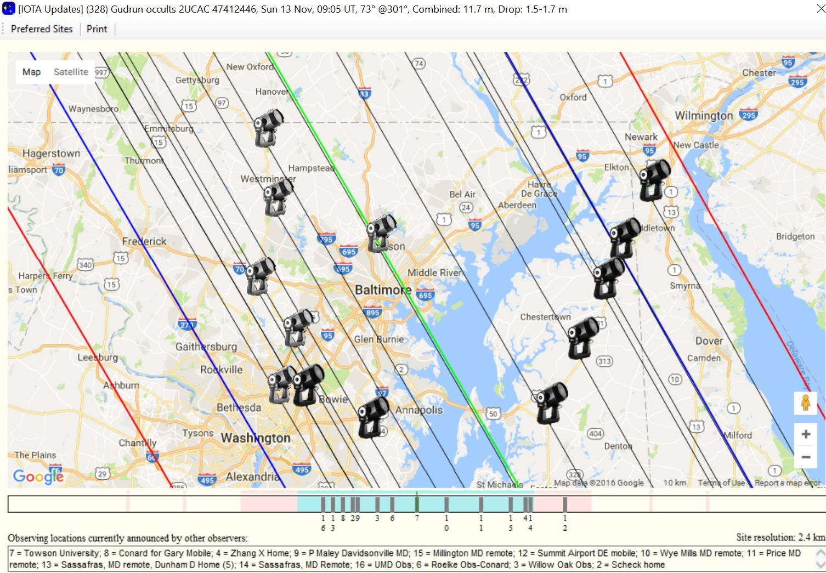
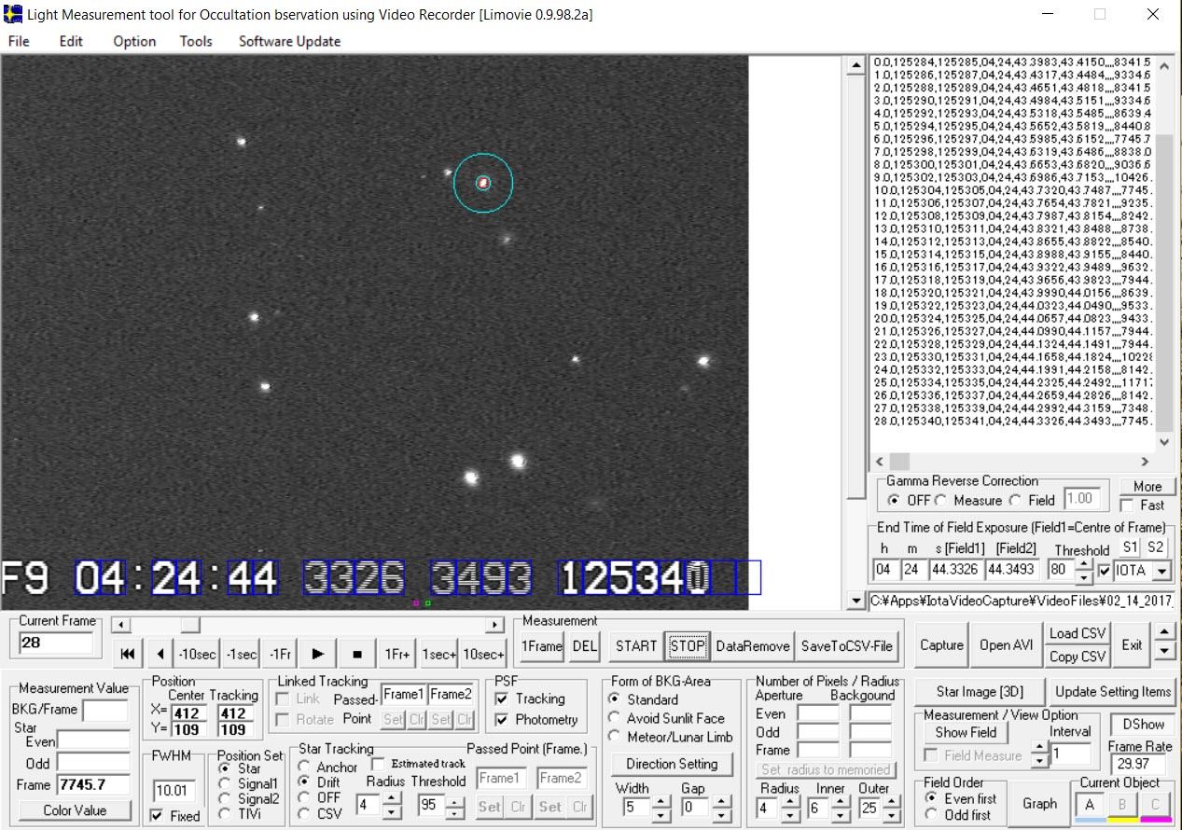
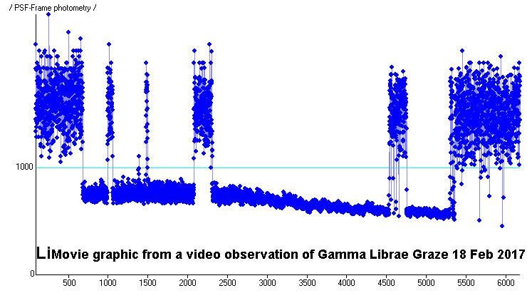
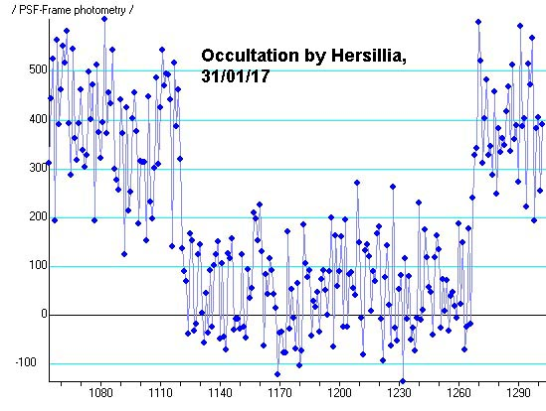
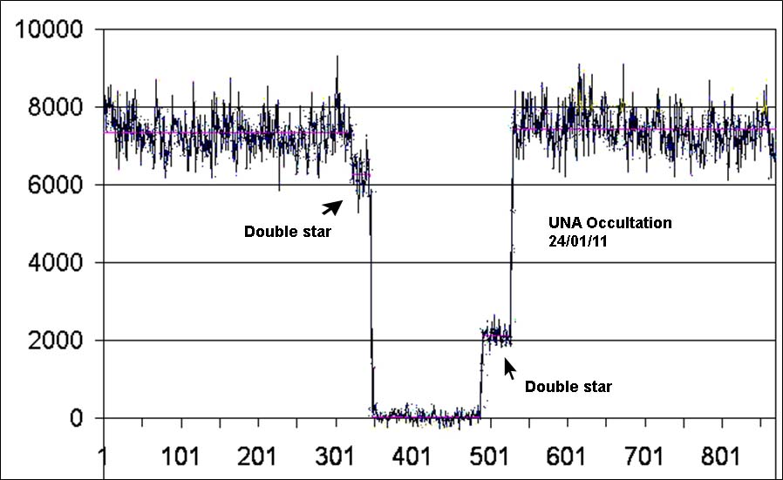
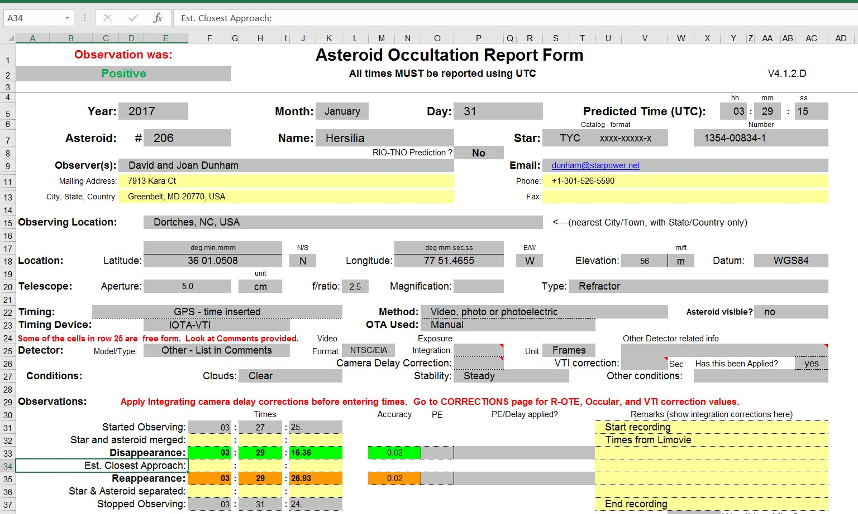
Occultations from Prediction to Reduction and Publication
Lunar occultation prediction with Occult software
Asteroid prediction access via Occult Watcher
Observers collaborate to maximize event coverage
Occultations recorded with a variety of methods, stopwatch while observing visually, analogue video recording, CCD drift scan as the observers experience and budget dictates
Data extracted from video records with Virtual Dub and/or LiMovie
IOTA collects and archives all occultation observations worldwide. Designated members in various IOTA organizations have the responsibility to collate, check, and distribute reported data.
Articles about specific events can be prepared for the JOA, Reflector, S&T, and other publications

Slide 4
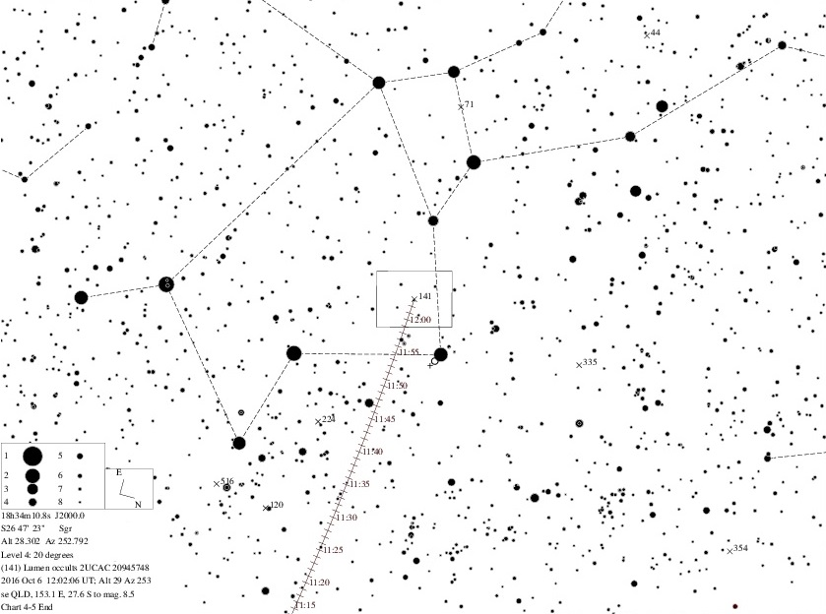
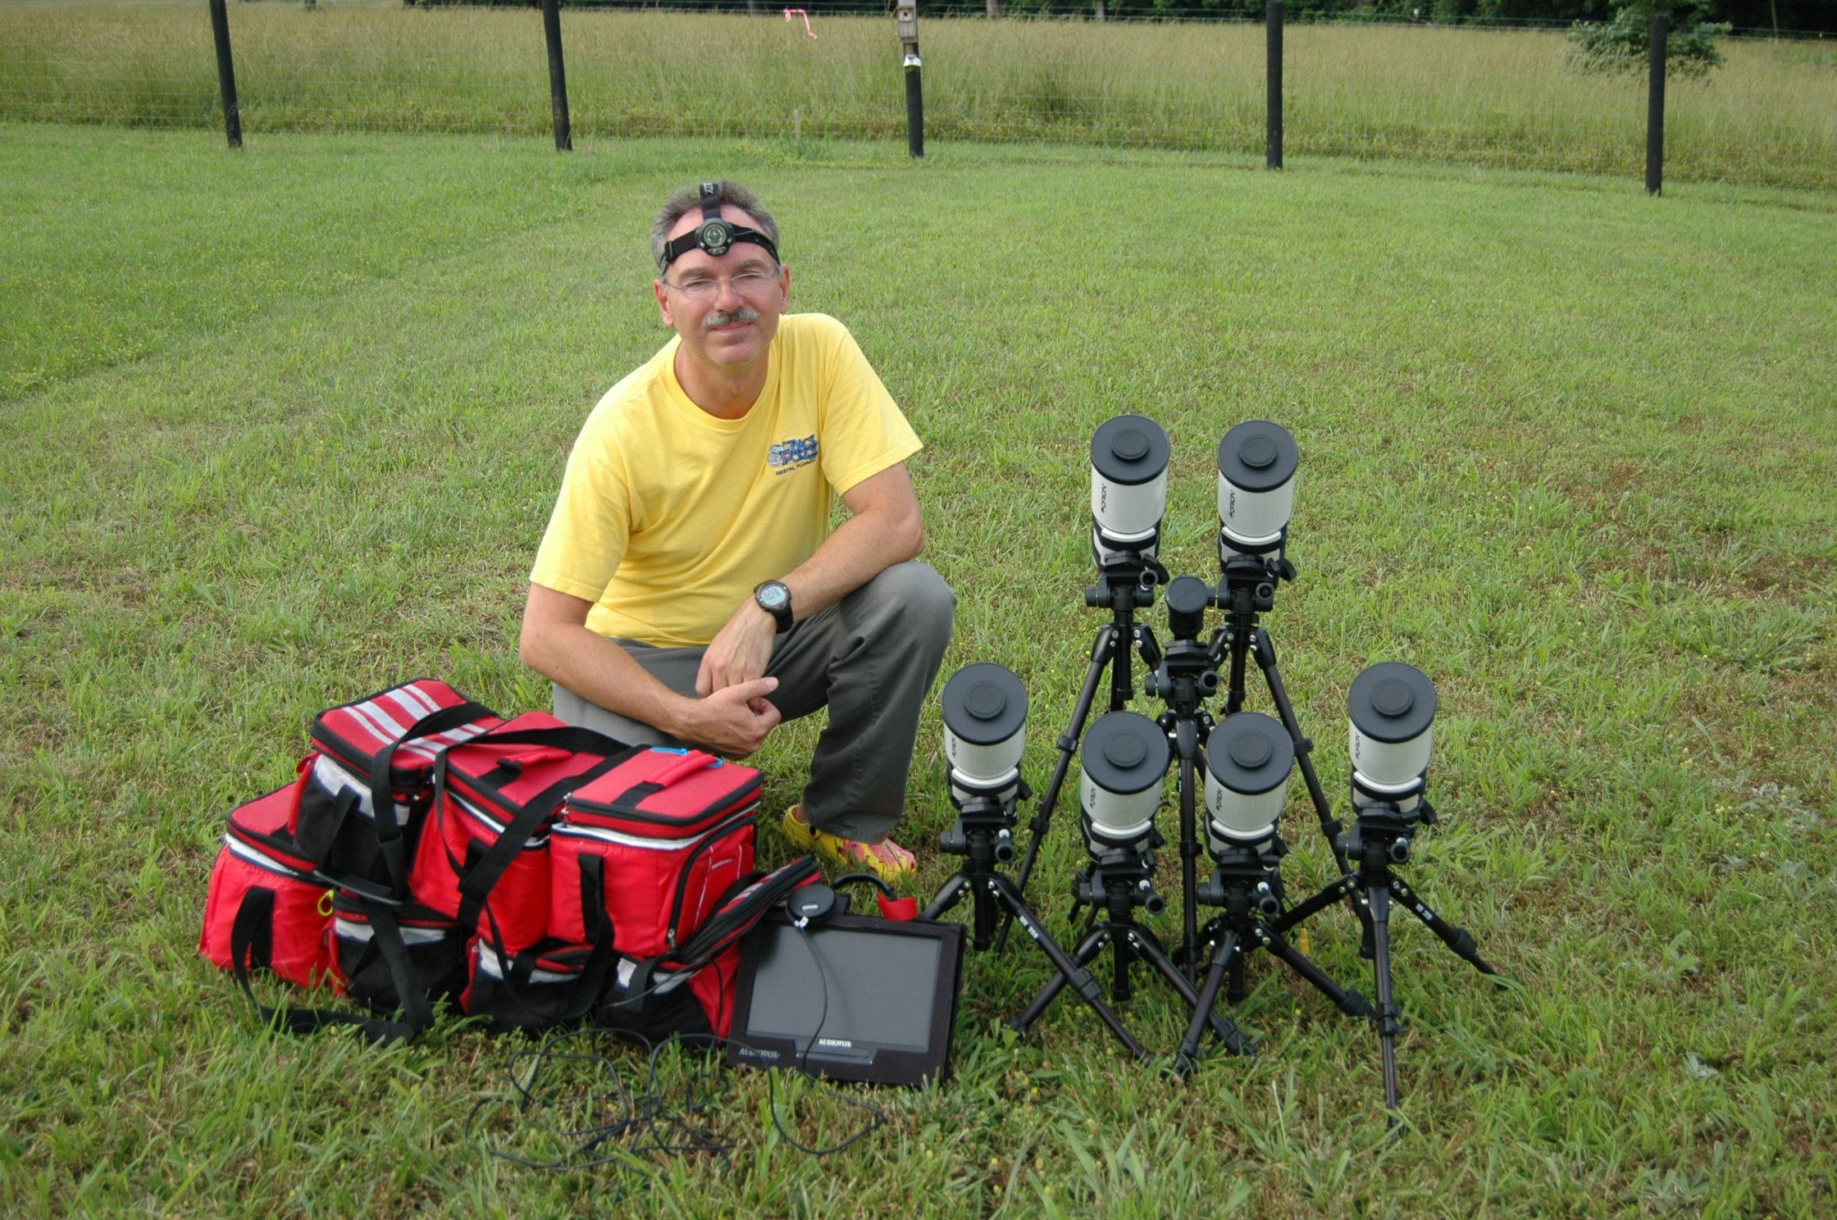
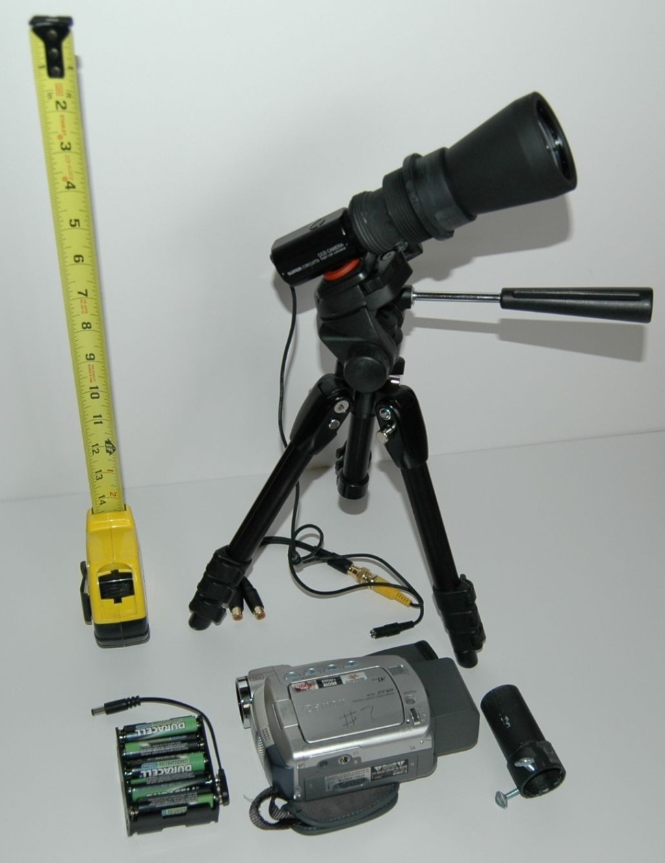
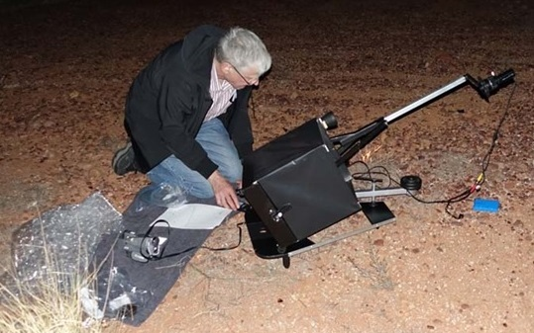
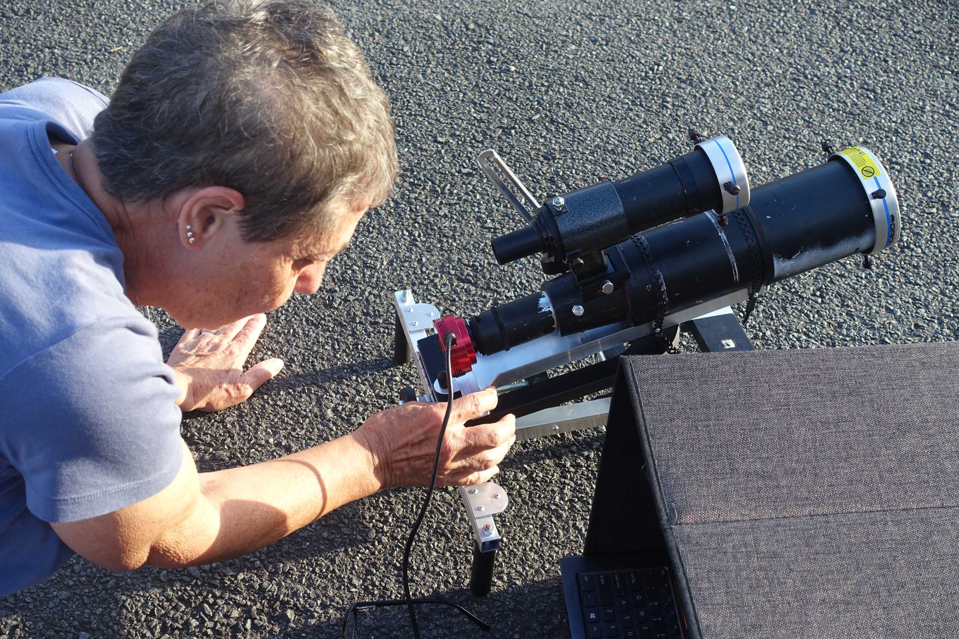
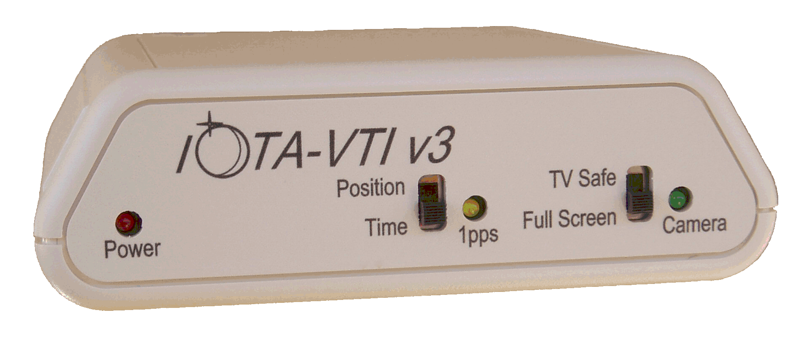
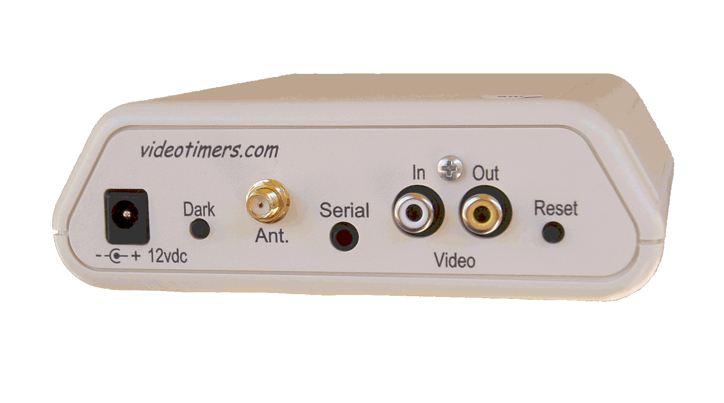
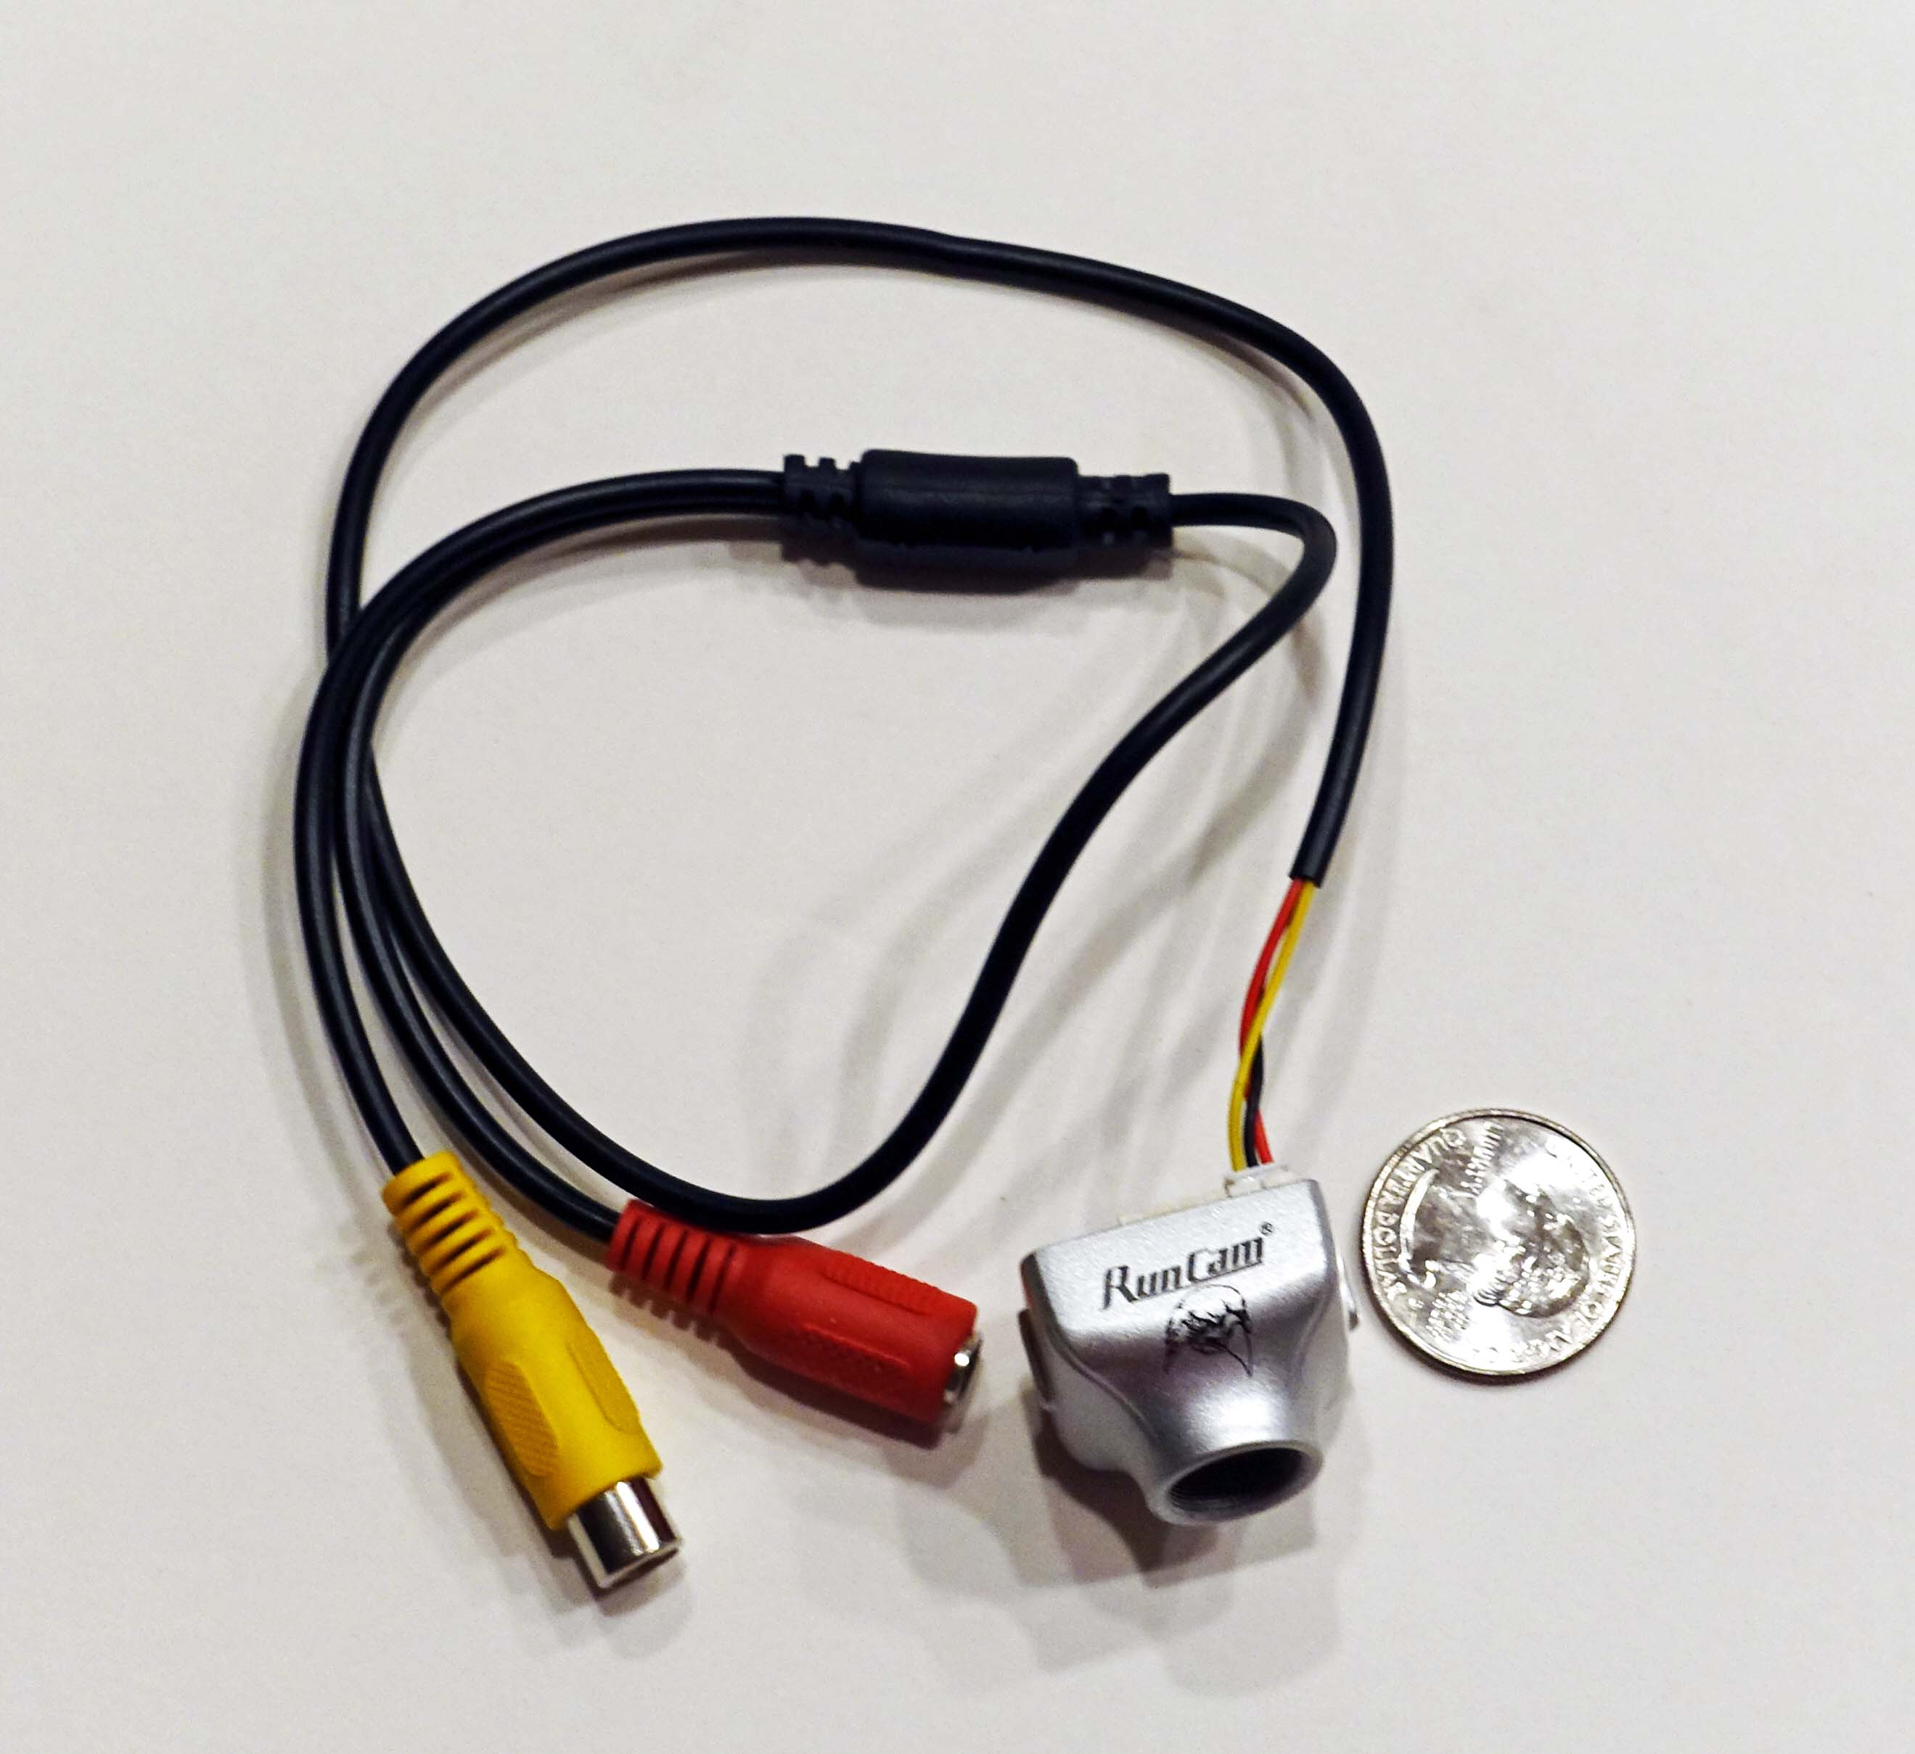
Remote Stations
Remote Stations are those deployed for unattended recording of an occultation. The equipment needs to be sturdy, portable, easily concealed, and inexpensive.
Suitable scopes are wide-field, on a simple alt-az mount and undriven. The scope is pointed to the predicted location of the star at the occultation time and the occultation is recorded as the star drifts across the field.
Prepoint chart
One observer can deploy multiple stations increasing the coverage of individual events
Mighty Mini optics (half of a Tasco Essentials 10x50 binocular)
PC164CEX-2 video camera powered by 9 AA NiMH battery pack on a small tripod, limiting magnitude is10.2
FOV = 3.2 x 2.4 degrees (using Owl FR)
Canon ZR camcorder (digital VCR)
Prime focus adapter for lunar occultations
Total weight: under 10 lbs
System designed by Scott Degenhardt
Paver mount with 80mm short-tube refractor and with 10” suitcase telescope, designed by John Broughton
Recording systems use analogue video with GPS time inserted using the IOTA Video Time Inserter
www.videotimers.com
RunCam Night Eagle an inexpensive , small, very sensitive replacement for the PC 164C EX-2 . An Astro version is under development.
Data are recorded using camcorders or digitized and captured with the IOTA Video Recorder Application

