Slide 1
Asteroidal Occultations: Results 2015-2017 May
Dave Herald

Slide 2
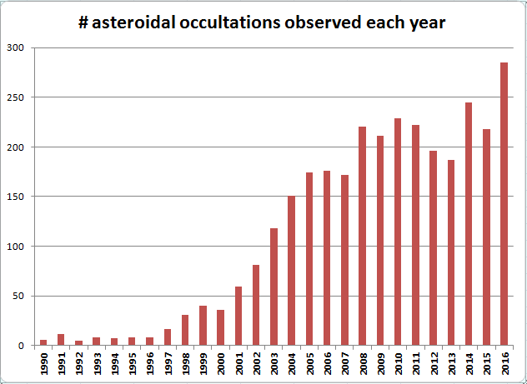
~250 events/year, & growing
GAIA
UCAC3
UCAC4
UCAC2
Hipparcos
Tycho2
PPM

Slide 3
Number of successful events by region, and max # sites: 2016/01 2016/12
2015
Australasia 53 (44) (8 sites)
Europe 91 (64) (19 sites)
Japan 27 (24) (13 sites)
US 107 (84) (25 sites)
Other 7 (23 sites)
Late additions 15
Total 300

Slide 4
Double stars discovered in asteroidal occultations
New double stars can be discovered in an asteroidal occultation
Separations are usually in the range 0.1” to 0.001”
If several observers, the uncertainty in separation can be less than 1 milli-arcsecond [ <0.001”]

Slide 5
4 double stars discovered in 2016
Star number Sep (mas) P.A. Date Asteroid
1981-01493-1 211.0 309.3 2016 Mar 17 412 Elisabetha
2U31329020 10.0 57.0 2016 Mar 19 695 Bella
1307-01531-1 38.0 249.0 2016 Oct 18 72 Feronia
2U43051828 36.0 248.0 2016 Nov 7 2494 Inge
Note – the 2nd is below the resolution limit of Gaia

Slide 6
17 examples of good Profiles

Slide 7
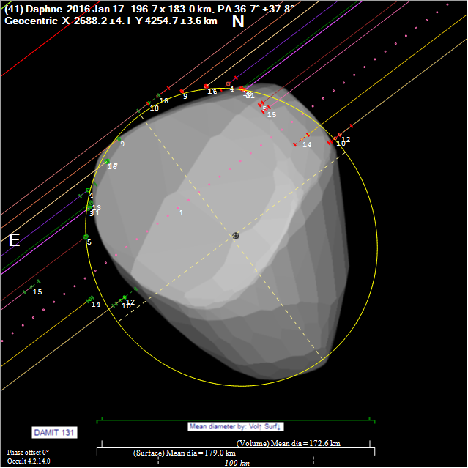
41 Daphne 2016 Jan 17
Poor fit to shape model
Perhaps a time base issue for some observers?

Slide 8
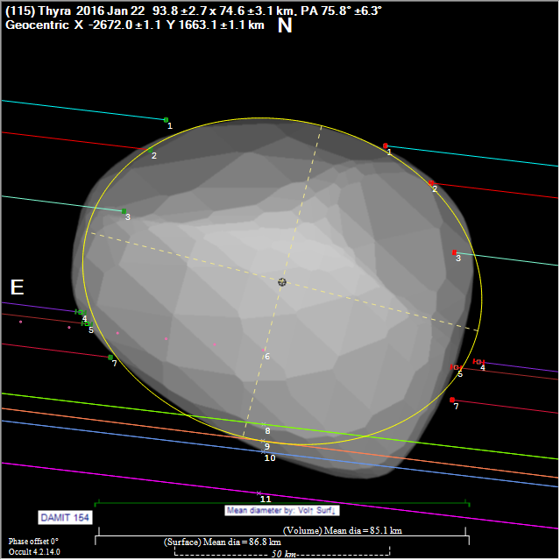
115 Thyra 2016 Jan 22
Problems with some chords
3 miss events …?
Fitted dia = 85km IRAS dia = 55km AKARI dia = 81km WISE dia = 55km

Slide 9
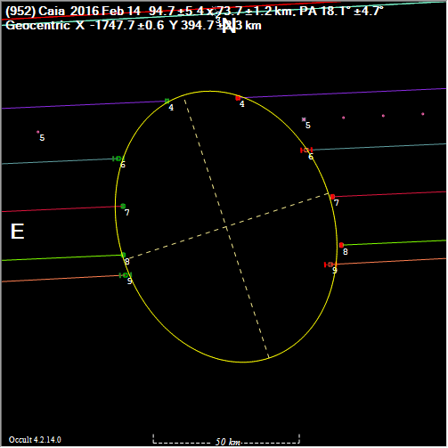
952 Caia 2016 Feb 14
No shape model
Fitted dia = 95 x 75km
Other events - nil IRAS dia = 88km AKARI dia = 88km WISE dia = 89km

Slide 10
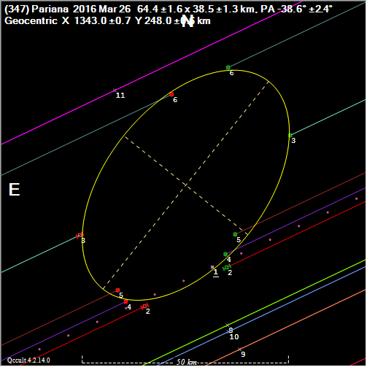
347 Pariana 2016 Mar 26
No shape model
Fitted dia = 64 x 39km
Other events - nil IRAS dia = 51km AKARI dia =51km WISE dia = 51km

Slide 11
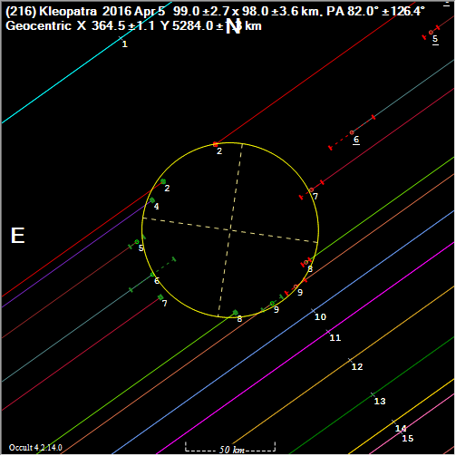
216 Kleopatra 2016 Apr 5
No shape model
Problems with chords 4, 5, 6 & 7
Fitted dia = 99km IRAS dia = 138km AKARI dia =122km WISE dia = 138km

Slide 12
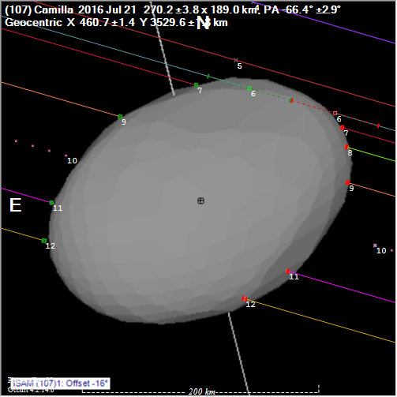
107 Camilla 2016 Jul 21
Large uncertainty with chord 6
Best fit to model: dia = 227km phase -8°
IRAS dia = 219km AKARI dia =200km WISE dia = 219km

Slide 13
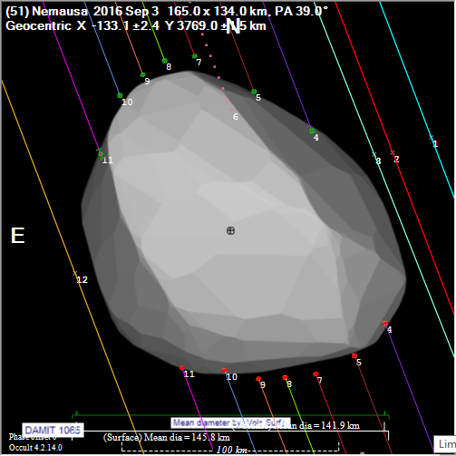
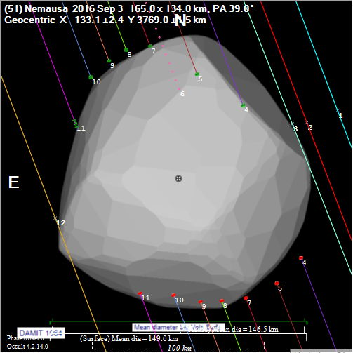
51 Nemausa 2016 Sep 3
2nd model is best fit
Fitted dia = 142km
IRAS dia = 142km AKARI dia =147km WISE dia = 143km

Slide 14
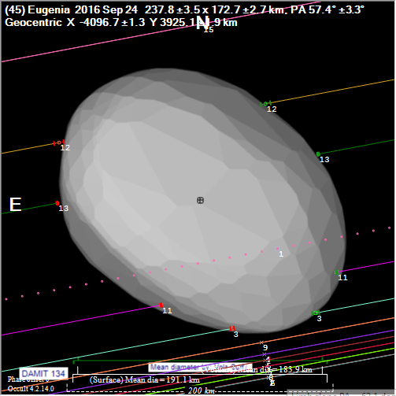
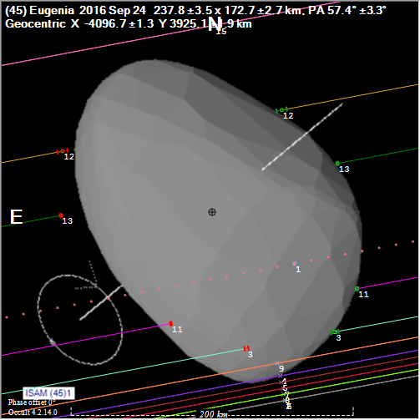
45 Eugenia 2016 Sep 24
Fitted dia = 184km
IRAS dia = 206km AKARI dia =184km WISE dia = 206km
2nd ISAM model a poor fit

Slide 15
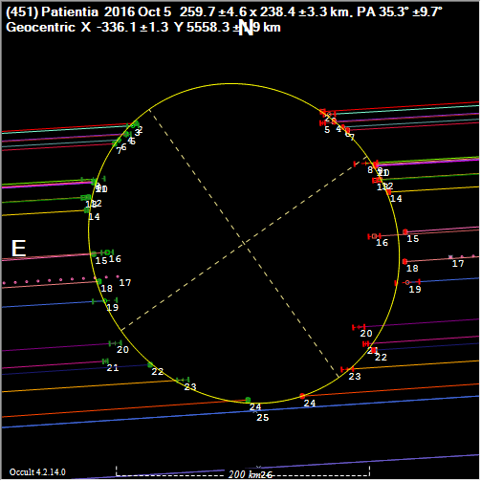
451 Patientia 2016 Oct 5
No shape model
Best fit = 260km x238km
IRAS dia = 251km AKARI dia =235km WISE dia = 252km

Slide 16
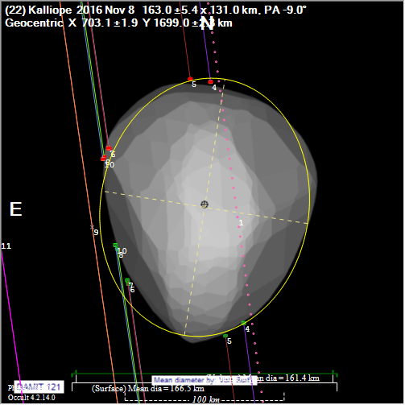
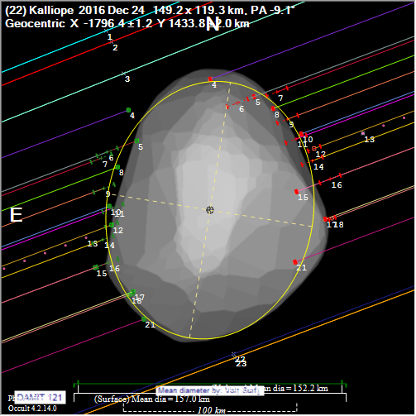
22 Kalliope 2016 Nov 8 & Dec 24
Nov 8
Fitted dia: Nov 8 161km Dec 24 152km
Large uncertainties in Dec 24 chords
IRAS dia = 167km AKARI dia =140km WISE dia = 167km
Dec 24

Slide 17
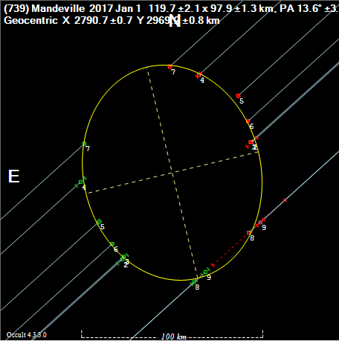
739 Mandeville 2017 Jan 1
No shape model
Best fit = 120km x98km
Other events:
124x84, 138x85
IRAS dia = 107km
AKARI dia =123km
WISE dia = 104km

Slide 18
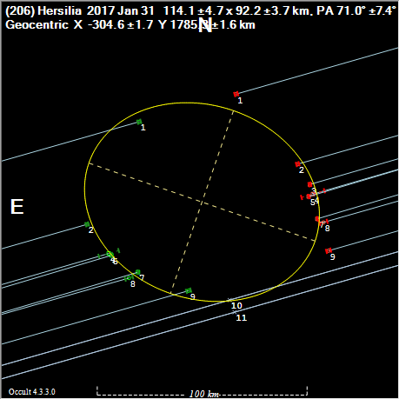
206 Hersilia 2017 Jan 31
No shape model
Best fit = 114km x92km
Other events: Nil
IRAS dia = -
AKARI dia =94km
WISE dia = 105km

Slide 19
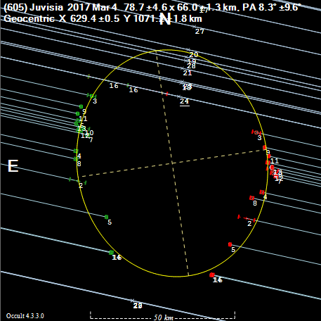
605 Juvisia 2017 Mar 4
No shape model
Best fit =79kmx66km
Problem with Misses
Other events: Nil
IRAS dia = 70km
AKARI dia =63km
WISE dia = -

Slide 20
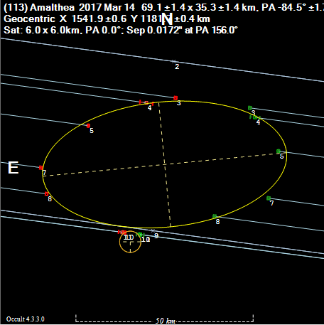
113 Amalthea 2017 Mar 14 Satellite discovery – by a MISS observation
No shape model
Best fit =69kmx35km
Other events: Nil
IRAS dia = 46km
AKARI dia =46km
WISE dia = 50km

Slide 21
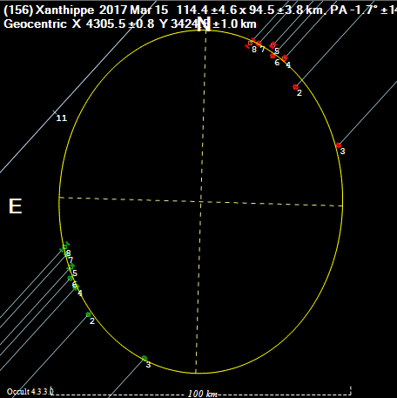
156 Xanthippe 2017 Mar 15
No shape model
Best fit =114kmx95km
Other events: 126x103, 110x110
IRAS dia = 121km
AKARI dia = 116km
WISE dia = 111km

Slide 22
599 Luisa 2017 Apr 10
No shape model
Best fit =79kmx64km
Other events: nil
IRAS dia = 65km
AKARI dia = 62km
WISE dia = 73km

Slide 23
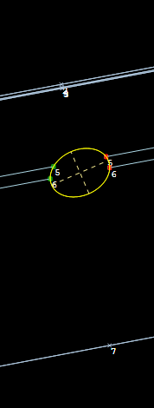
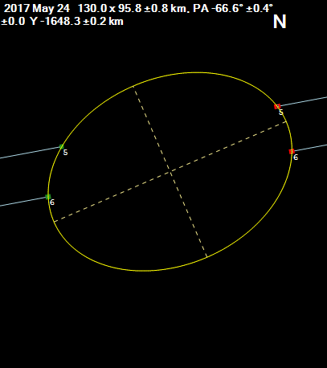
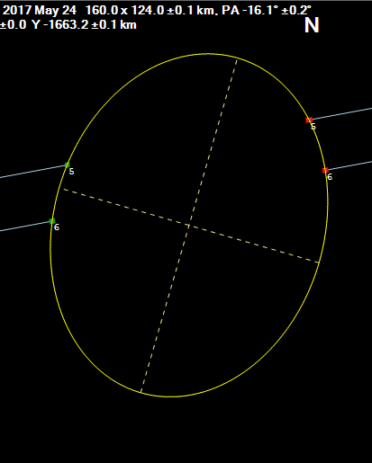
(469506) 2003 FF128 2017 May 24 only 3rd Plutino to have diameter measured Definitely non-circular. Dia ~130km
130 x 96 km
160 x 124 km

Slide 24
Any questions?

