Slide 1
HIGH PRIORITY EVENTS FROM SWRI FOR 2017
PAUL D. MALEY, BILL MERLINE (SWRI), BRIAN ENCKE (SWRI)
IOTA MEETING, STILLWATER OK
JULY 30, 2016

Slide 2
SOUTHWEST RESEARCH INSTITUTE PARTNER RELATIONSHIP
NO FUNDING FOR IMMEDIATE FUTURE
RECOMMENDATIONS BASED ON SATELLITE PRESENCE, SHAPE MODEL
2017 IS NOT A GOOD YEAR FOR SCIENCE
RECOMMENDATIONS BASED ON LIKELIHOOD OF GETTING A LARGE NUMBER OF CHORDS

Slide 5
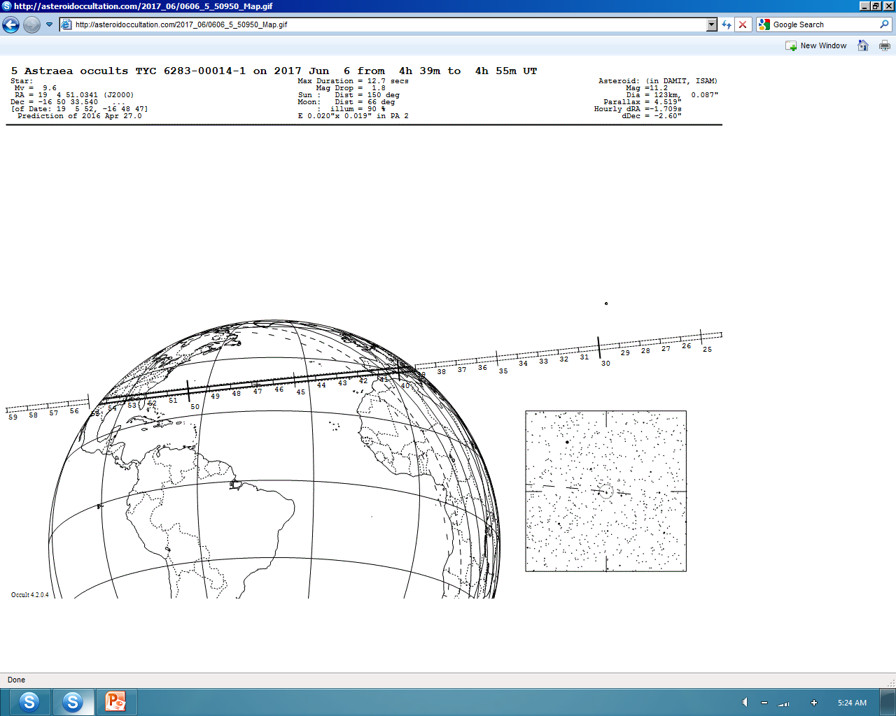

Slide 10
SUMMARY
PRIORITY
Sept. 12 Germania
June 6 Astraea
Sept 3 Euphrosyne
Dec. 11 Lumen
Nov 6 Cava
April 11 Artemis
Mar. 30 Leto

