Slide 1
IOTA Membership and Subscription Numbers
Print
29 USA vs 34 in 2014 July
3 Outside USA vs 4 in 2014 July
Online-only
62 subscribers vs 57 in 2014 July
Net decrease of 1 member

Slide 2
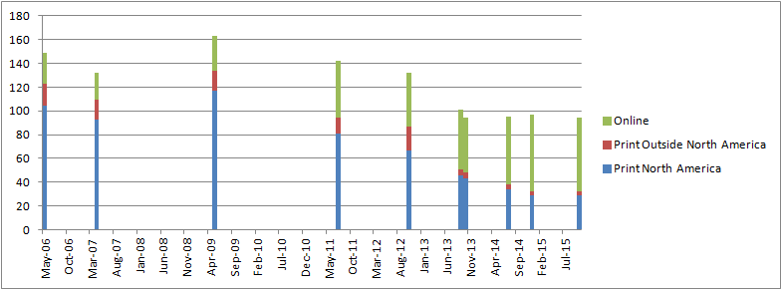
IOTA Membership Trends
Date | Print North America | Print Outside North America | Online | Total
Oct-15 | 29 | 3 | 62 | 94
Dec-14 | 29 | 3 | 65 | 97
Jul-14 | 34 | 4 | 57 | 95
Oct-13 | 43 | 5 | 46 | 94
Sep-13 | 46 | 5 | 50 | 101
Oct-12 | 67 | 20 | 45 | 132
Jul-11 | 81 | 13 | 48 | 142
May-09 | 117 | 17 | 29 | 163
Apr-07 | 93 | 16 | 23 | 132
May-06 | 104 | 19 | 26 | 149

Slide 3
IOTA Financial Overview
Starting Balance: 2014 July 2
$7,544.48
Ending Balance: 2015 October 14
$9,608.45
Net increase in Balance:
$2,063.97 but…$2K due to award pool

Slide 4
IOTA Financial Details
IOTA-VTI Royalties: $688
Up $160 from last annual meeting
PayPal Balance: $1417.55
Down $680.64 from last annual meeting
Expenses
JOA layout/print costs Consistent
Web service: Still donated
Awards Need paying

Slide 5
IOTA Business Items
JOA publication
Seemingly getting more and more behind per issue. Membership need to write/submit more!
Online access
New password protocol seems to be working fine
Remembering passwords is the only problem.
Complaints
A few problems here and there…

