Slide 1
Basics of Observing and Timing Grazing Occultations
presented
2014 July 12, UMD Obs., College Park, MD
32nd Annual IOTA Meeting
David W. Dunham

Slide 2
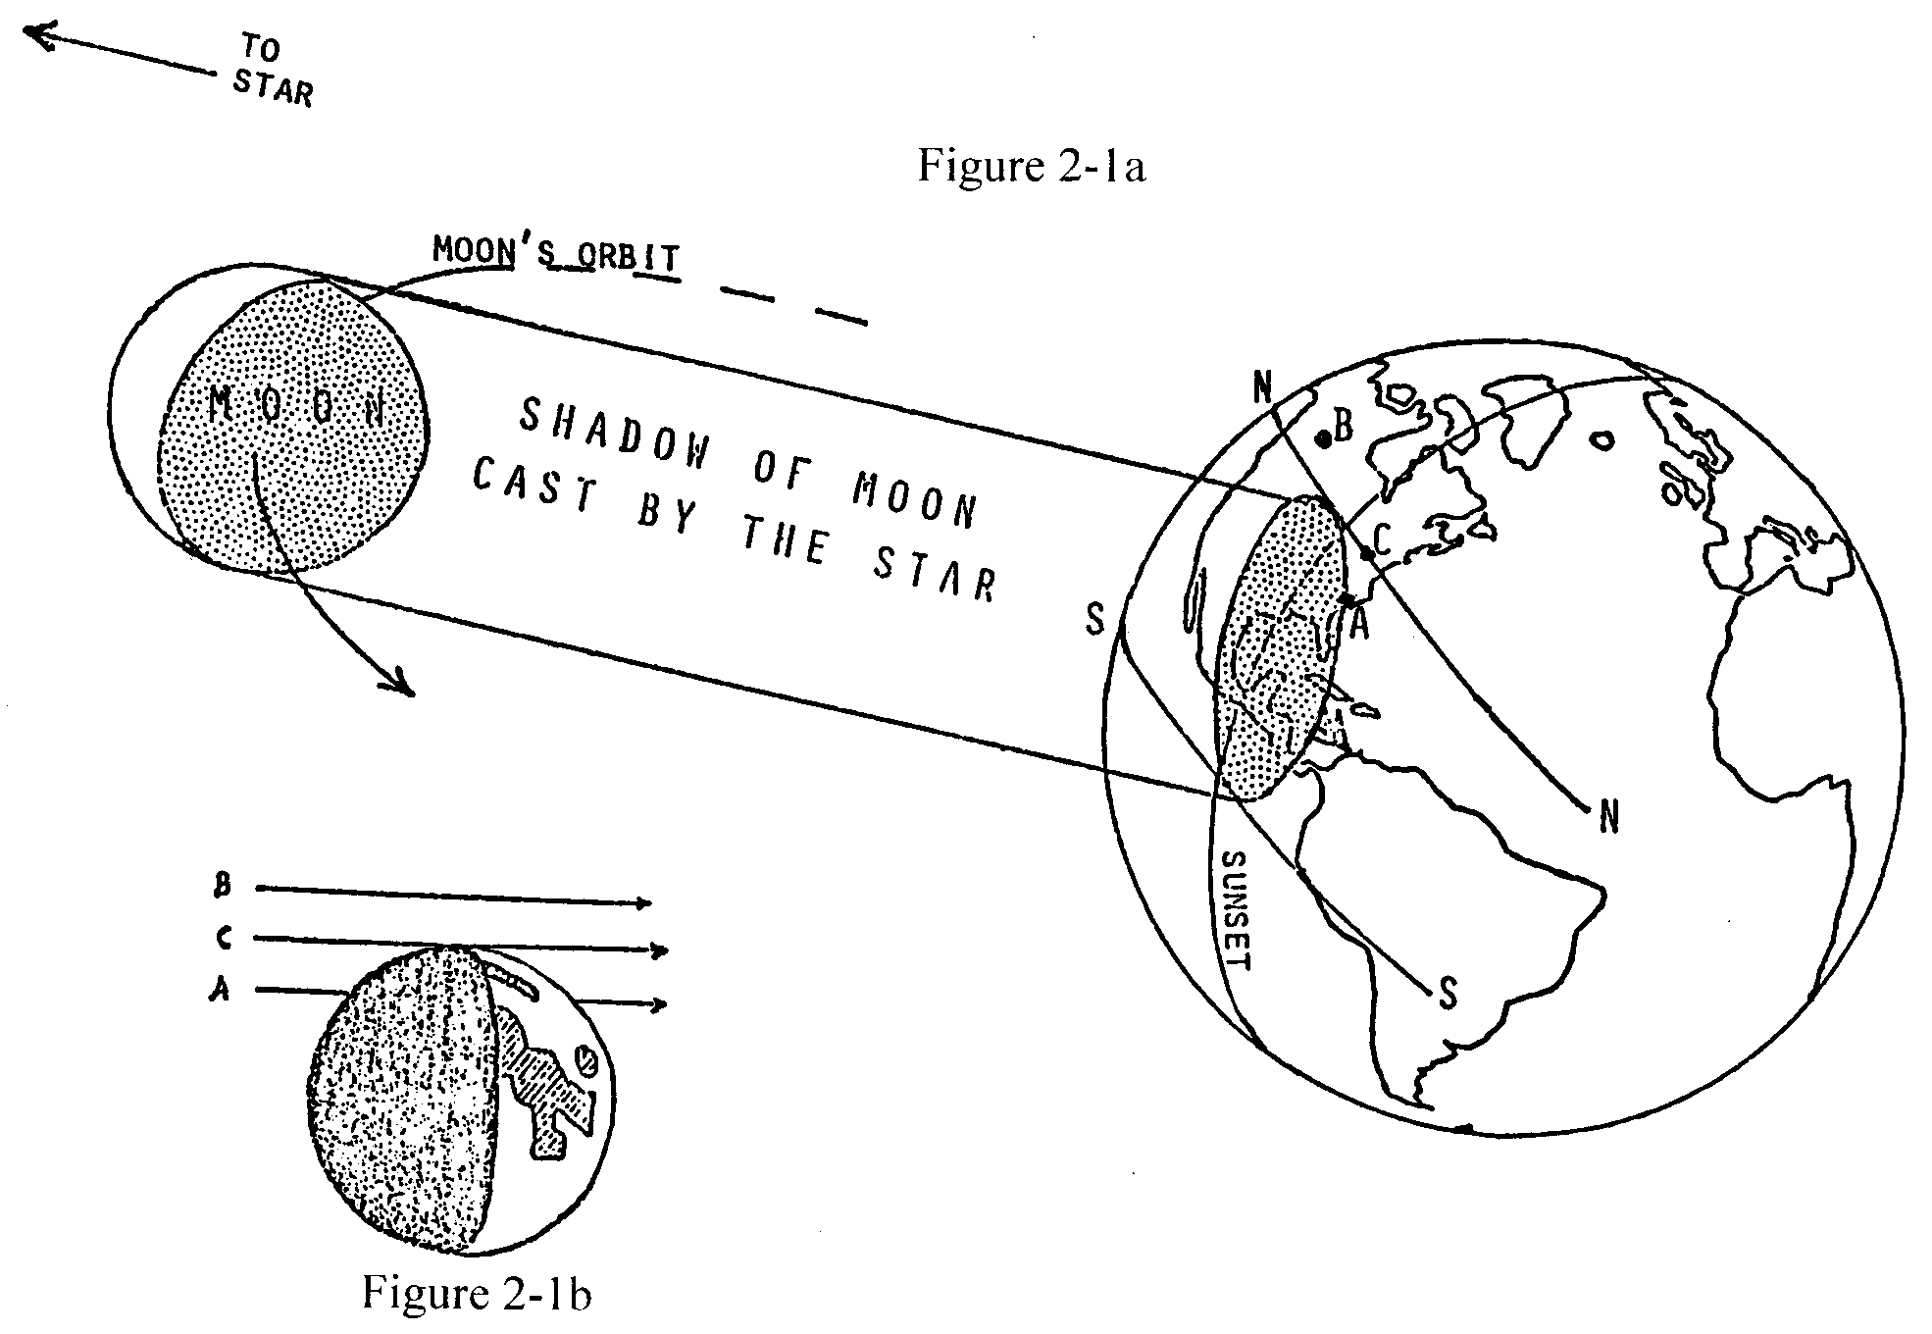
Lunar Occultation Geometry

Slide 3
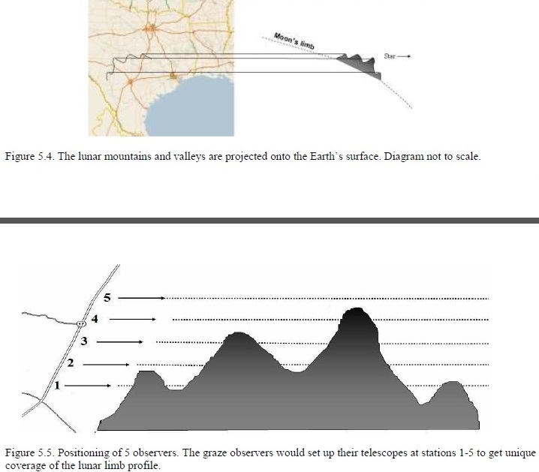
Lunar profile projected onto Earth’s surface during grazing occultation

Slide 4
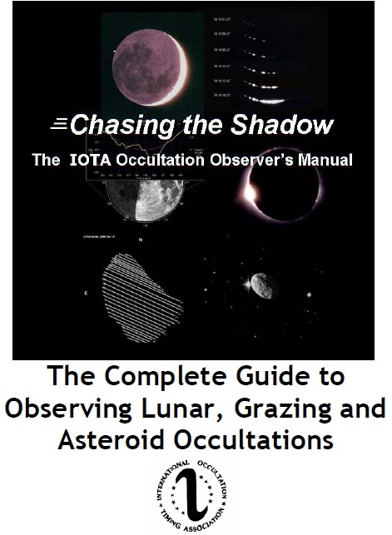
Free IOTA Observer’s
Manual available at
http://www.poyntsource.com/IOTAmanual/Preview.htm
For visual timings, use http://www.time.gov.
For mobile and video use, WWV short-wave time signals give the cheapest accurate time base.
5.0 & 10.0 megahertz at night and 15.0 megahertz for day use.

Slide 5
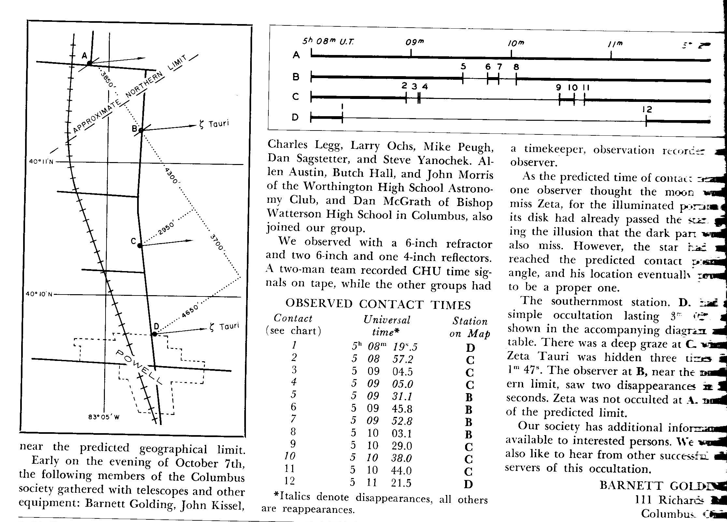
This is the 2nd page (page 370) of the 2-page article about the 1963 October 8th zeta Tauri graze in S&T’s Dec. 1963 issue

Slide 6
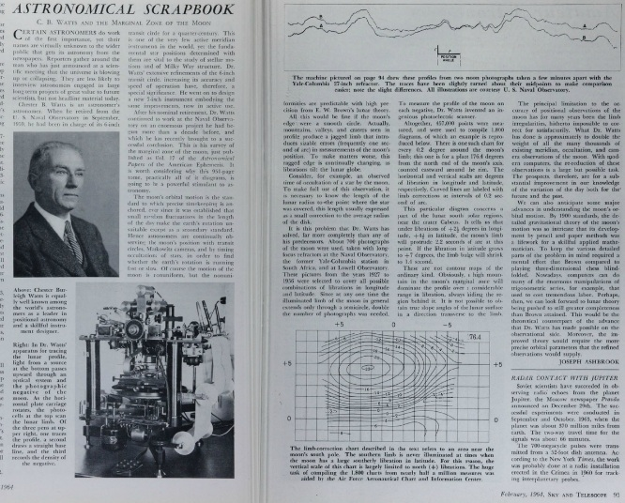
The 1964 publication of Watts’ charts gave us the possibility to predict the lunar profile for grazing occultations
This was published in the 1964 Feb. issue of Sky and Telescope.
The figure at the bottom for WA 176.4° was in the range for a graze we observed that month, so I knew from it that a high mountain would dominate our profile.

Slide 7
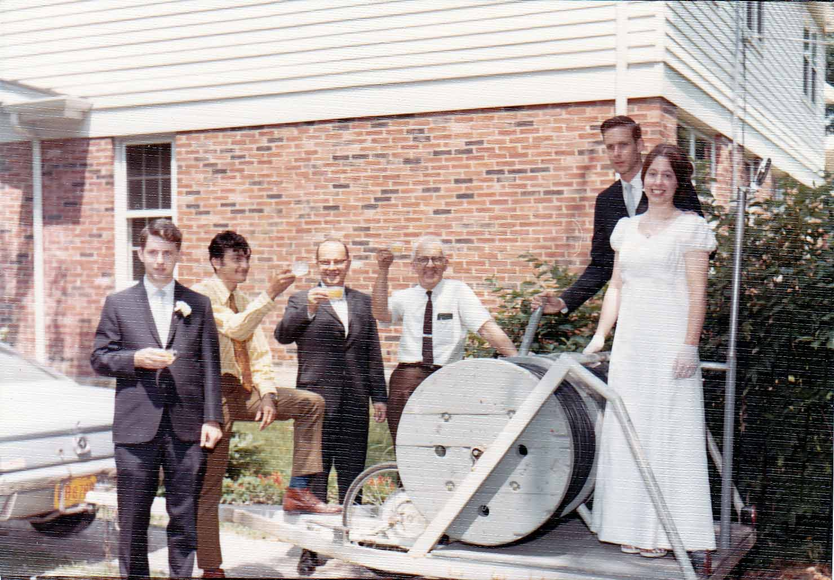
1970 July 11, standing on the Milwaukee cable trailer at our wedding in Highland Park, Illinois
From left to right, Tom Van Flandern, Ronald Abileah,
Homer DaBoll, Edward Halbach, David Dunham, and Joan Dunham

Slide 8
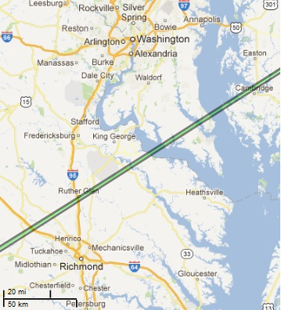
Finally, I observed a graze of β² Capricorni with 12 others near Ruther Glen, VA on 1977 June 5, Moon 83%-, CA 3N, Sun alt. -2°
In spite of the conditions, the events were easily seen with the star’s 3.1-mag. brilliance. In the meantime, the International Occultation Timing Association (IOTA) had been formally established as a dues-paying organization in July 1975, primarily to promote the observation and analysis of lunar grazing occultations.
_____

Slide 9
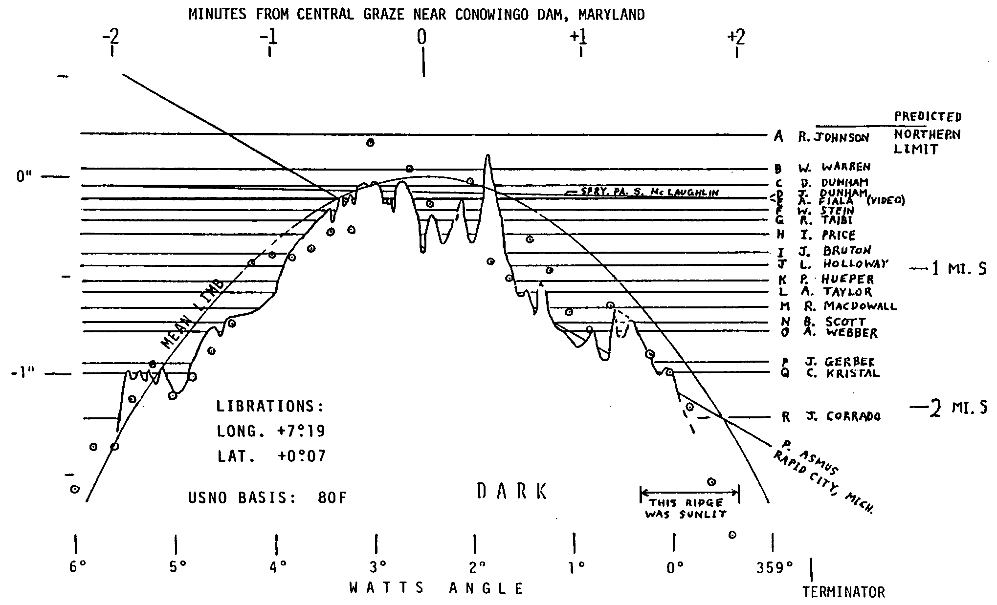
Lunar Profile from Graze of delta Cancri – 1981 May 9-10
Alan Fiala, USNO, obtained the first video recording of multiple events during this graze, with 7 D’s and 7 R’s
Circled dots are Watts’ predicted limb corrections

Slide 10
Video of 1990 April Aldebaran Grazing Occultation from Poland
Graze Observer’s Handbook available for $21 from
Hal Povenmire, katiehal1@yahoo.com – also, research on tektites

Slide 11
The First Multiple Stations were Deployed for Grazing Occultations
In the 1990’s, I often thought, the equipment is doing all the work, maybe I should be somewhere else making another observation.
For a graze of omicron Leonis the morning of 1998 November 12, I set up a 5-in. clock-driven SCT at Delta, Pennsylvania, near York
I left a student there after showing him how to make adjustments to keep the star in the field of view, and set up another telescope about 0.5 km away to record the event
When I came back, he was excited to see the multiple occultations of the star. “Did you make any adjustments?” “No”. “At least, you were there to protect the equipment”.
“Actually, it was the other way around. Whenever a car drove by, I hid behind the telescope box.”

Slide 12
2001 Dec. 21 Grazing Occultation of 4.0-mag. τ² Aqr
Moon 32%+, Cusp Angle 12S
Observed from 8 stations at Kitty Hawk, North Carolina, by only 4 observers. Kitty Hawk has many summer homes, unoccupied on a December weekday, so we had many safe places to set up telescopes 1 to 2 hours before the graze.
4 of the video stations were unattended
Also observed from 6 stations in Georgia

Slide 13
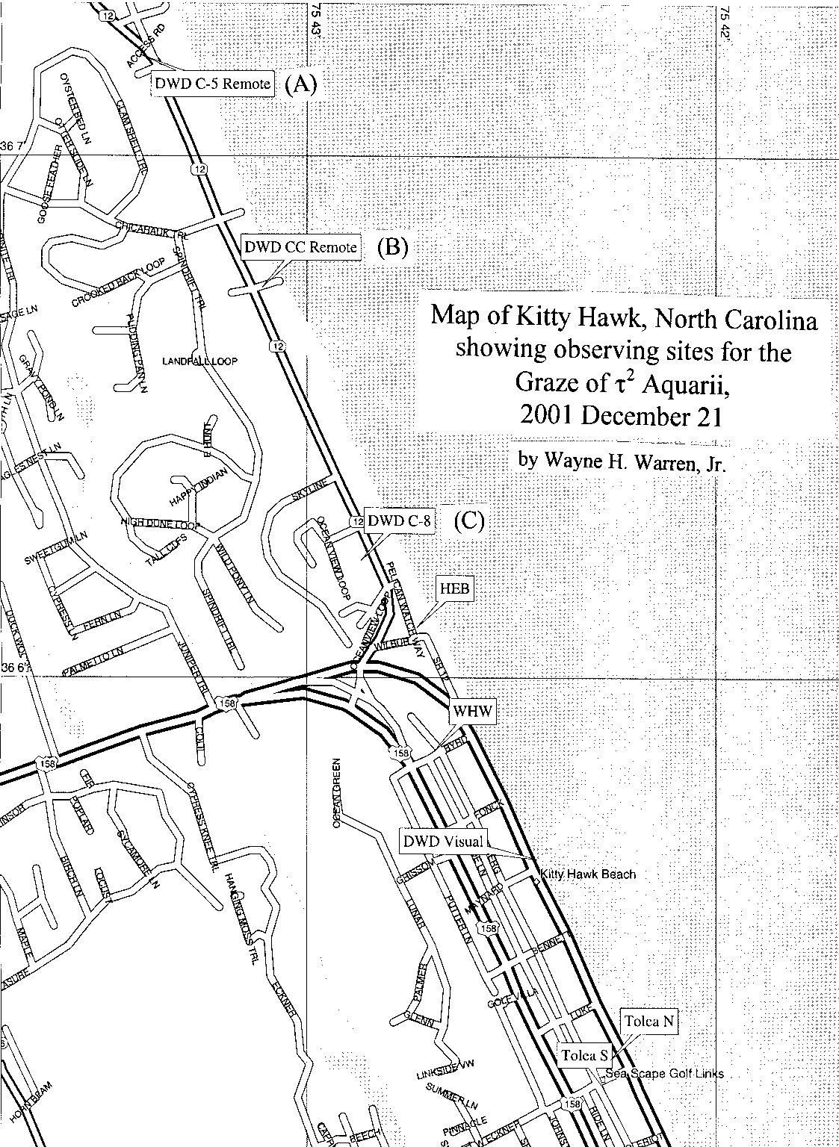

Slide 14
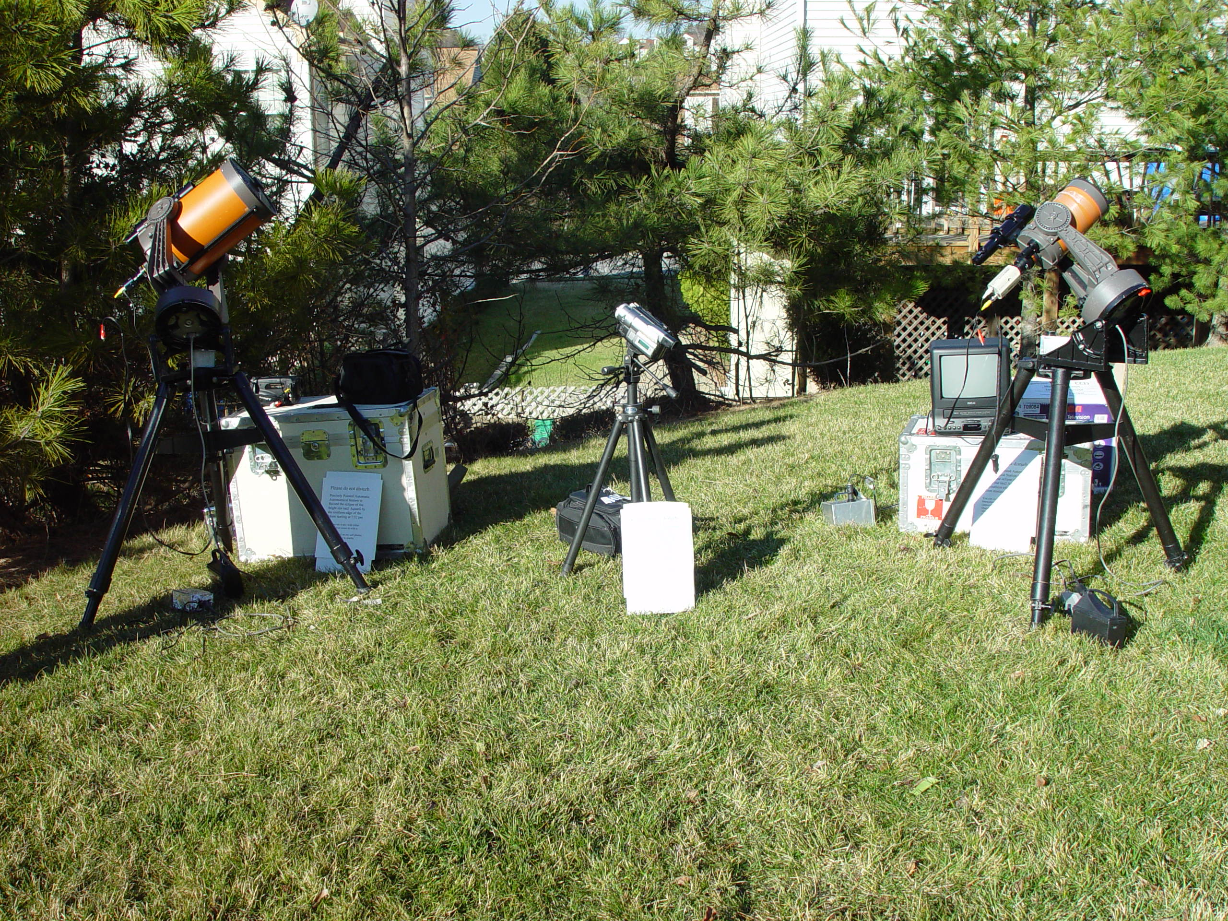
My Telescopes for Remote Observation

Slide 15
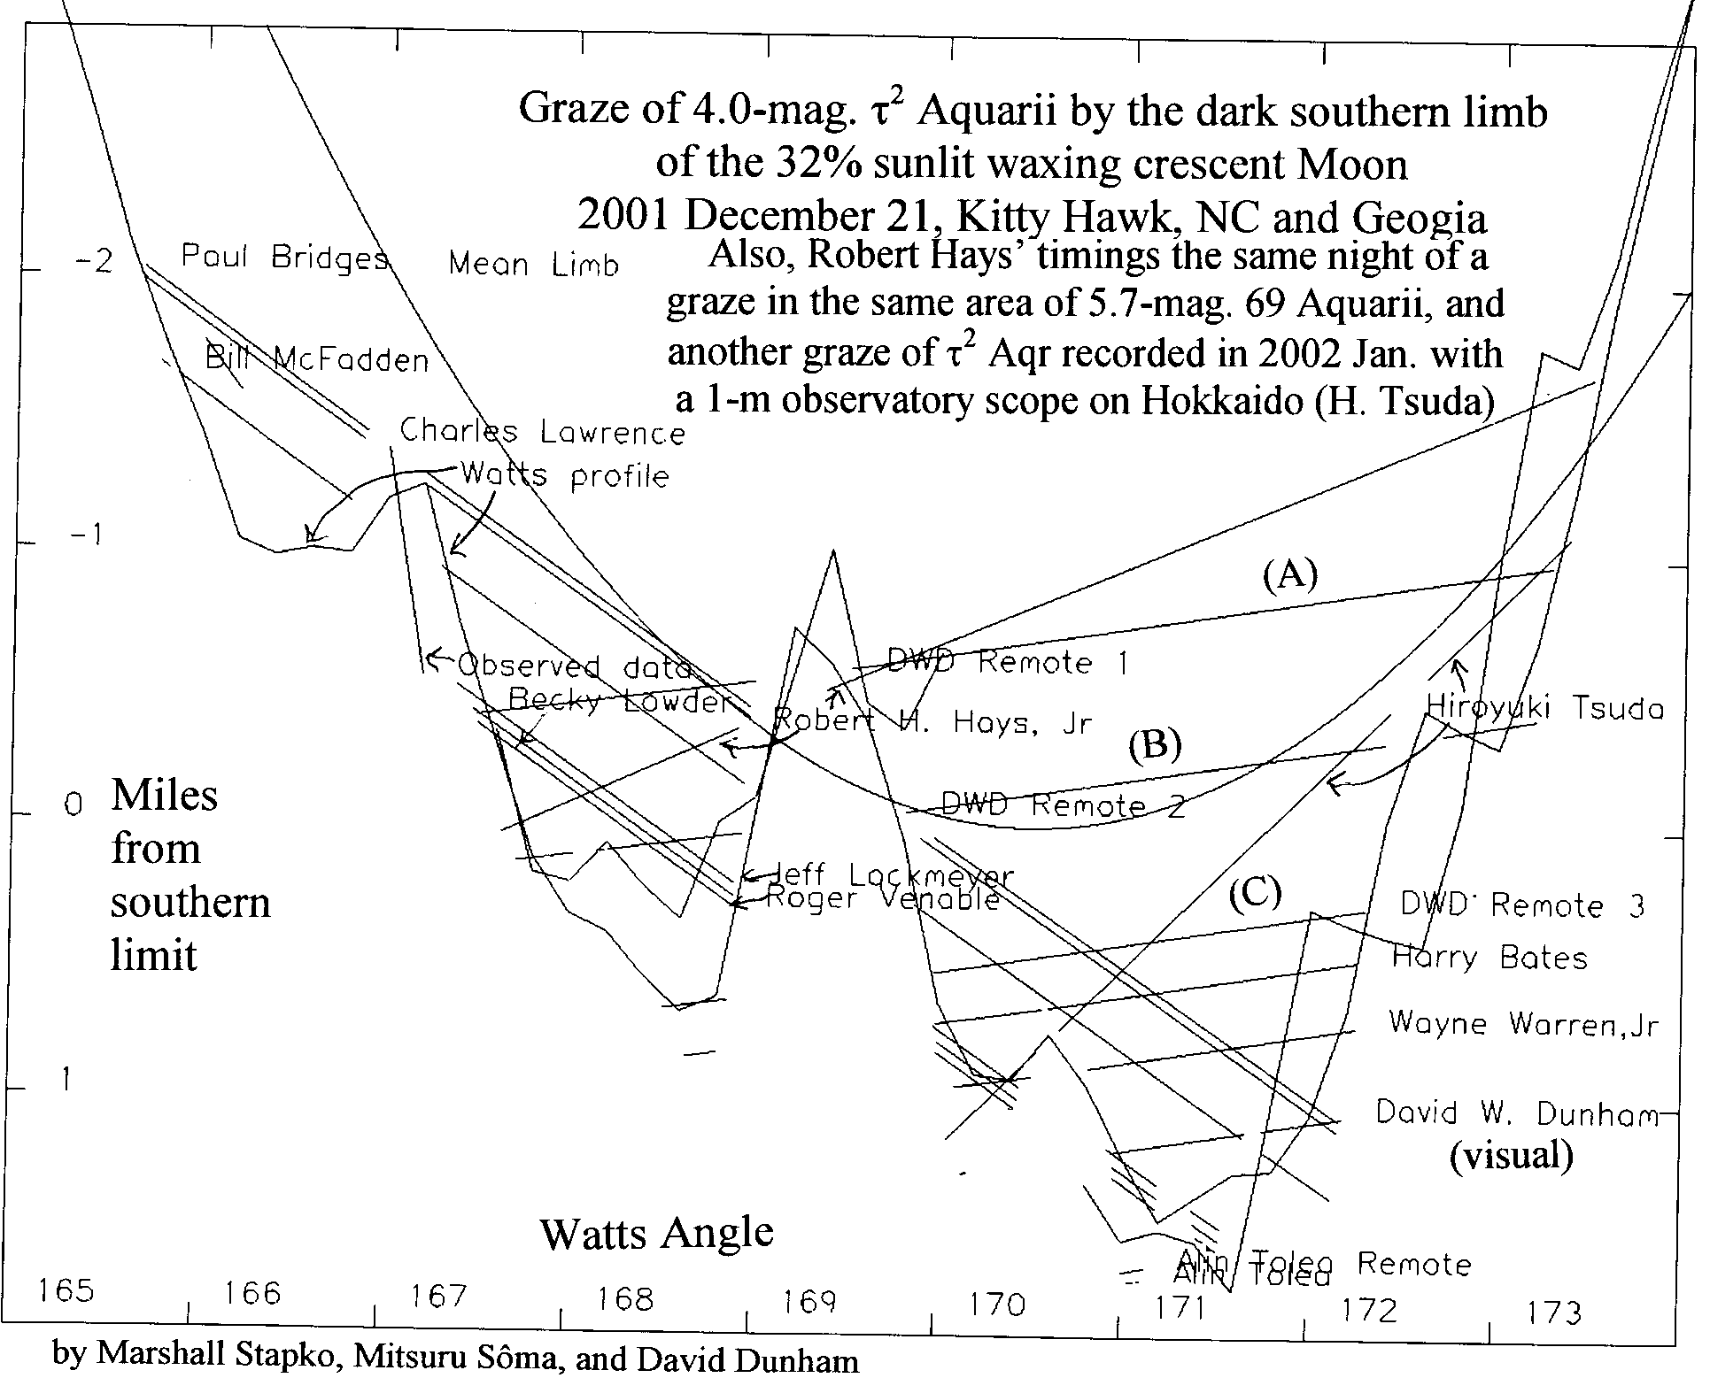

Slide 16
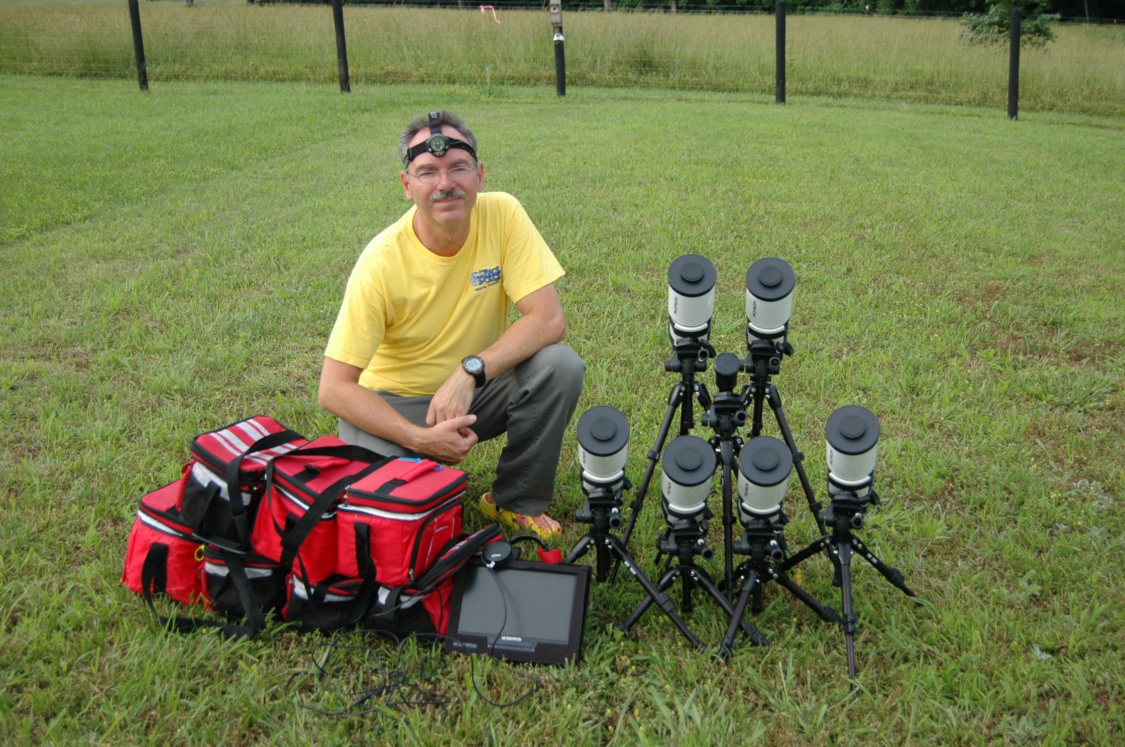
Multi-Station Occultation Observing with Galileo Sized Optical Systems
Scott Degenhardt, IOTA Galileo’s Legacy 2009
Waianae, Hawaii

Slide 17
Mighty Midi – Orion 80mm short tube
Can record
occultations of stars
to mag. 11.0, even
mag. 11.3 under
good conditions; these work better for grazes
I use visual finder
scope and $60
Quantanray tripod
while scotty uses a
mighty mini video
as the finder and
MX-350 tripod
(not as sturdy as the
Quantanray)

Slide 18
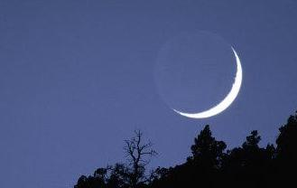
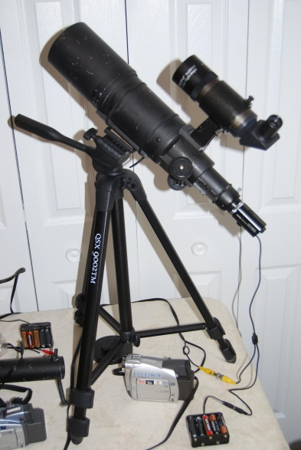
Grazing
Occultation of
3.5-mag. eta
Geminorum in
Arizona,
2011 April 10,
my first success
with remote
mini/midi stations (a humiliating defeat, it was machines, 3; humans, 0)
Moon 36%+
Cusp Angle 15N
Eta Geminorum - Graze

Slide 19
Stations on N. 387th Ave.
N. Remote
Cen. Remote
Attended
S. Remote

Slide 20
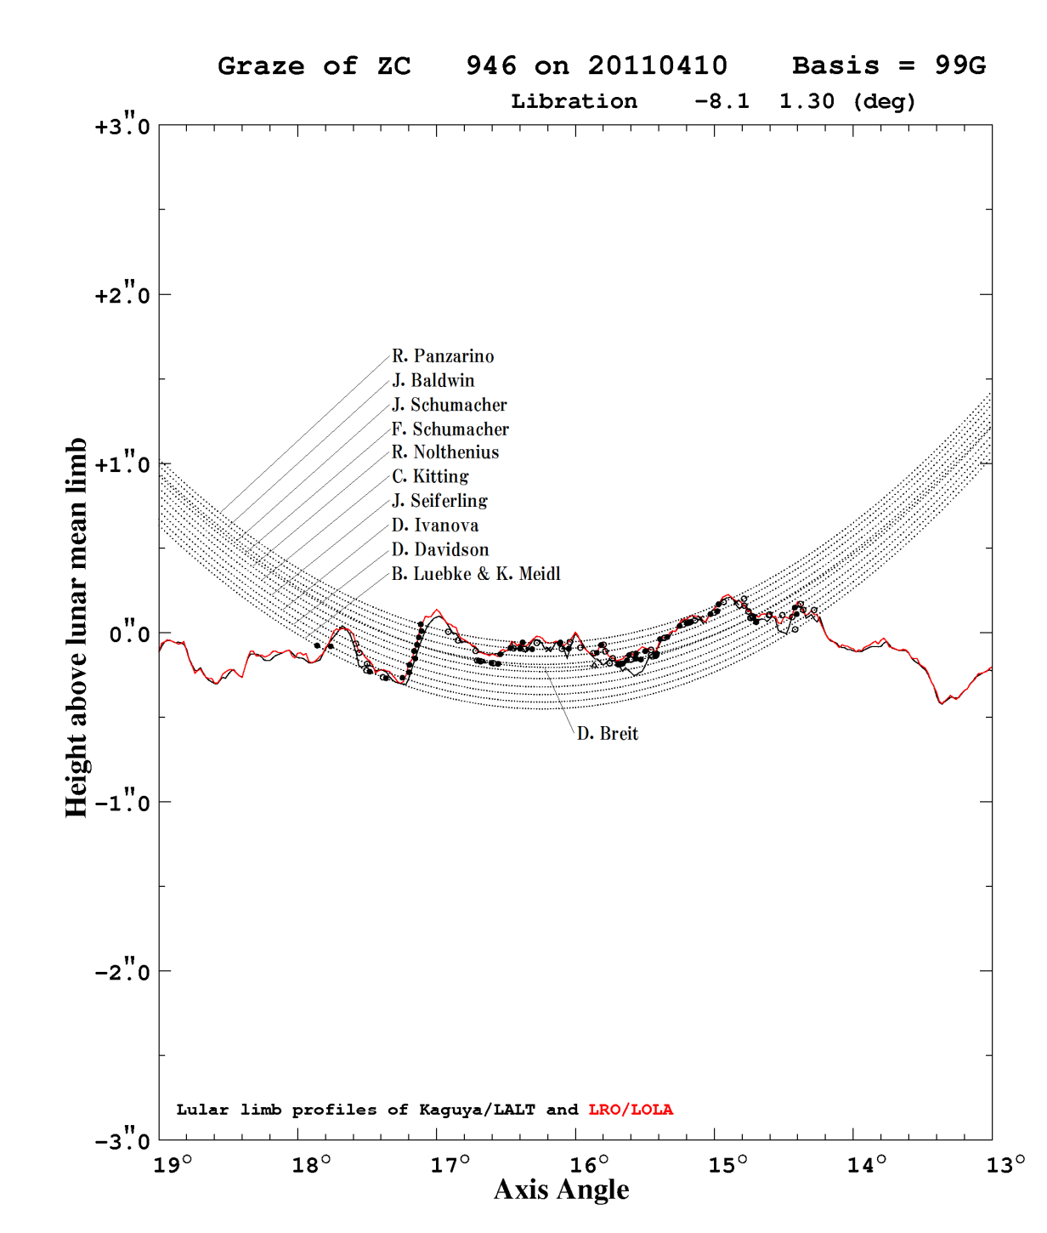
Comparison of Kaguya & LRO profiles
Here is a recent reduction of observations of the 2011 April 10th eta Geminorum graze by Dr. Mitsuru Sôma at the
Japanese National Observatory. The profiles are close, but LRO’s, with more orbits and points than Kaguya, is more accurate near Axis Angles 14.3 and 15.4.
With multiple stations and LRO data, there are still new things that can be done with grazing occultations!

Slide 21
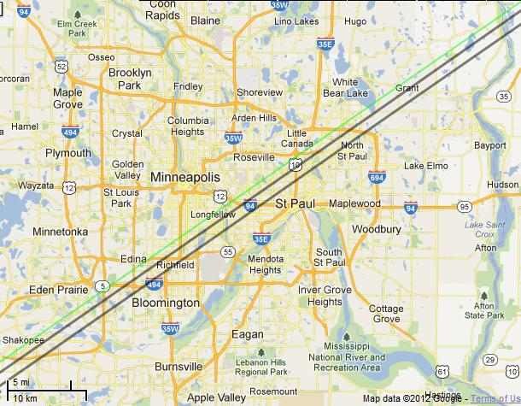
Graze of 4.9-mag. ω² Tauri (ZC 628) over Minneapolis, Minn. on 2012 Aug. 11, Moon 35%-, CA 2N
Google map to plot graze paths & find observing sites
Produced with Occult 4 & at
http://www.timerson.net/iota/
I made plans to observe it from near Grant. With the small cusp angle, I thought that there would be too much glare to record with midi systems, but I took 2 of them, to try, and 2
4-inch SCT’s for attended stations that Joan and I ran. But like in Arizona, the machines triumphed; it was machines, 2, humans, 0. Station 3 recorded 6 D’s and 6 R’s; I’ll play the video.
__
Station 4’s single R indicates a south shift of about 200m; we can still determine corrections to stellar proper motions from graze observations

Slide 22
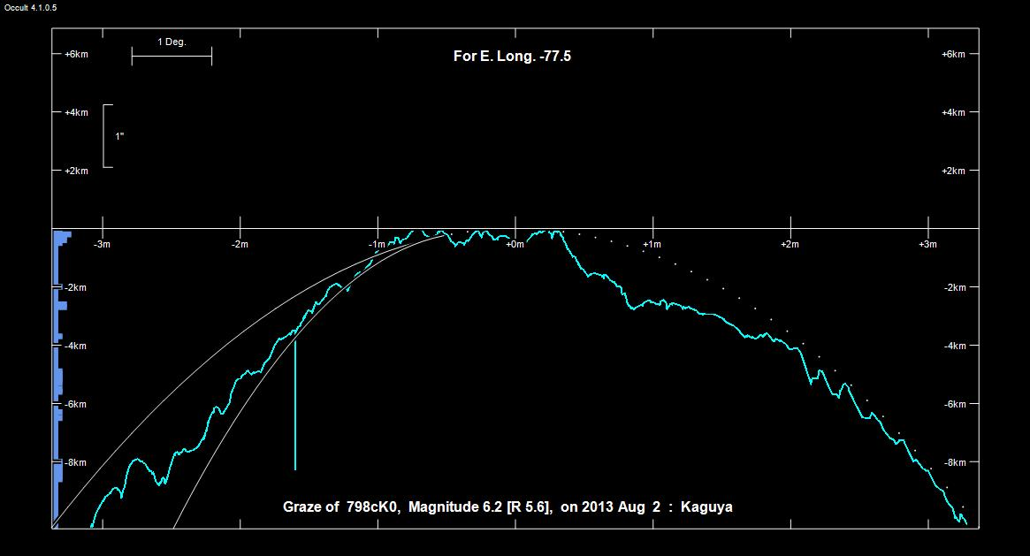
Kaguya profile for graze of 6.2-mag. ZC 798 1° from north cusp of 17% sunlit waning Moon

Slide 23
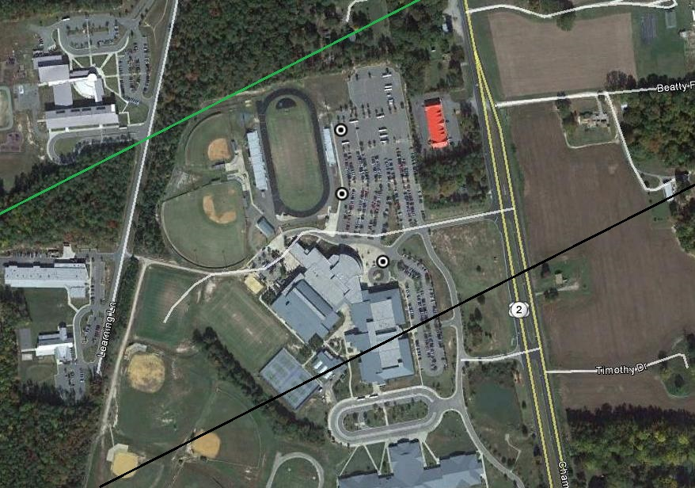
Locations of our 3 stations for the August 2nd graze of ZC 798 in the dark parking
lot of Hanover High School, west of US 301 about 15 miles n.e. of Richmond, VA

