Slide 1
Hands-On Astronomy
April Russell

Slide 2
Agenda
Hands-on astronomy
Science of modeling
3D printing
Discussion

Slide 3
What is hands-on astronomy?
Observation
Backyard observing with telescopes
Instrumentation
Mirror grinding
Education/Outreach
Solar system models
Planispheres
Starlab
NASA recommends making asteroids out of clay BORING!
Where is the technology?
Notes:
Other outreach stuff – moonballs, some digital starlabs, trips to planetariums
NASA technology – GPS, optics
NASA only gives the approximate shapes too, and random cratering

Slide 4
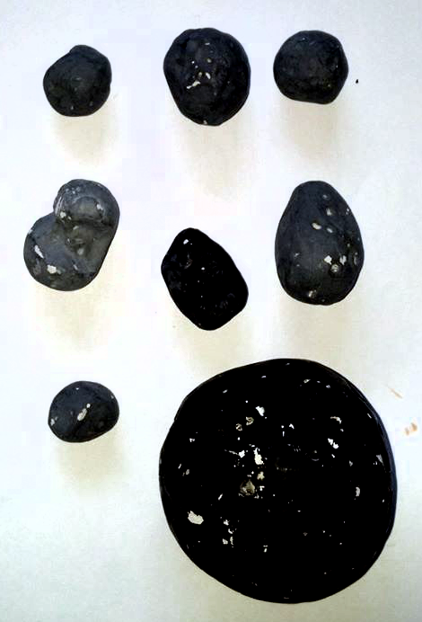
Traditional clay models
Cheap and easy, but…
Time intensive
Not scientifically accurate
they all start looking the same!
Not exciting!
Notes:
Why fund/do the science if we aren’t going to make models of the shapes and show it off? Of course, scientists use the info in the lab to make discoveries, but it’s hard for people to know what’s going on when it’s just in the ether… make it tangible instead … use them to show the techniques/get people interested

Slide 5
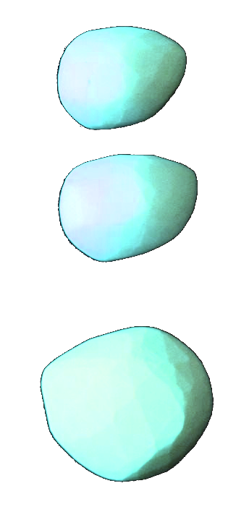
A Better way: 3D printed asteroids
Scientifically accurate - see differentiation between asteroids
Variety of materials/printing methods available
Tangible science – show off techniques and get people interested

Slide 7
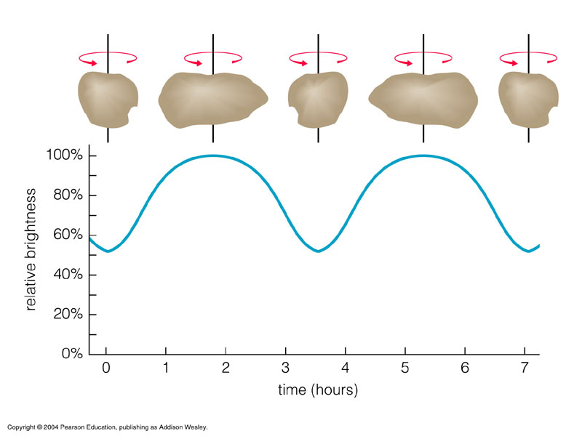
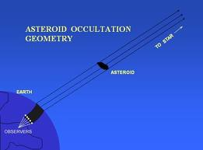
How do we get from observations to objects?
Astronomy
Observations/data collection of variation in brightness
Data reduction
Model generation
Inversion (Canopus)
Rectification (MeshLab, other)
Verify with occultations
Additive manufacturing (3-D printing)
Notes:
Hands-on approach to material
Develop a deeper understanding
Critical thinking

Slide 8
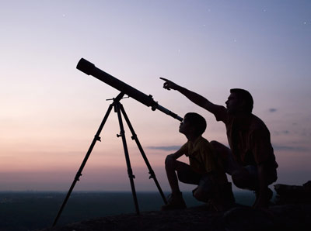
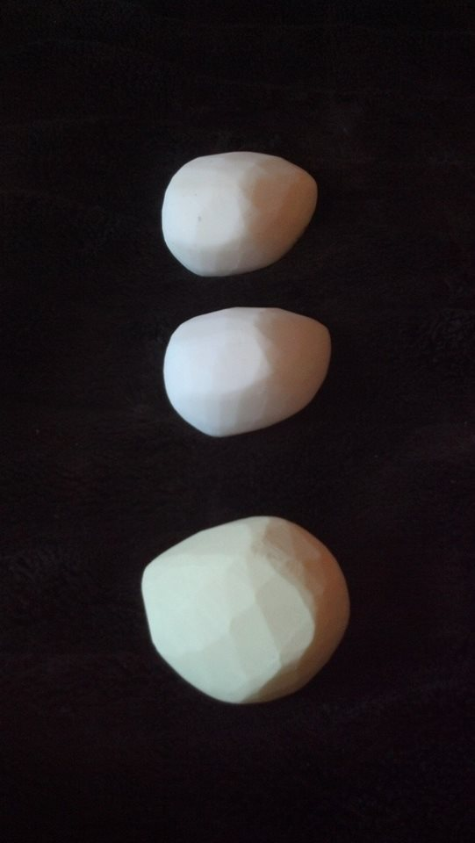
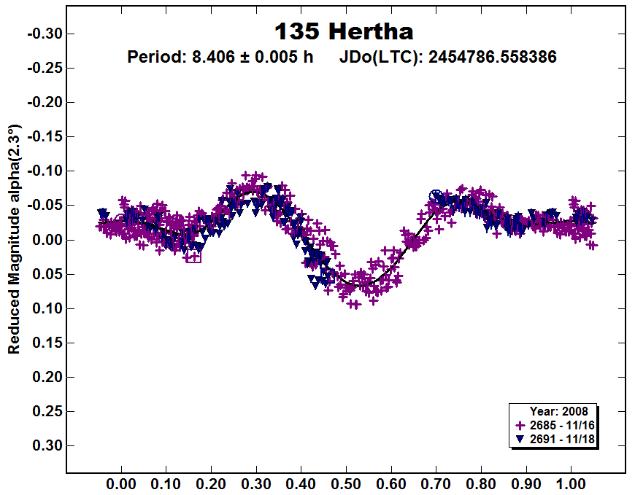
Example: 135 Hertha
Observations
Virtual Model
Printed Models
Light Curve
Occultation
Notes:
Start with observation data, use computer modeling, and then 3d printer
Give more info on programs used to create computer model

Slide 9
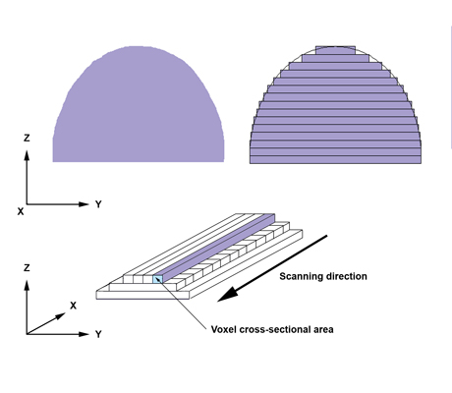
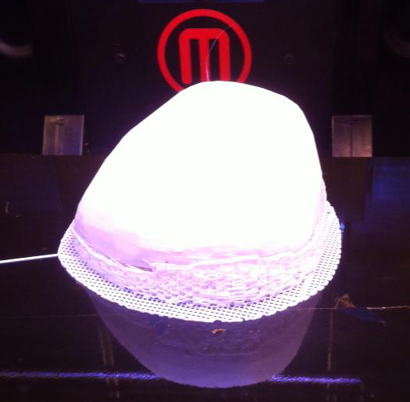
Process from Digital to Print
Convert scientific model to printable format
Approximates shape using triangular facets
Add texture (cratering)
Set density / Add void space
May have limits on # of vertices, wall thickness, holes, overhangs, etc
Slices virtual model into digital cross sections
Print Model
Extrusion method builds model in layers; many options

Slide 10
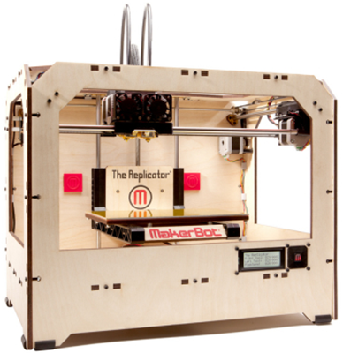
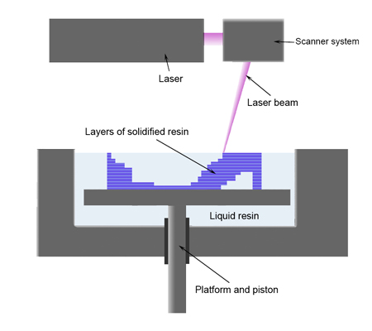
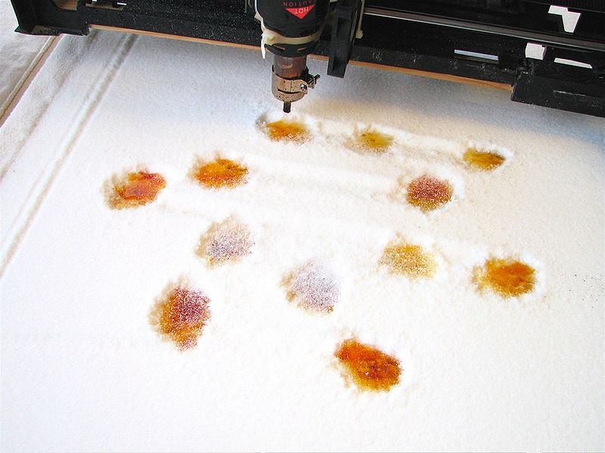
Common 3D Printing Technologies
Extrusion/fused deposition
(ABS/Plastics)
Photopolymerization /Stereolithography
(Polymers)
Granular materials binding
(Polymers/Metals/Food)

Slide 11
Options for 3-d Printing
Own Machine - $500-$20,000+
Open Source / Kit
RepRap, Makerbot, others
Commercial
Stratasys, 3D Systems, others
Services – priced by volume, depends on material
Shapeways, Solid Concepts, others

Slide 12
Example 3-D Printing Model

Slide 13
Things to keep in mind
Verify your model is printable
Surfaces must be a closed manifold and be assigned the correct normals (in/out)
Not usually an issue for asteroid models
Check maximum size and minimum wall thickness
Optimize your model
Much cheaper if hollow, though printer may require it has a hole
Consider different mediums and colors – think about ceramic, plastics, metal, candy
Consider partial fills, thin shells, and mesh v. solid designs

Slide 14
Summary
3D printing offers a new opportunity for hands on astronomy that ties together a variety of exciting fields

Slide 15
Questions?

Slide 16
Additional Resources
Background Information
http://nightsky.jpl.nasa.gov/docs/AsteroidHunters.pdf
http://home.comcast.net/~eliws/ceres/files/LightCurveModelsOf20Asteroids.pdf
Data available at DAMIT website
http://astro.troja.mff.cuni.cz/projects/asteroids3D/web.php
Images and Video
http://www.poyntsource.com/Richard/images/Asteroid%20Occultation%20Geometry.jpg
http://www.minorplanet.info/MPO/pdolc/A135_2008.PNG
http://www.poyntsource.com/Richard/IOTAMeeting2011.htm
http://static.ddmcdn.com/gif/telescope-sam-1.jpg
http://www.shapeways.com
http://en.wikipedia.org/wiki/3D_printing

