Slide 1
IOTA Membership and Subscription Numbers
Print
43 USA vs 67 in 2012 Oct
5 Outside USA vs 20 in 2012 Oct
Online-only
46 subscribers vs 45 in 2012 Oct
Net decrease of 38 members

Slide 2
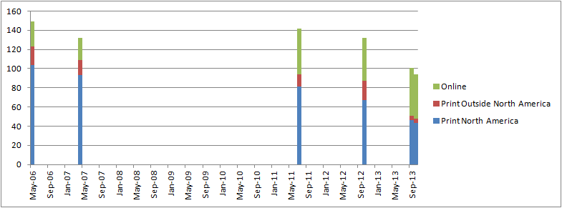
IOTA Membership Trends
Date | Print North America | Print Outside North America | Online | Total
13-Oct | 43 | 5 | 46 | 94
Sep-13 | 46 | 5 | 50 | 101
Oct-12 | 67 | 20 | 45 | 132
Jul-11 | 81 | 13 | 48 | 142
Apr-07 | 93 | 16 | 23 | 132
May-06 | 104 | 19 | 26 | 149

Slide 3
IOTA Financial Overview
Starting Balance: 2012 October 19
$5,997.29
Ending Balance: 2013 October 3
$6,038.02
Net increase in Balance:
$40.73

Slide 4
IOTA Financial Details
Membership Income: $960
Interest: $4.53
IOTA-VTI Royalties: $381
PayPal Balance: $1060.00
Expenses
Printing/mailing costs: $1301.32
JOA layout/design: $790.67 (3 issues?)
Web service: Still donated
Awards $ ?
Fees: PayPal fees totaled $44.97
TX Tax Exempt Filing: $5

Slide 5
IOTA Business Items
JOA publication
Ever so slightly behind on latest issues
Online access
Issues uploaded well before print copies are delivered
New password protocol with latest issue
Old passwords a thing of the past
Complaints
None this past year…

Slide 6
Representative JOA 1203 costs
Layout/Design:
$305.99 (Є238)
x Copies Printed:
$232.56
Envelopes/Labels/Printable Postage Sheets:
$124.30 (purchased every 2-3 issues)
Postage:
$332.56

Slide 7
Representative JOA 1203 costs
Net cost of ~$912.55 for this issue
(“about” due to irregularity in supplies)
87 issues mailed so each issue cost ~$10.49
Price paid per issue by members depends upon several factors (location, payment & delivery options) but is ~$10.29

