Slide 1
After upgrading Astrid to version 1.0.56 or later, downloading events into Astrid using
“Sync from OWCloud” will not work until obtain a private API key from OWCloud and
insert it into the proper field in your Astrid Observer Settings.
To do so, perform the following steps, as shown in the pages below.
Log in to OWCloud (typically by selecting “Show Online Map with Stations” for an event in OW Desktop)
In OWCloud “User Profile”, verify your email address by having OWCloud send you an email with a link to click.
In your email, click on the link sent to you by OWCloud to verify your email
Return to OWCloud and refresh the OWCloud “User Profile” page to display your new private API key
Copy the private “API Key” that OWCloud now displays for you
Connect to Astrid on the same computer you used to copy the API key
Start the Astrid app and select “Settings” (you may use the simulated mount or a Broughton mount for this step)
Select “Observer”
Paste your private API key into the appropriate field
Click “Save Settings”
Now you can continue to use “Sync from OWCloud” to download your events into Astrid

Slide 2
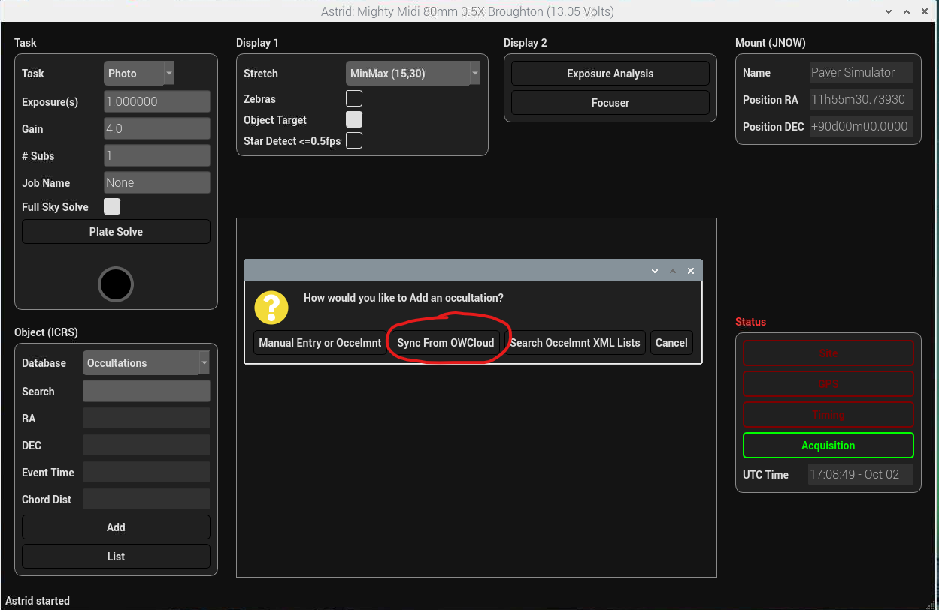
With version 1.0.56 or higher (or after
current global API key is deactivated,
which will be announced)
this attempt will fail before obtaining
your personal API key.

Slide 3
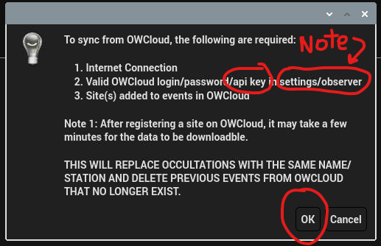

Slide 4
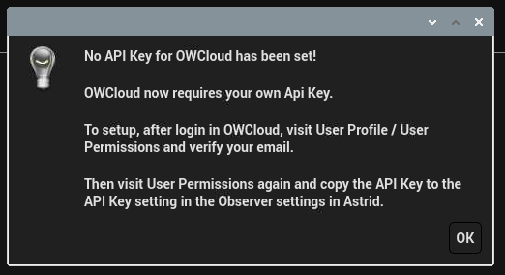
With version 1.0.56 or higher (or after the current global API key
has been deactivated, for which notice will be given)
this Astrid error message will be displayed until you
obtain and save your private API key in Astrid Observer settings
(see following pages)

Slide 5
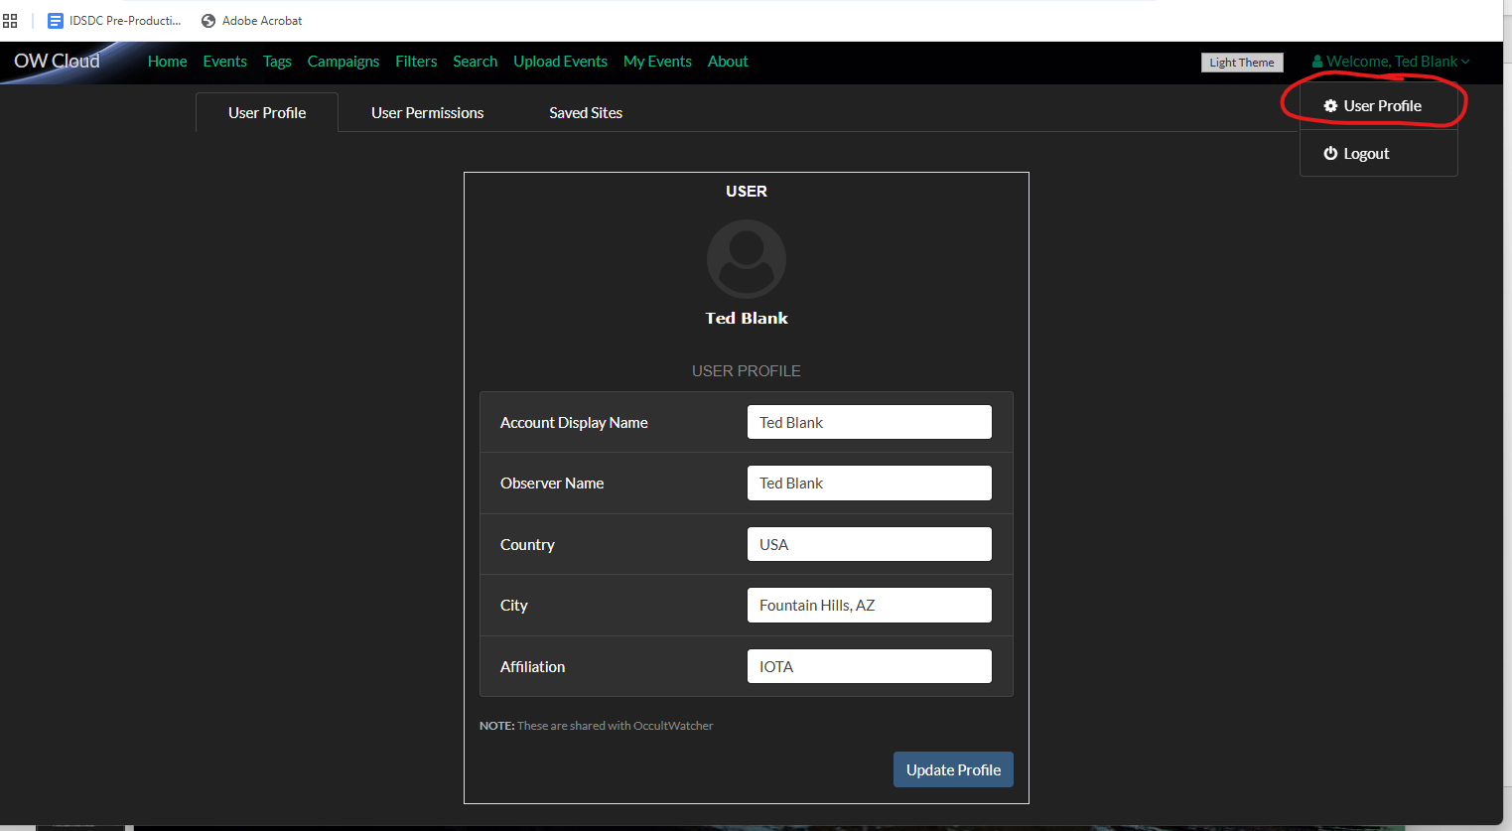

Slide 6
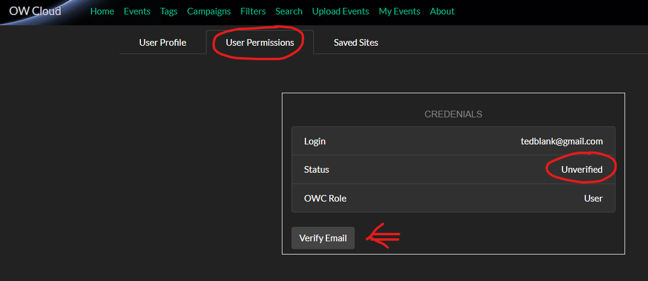

Slide 7
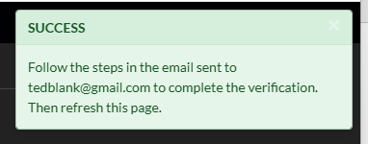
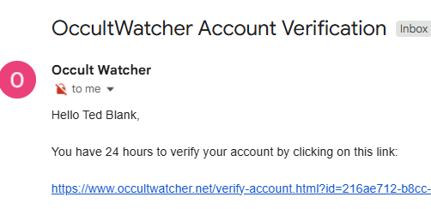
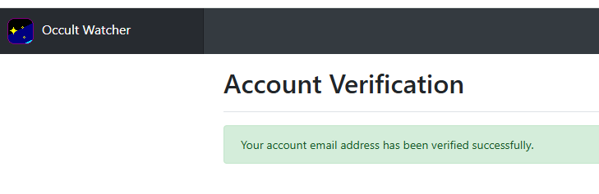

Slide 8
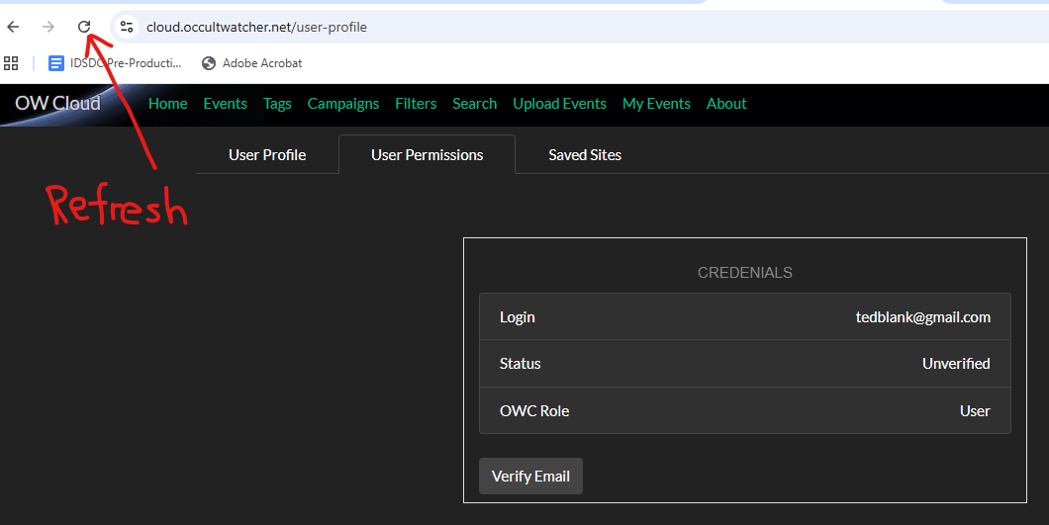
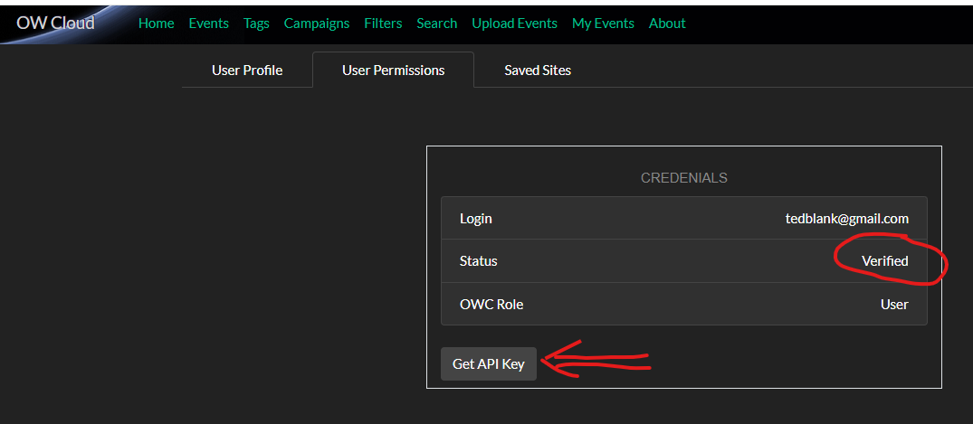
After clicking on email link and refreshing this page,
click on “Get API Key”

Slide 9
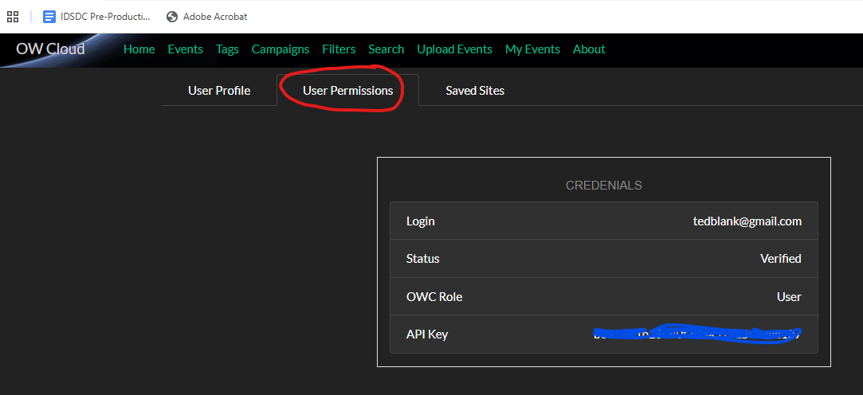
Copy Your Personal API Key
to the clipboard for later
pasting into Astrid Settings
“Observer/OW Cloud API key”
(or carefully write it down if you
log in to Astrid on a different
computer.)

Slide 10
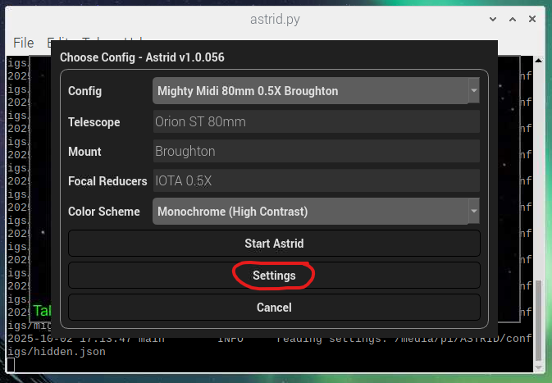

Slide 11
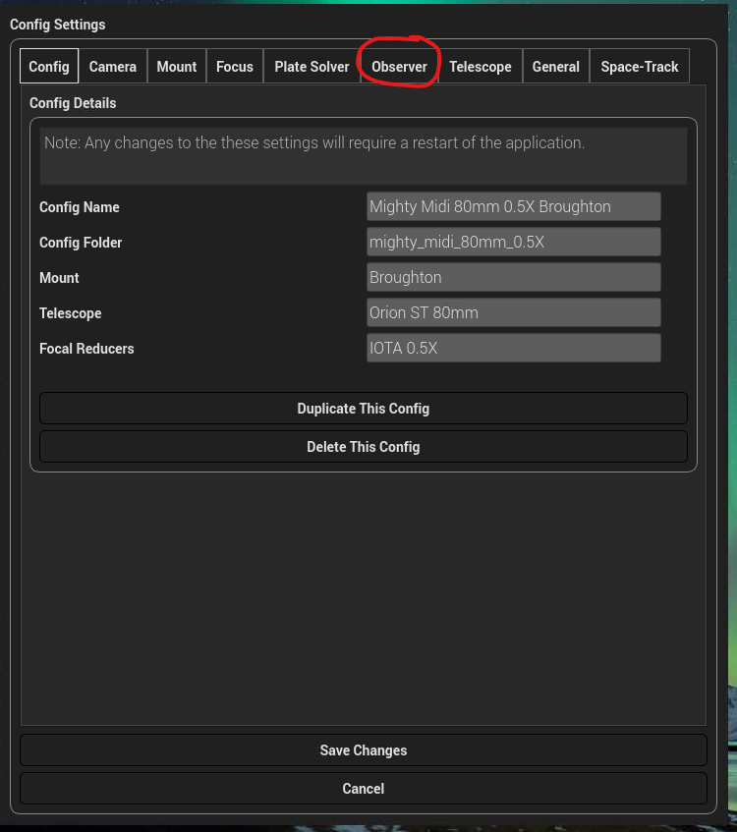

Slide 12
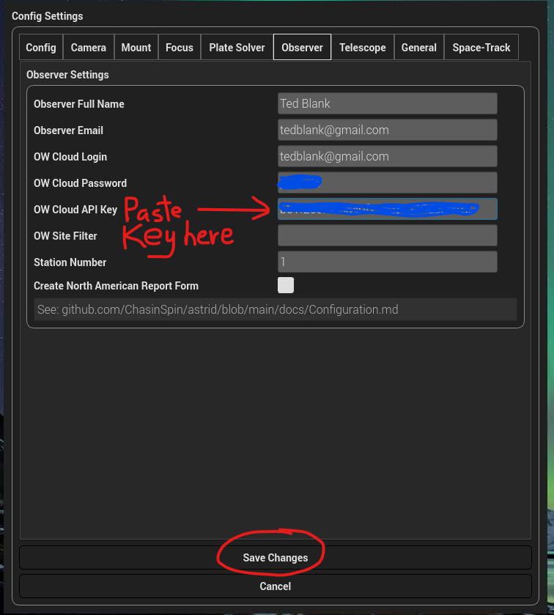
Paste (or type)
your personal API key
here

Slide 14
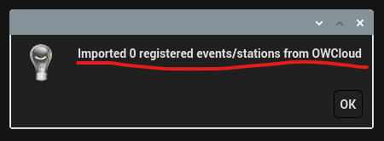
Success! (I had no events registered at this time)

